Slide 1
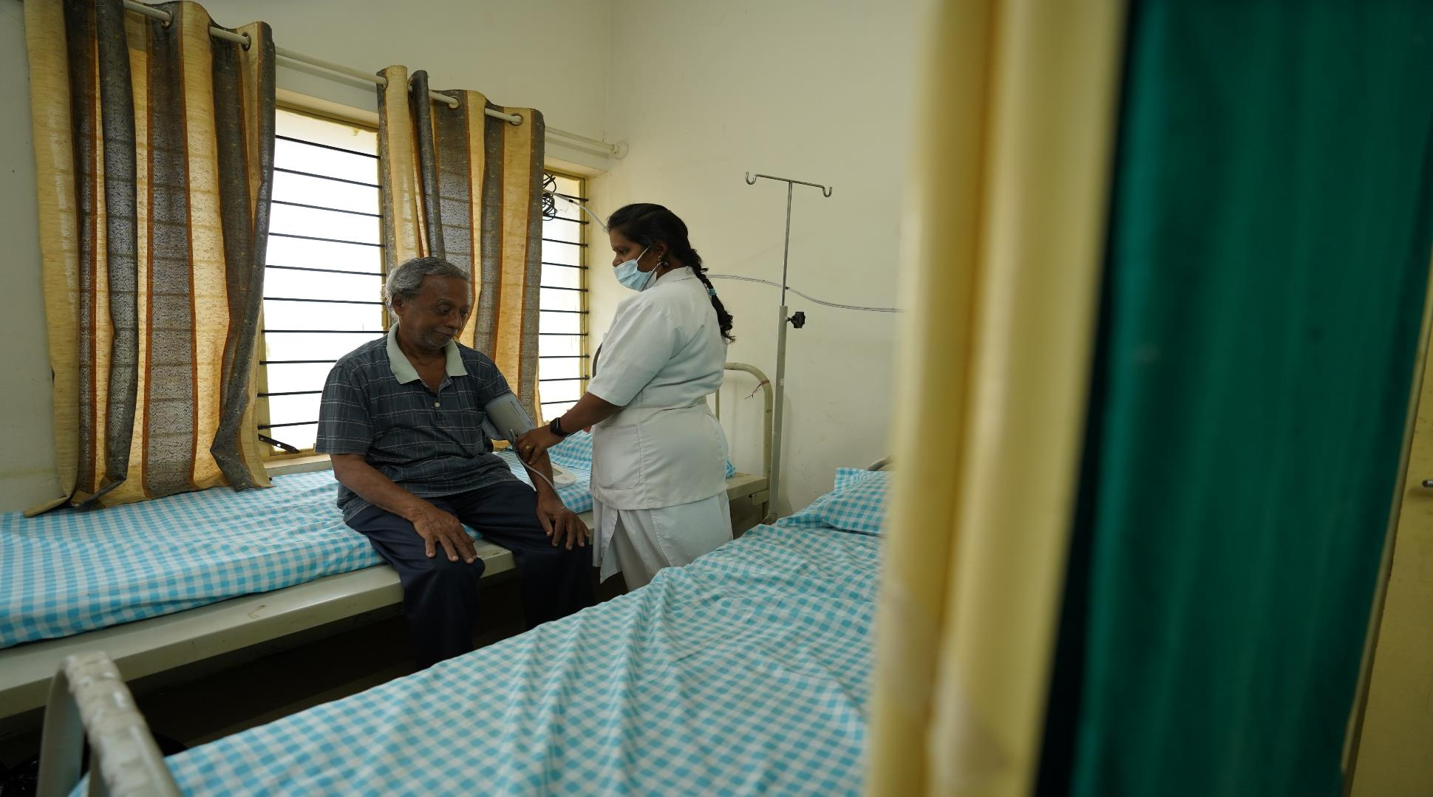

WASH IN HEALTH CARE FACILITIES (HCF)
- LEARNINGS FROM THE FIELD
- Aswati Warrier, WaterAid India

Slide 2

What we do
Drinking water
WASH in Institutions
Inclusive, sustainable sanitation
Hygiene
WASH – Water, Sanitation and Hygiene

Slide 3
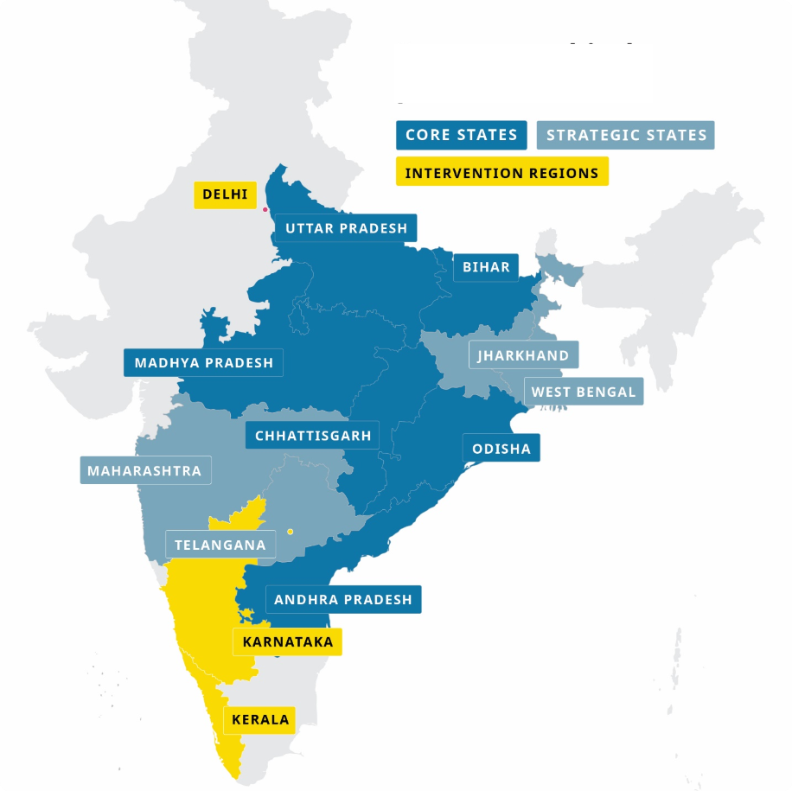

WaterAid India's work in HCF
“… every health care facility in every setting, has safely managed, reliable water, sanitation and hygiene facilities and practices to meet staff and patient needs in order to provide quality, safe, people-centred care, with particular attention to the needs of women, girls and children.’’
– The Global Action Plan for WASH in health care facilities
In 2022-23, we reached out to 63 HCF with 41 HCF gaining improved access to WASH
Notes:
WaterAid’s work in HCF is in track with the Global Action Plan for WASH in health care facilities

Slide 4
WASH
Health and safety
Disease prevention and treatment
Staff morale and performance
People- centred care
Health care costs
Climate change and disaster resilience
Why do we need to focus on WASH in HCF ?
Notes:
Improved WASH in HCF has multiple benefits-
Reduced health care acquired infections
Reduced anti microbial resistance
Improved occupational health and safety
Outbreak prevention and control (e.g. cholera, Ebola) Diarrheal disease prevention and control
Improved satisfaction and ability to provide safe care
Increased uptake of services; e.g. facility births, vaccinations
Health staff model good behavior; improved hygiene practices at home
More efficient services Disease/deaths averted
Facilities better prepared to continue to provide WASH in disasters; climate related events

Slide 5
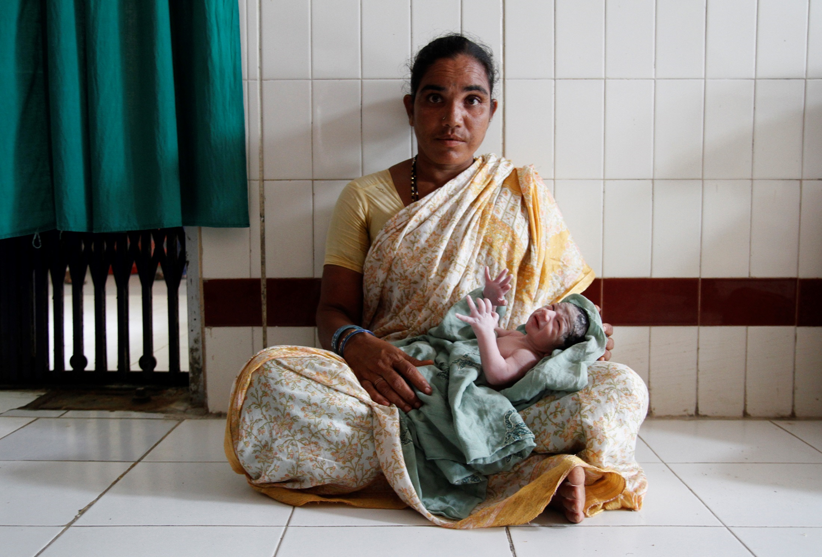
Neonatal mortality ratae:
26 per 1000 live births
Maternal mortality ratio:
103 per 100,000 live births
Sepsis - a leading cause of infection and accounts for at least 11% of maternal deaths
Notes:
Sepsis is a serious condition in which the body responds improperly to an infection

Slide 6
National standards for WASH in HCF
IPHS for 30 bedded CHC
10,000 litres of potable water per day to meet all the requirements; Storage capacity for 2 days
Gender-segregated toilets
Hand washing facilities in all OPD clinics, wards, emergency and OT areas.
1. Water Closet : 1 for every 8 beds (male) 1 for every 6 beds (Female)
2. Ablution Taps : 1 for each water closet
- plus 1 water tap with drainage arrangement in the vicinity of water closet.
3. Urinals: 1 for every 12 beds (Male Only)
4. Wash Basin: 1 for every 12 beds
5. Baths: 1 bath with shower for every 12 beds
6. Bed pan washing sink: 1 for each ward in dirty utility and sluice room
7. Cleaner’s sinks and sinks/ slab for cleaning mackintosh:
1 for each ward in dirty utility and sluice room
8. Kitchen sinks: 1 for each ward in ward dishwasher’s pantry
Notes:
A good

Slide 7
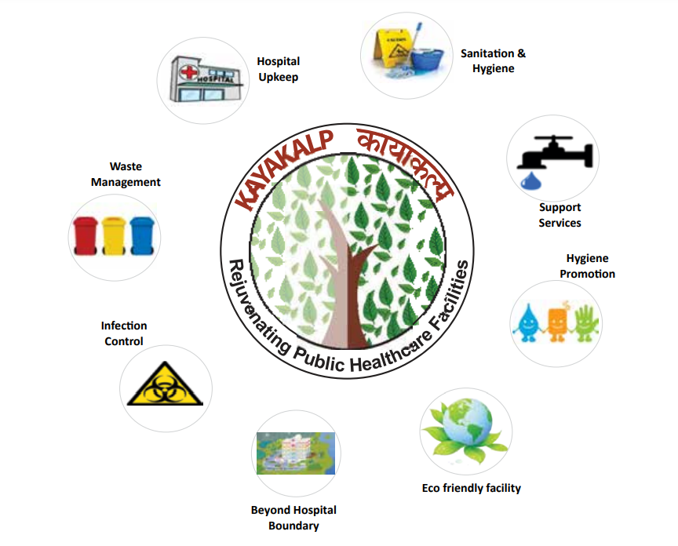
National standards for WASH in HCF
KAYAKALP GUIDELINES
  Catalyzing improvements in health care facilities through the Swachh Bharat Mission
  Focus on public health care facilities at primary, secondary and tertiary levels of care
  Facilitates infrastructure improvements, systems strengthening, trainings and capacity building
  Reward based scheme
  Related policy initiative linking improvements in WASH in HCFs with ODF status
Notes:
Criteria for assessment

Slide 8
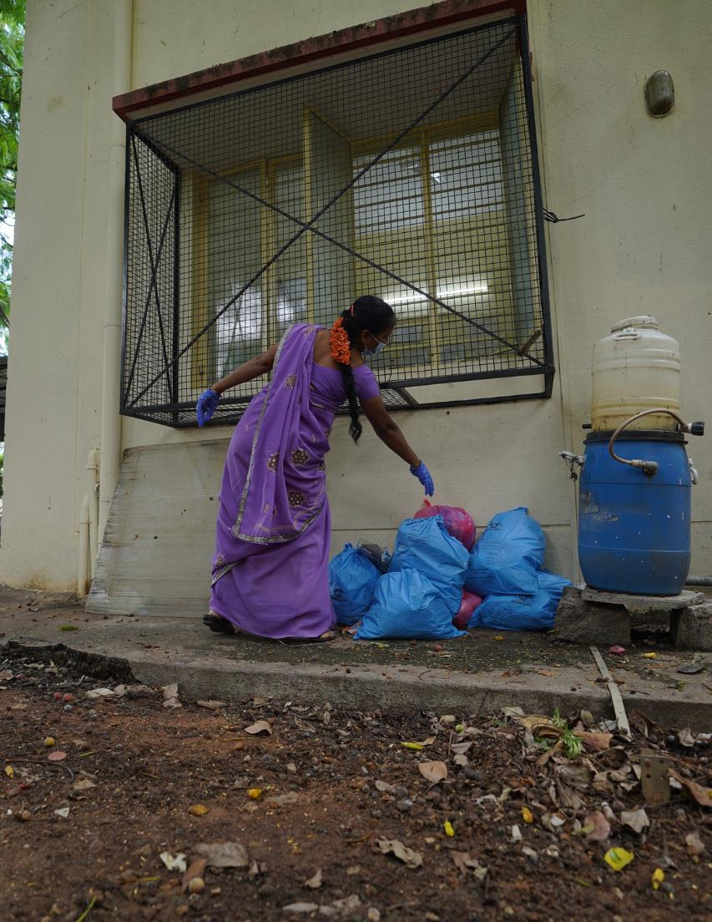
WASH GAPS in HCF
  Improvement in WASH infrastructure, post COVID19, however there is a gap in Adequacy, Accessibility, Functionality and Quality.
  Solid, Liquid and Medical Waste management- treatment and segregation is still lacking.
  Investment in WASH competes with other critical components.

Slide 9
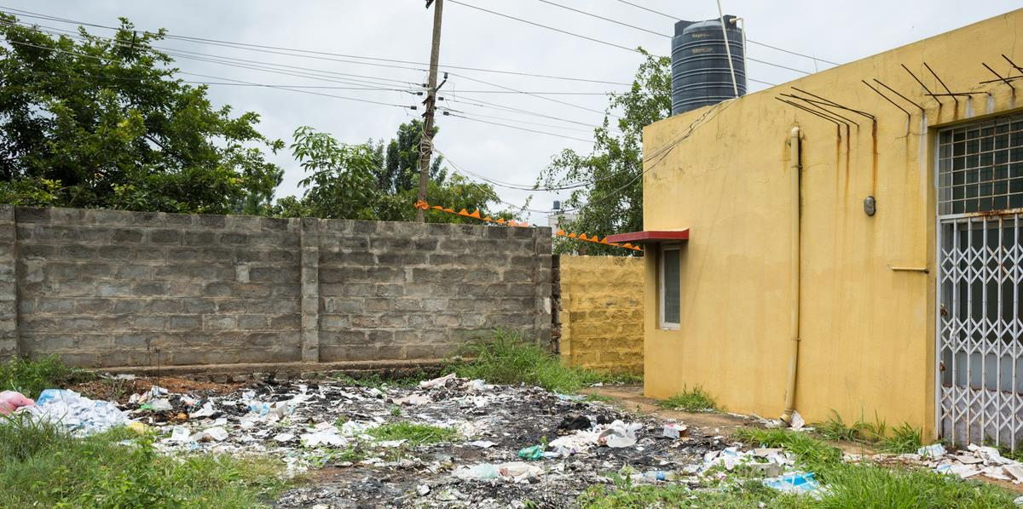
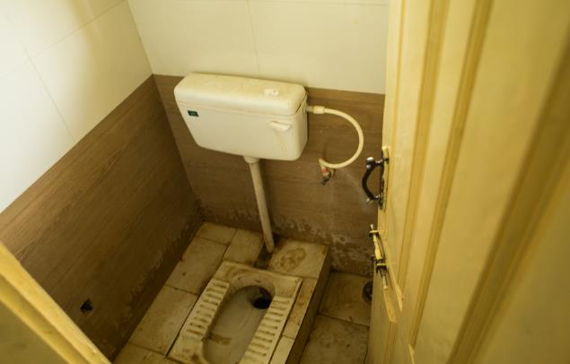
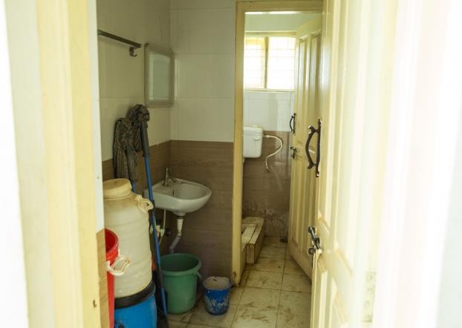
CASE STUDY
Urban Primary Health Center, Thippenahalli, Bengaluru
Lack of a hygienic environment
High population coverage
Lack of accessible toilets for public
Redundant Rogi Kalyan Samithi
Frontline workers and knowledge on Menstrual Hygiene products

Slide 10
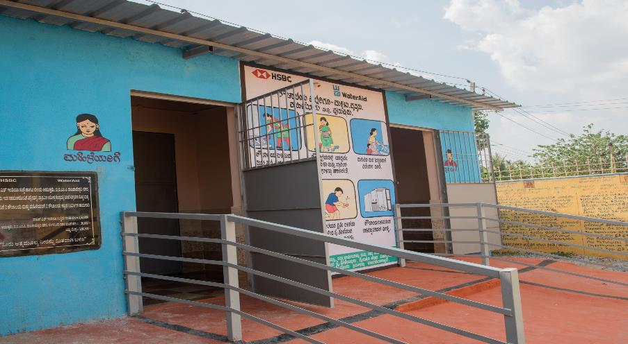
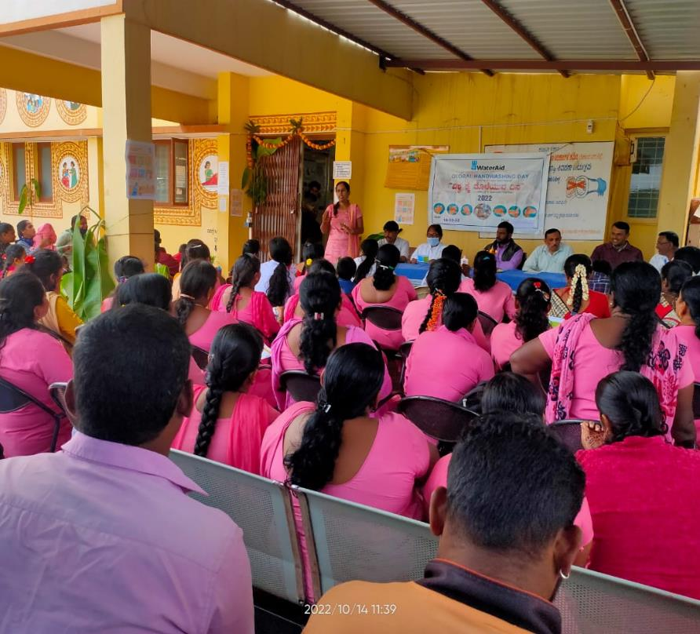
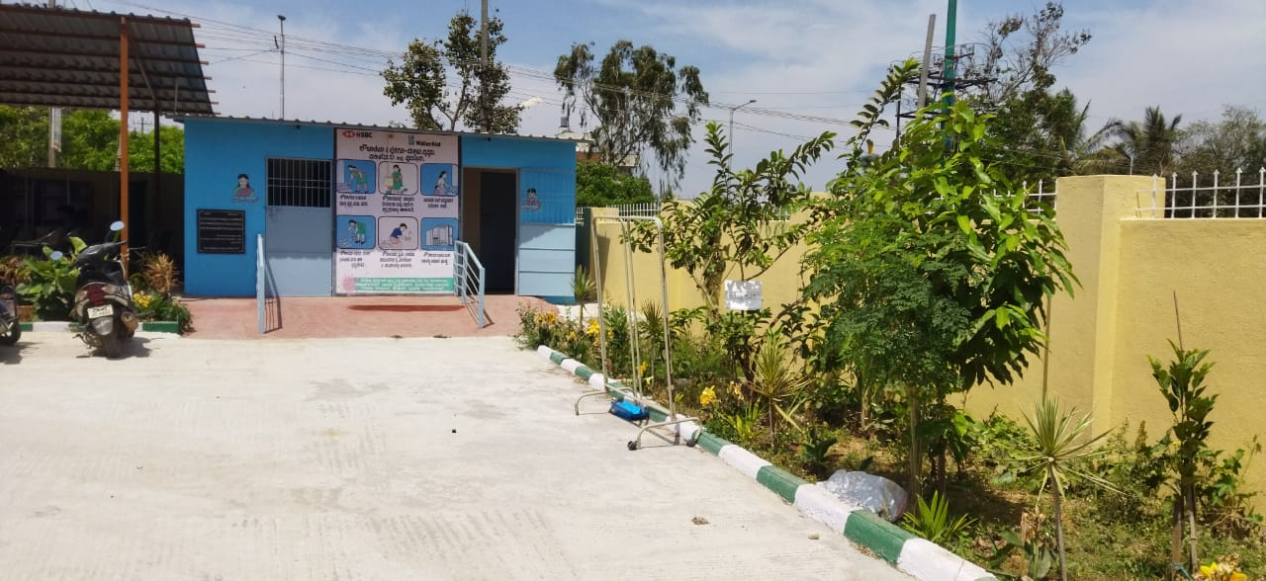
Post Intervention
Urban Primary Health Center, Bengaluru

Slide 11
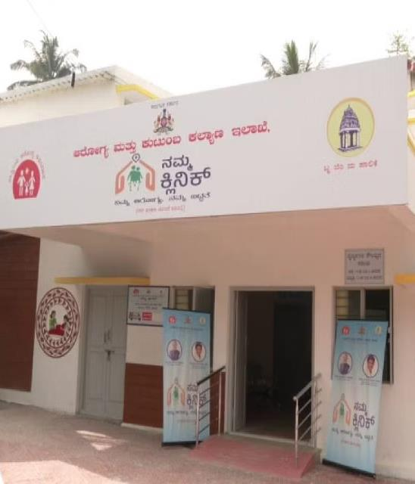




TAKING FORWARD THE LEARNINGS
Need for a focus on Sub-centers
Monitoring Mechanisms
Accessibility of WASH for all
Operation, Maintenance and Sustainability

Slide 12
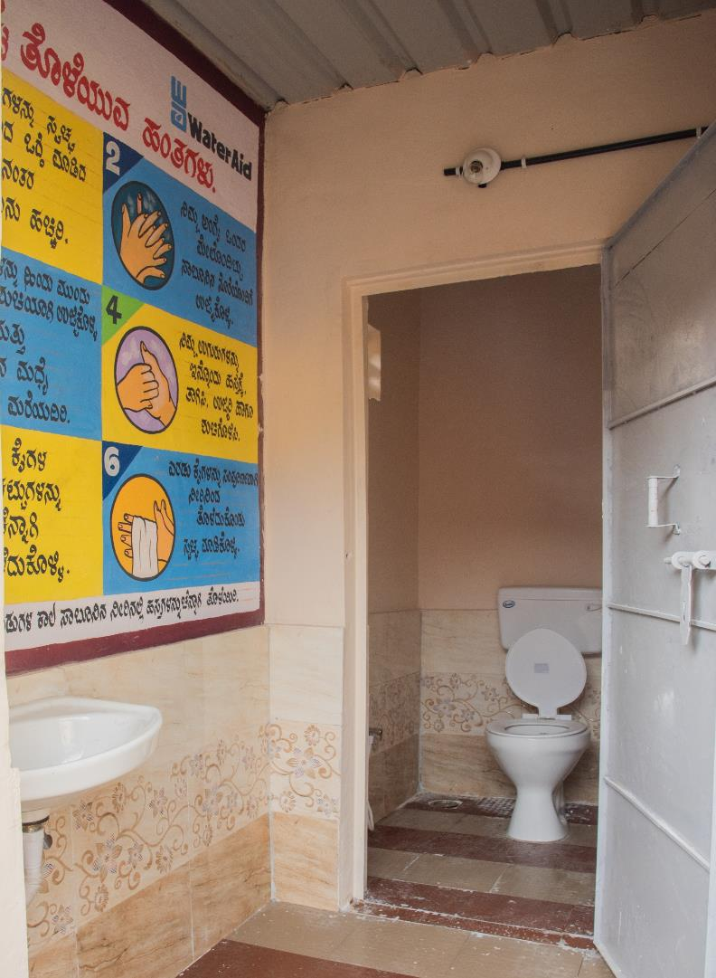
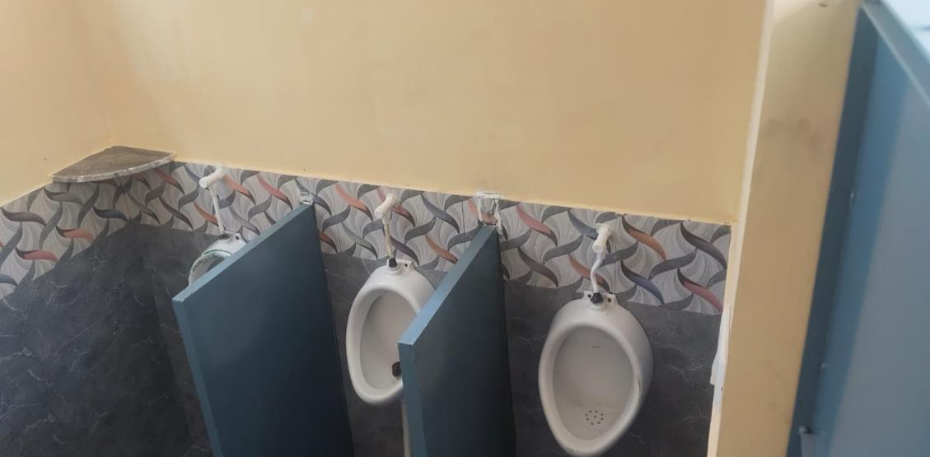
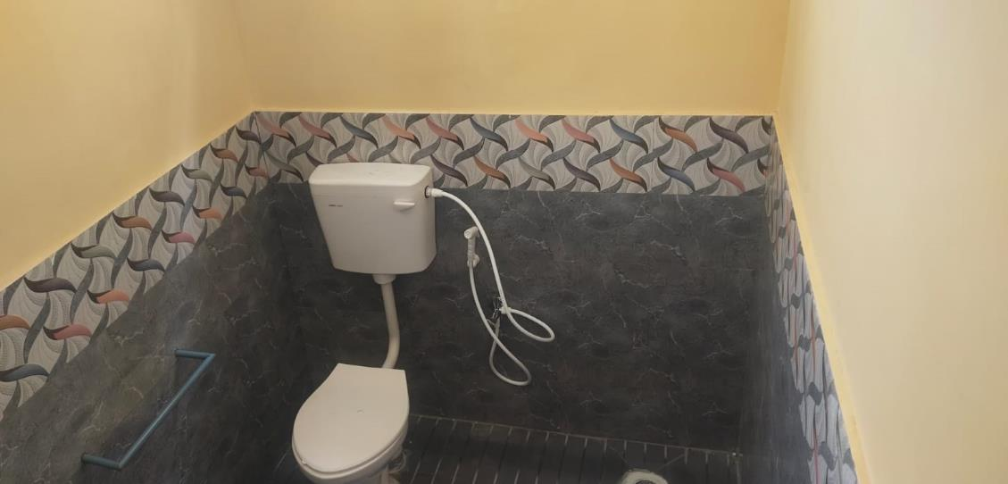

Slide 13
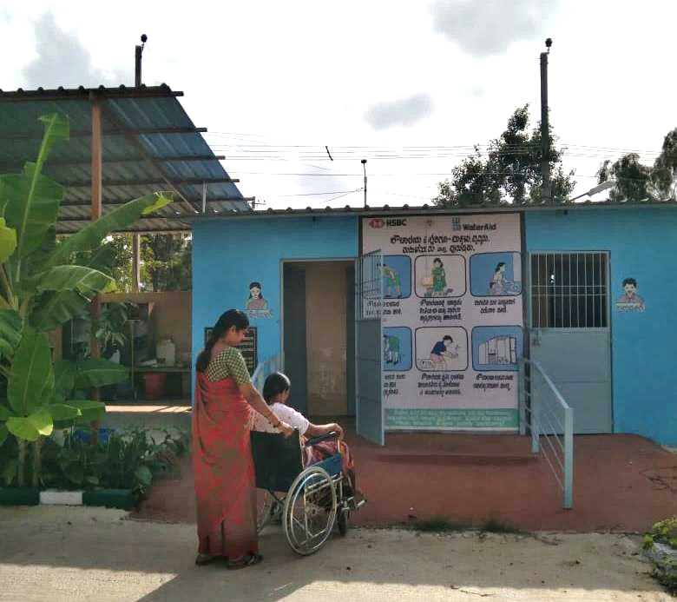
Questions?

