Slide 1
WATER @ WORK MINISTRY
Dan Blevins: Executive Director, Water @ Work Ministry,
Dr. Omar Keith Helferich: Professor Emeritus Central Michigan University University

Slide 2
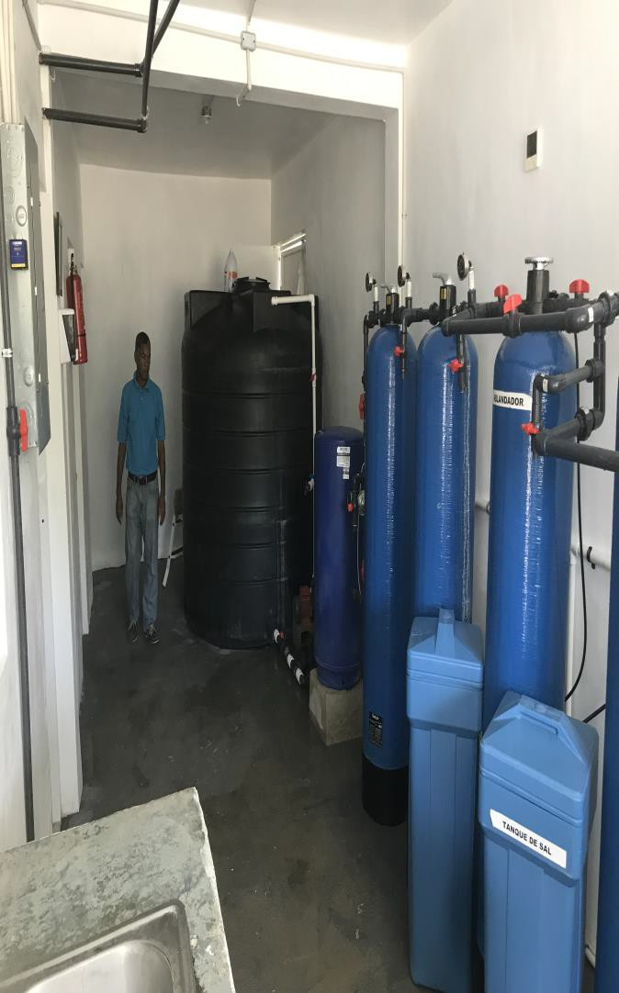
W@W MINISTRY: Clean Water Program
Mission Clean Water for poverty level villages and bateys
Operated by Fundacion Water Work independent nonprofit charitable
Eight operating plants – two funded by Rotary Grants
Plants certified by DR
public health
Operated by local organization with local manager & 5 staff
SUSTAINABILITY PROGRAM-2018 SOCIAL
*Population served
*Local employment
*Local contractors
*Community opportunities
ENVIRONMENT
*Bottles recycled
*Improved awareness
*Reduced carbon emissions
ECONOMIC by plant (6)
*Production of 5 gallon bottles of water
*Bottles of 5 gallon water distributed
*Revenue in Pesos and US dollars
*Price vs market for bottles
*Contribution –profitability

Slide 3
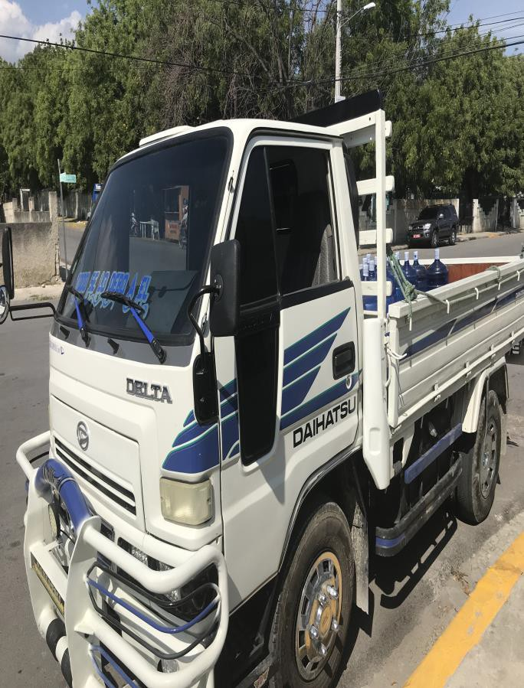
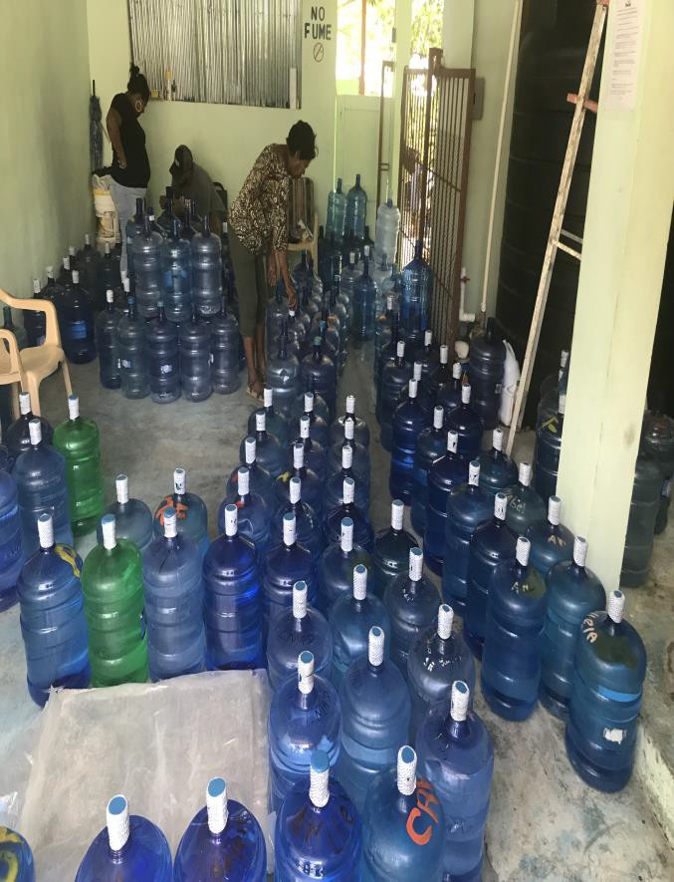
Water @ Work Distribution –M&E PROCESS
M&E PROCESS FOLLOWS DMERL STEPS *
Define: Develop the program concept- Outcomes
desired, Outputs, Activities, Resource Inputs- Log Frame
Monitor: Use Indicators to measure performance.
Evaluate: Assessment of performance through the
stages of the program
Resolve: Identification and addressing the challenges
Learn: Incorporate lessons learned into ongoing practices to increase effectiveness & sustainability
DMERL is the adaption of the recognized sustainability process by many organizations. The process uses the M&E MERL-
Monitor, Evaluate, Resolve and Learn plus adds a Define step. (Rotary Grant preparation is a Define step. )

Slide 4
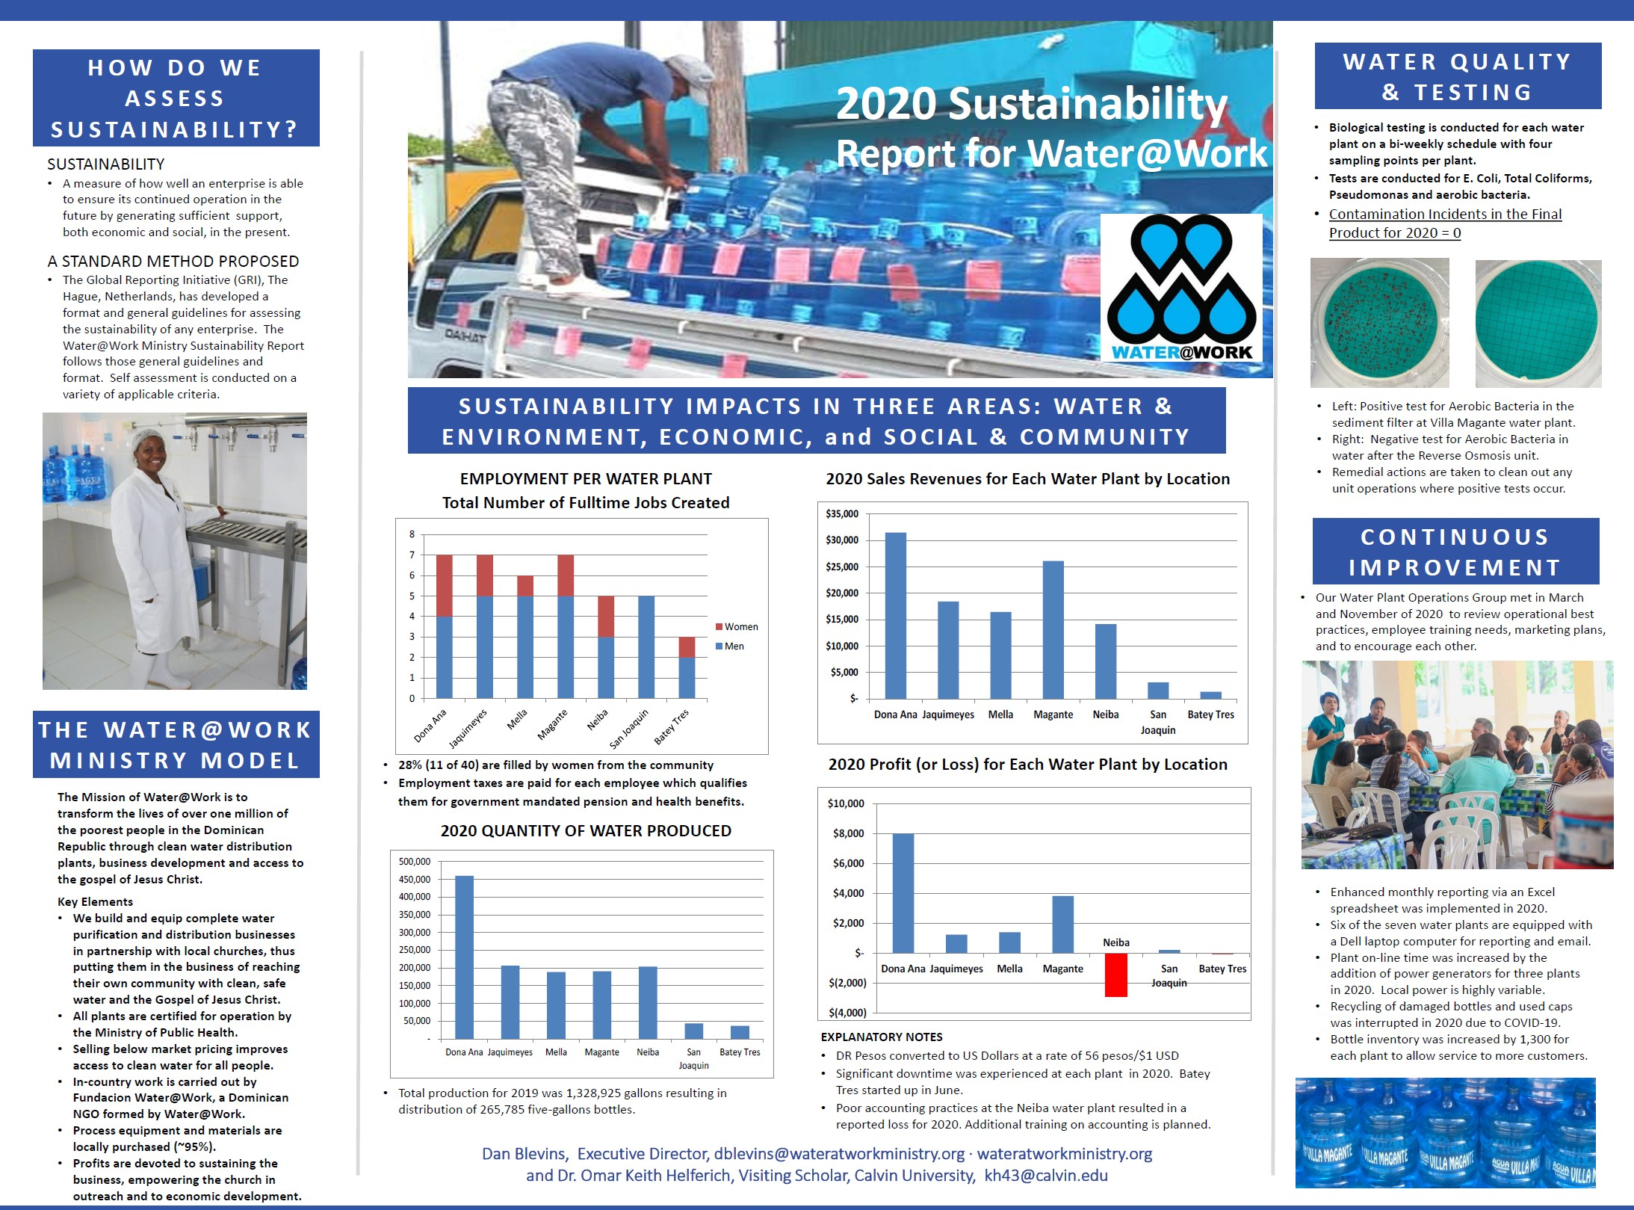
WATER@WORK 2020 SUSTAINABILITY REPORT

Slide 5
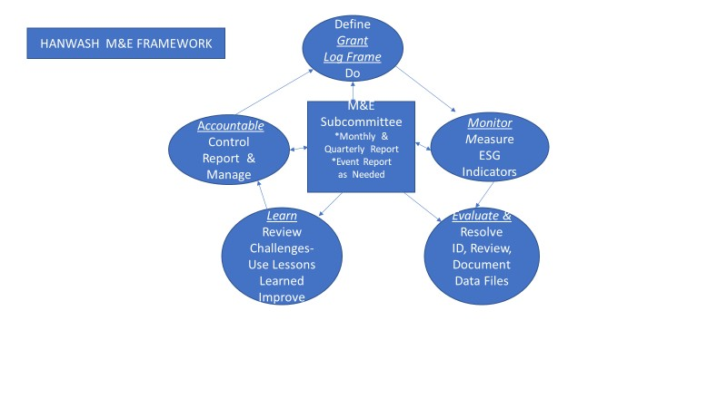
HANWASH-HAITI NATIONAL CLEAN WATER AND SANITATION
AND HYGIENE STRATEGY
Vision:
Universal and sustainable access to safely managed water, and sanitation and promotion of good hygiene practices throughout Haiti.

Slide 6
M&E- Summary Points
DEFINE- Develop the Log Frame as input to the Grant/Proposal- Kellogg Foundation website is starting point for the Log logic for Change Theory. Include M&E section with budget and role to develop.
MONITOR -Review the performance indicators for the project progress that cover each of the categories.
E_{G}V_{r}A_{e}L_{e}U_{n}ATE-Report on the indicators must include check against targets. Labeling of
, Yellow, or Red can be helpful for management.
Resolve- Identify the challenges that are coded as yellow and red. Develop challenge data base.
Lessons Learned-Perform organized review of the Challenge data base to develop
lessons learned opportunities.
CONTINUE PROCESS: AVOID the often progress- Define and Monitor are finished,
Evaluate is not finished and Learn is never started-DEFINE, MONITOR, EVALUATE,
RESOLVE, LEARN

