Slide 1
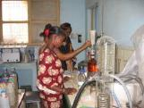
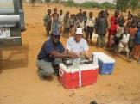
Building Long-term Sustainability of WASH Services in Healthcare Facilities (HCFs) Using the Circuit Rider Methodology
4th webinar in the series on WASH for HCFs
Braimah Apambire, Ph.D.
Desert Research Institute
July 11, 2023

Slide 2
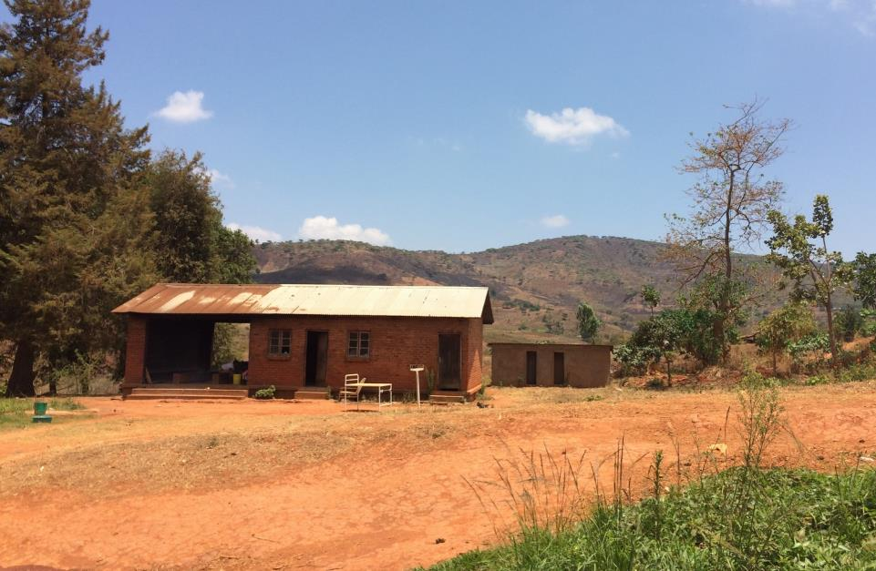
2019 Pilot Assessment 18 HCFs in Rumphi, Malawi
Assessed 18 HCFs: WASH service levels and sustainability factors
Interviewed district staff, facility staff, and patients
Partnered with Transform International, Rumphi district leadership
Chisimuka Health Center, November 2019
Notes:
big focus past few years, many orgs
DRI framework – sustainability bc of all the challenges. sustainability to make sure HCFs have WASH, which reduces disease
framework – later
Rumphi – pilot location and assessment
already had conducted lit review, but wanted to see conditions on the ground where we’d be piloting
assesed WASH service levels
assessed sustainabilty factors: what needs to be in place, aside from physical infrastructure and equipment, for good quality WASH services to be continually delivered
interviewed staff
not going into WASH service in detail – its reflected in global baseline report in terms of gaps
---
Within this, DRI is working on a project to develop a framework for sustainability of WASH in HCFs. there are still a lot of challenges, but sustainability is key to making sure HCFs have the WASH services they need, which in turn reduces disease transmission.
I’ll speak about our proposed framework shortly, but we began our project by identifying and partnering with a pilot area in Malawi, in the northern district of Rumphi. We conducted an assessment in all 18 of the district’s HCFs, of all sizes from a small health post like this up to a district hospital. While we had already conducted a literature review on WASH in HCFs, we wanted to see what this looked like on the ground in the location where we’d be piloting our proposed framework. So we assessed WASH service levels at the HCFs, including their water supply and quality, number and condition of sanitation facilities, and so on: indicators that WHO captures in considering WASH service levels. But we were most curious about sustainability factors, which we had identified through the literature review as well: what are things that need to be in place aside from the physical infrastructure itself, for good quality WASH services to be continually delivered?
To capture this, we interviewed staff, both at the district and facility levels, as well as patients. We wanted to understand their perceptions on WASH services, as well as their perceived challenges and opportunities.
I won’t get into the WASH findings in detail, because we found that they reflected what the JMP report found, with gaps in water service, poor water quality, insufficient facilities, and so on.

Slide 3
Key Findings from 2019 research in Rumphi
WATER | SANITATION | HAND HYGIENE | WASTE MANAGEMENT | ENVIRONMENTAL CLEANING
Lack of continuous water service from safe sources Inconsistent water treatment practices No water quality testing | Poor accessibility Lack of gender and staff/patient separation, No menstrual hygiene facilities Available toilets not always functional | Insufficient hand hygiene facilities often far from toilets (number & location) Water or alcohol rub often available, but sometimes not close to at points of care; insufficient soap throughout facilities | Inconsistent segregation and disposal practices within HCFs Lack of functional and/or environmentally safe incinerators/other disposal methods Capacity around operations of incinerators/other disposal methods | No cleaning guidelines Lack of training for cleaning staff Lack of accountability mechanism Cleaners’ role not valued
Notes:
Waste Management: Important to note that incinerators are one approach, but not the only one.

Slide 4
The Circuit Rider Model
Qualified traveling technicians visit a number of communities, providing support and assistance on water systems (20 – 40 systems, 4 – 6 times over the course of a year)
Technical and administrative assistance
Capacity building to local water boards
Focus on preventive maintenance of infrastructure – life-cycle costing

Slide 5
Technical Circuit Rider
Quality of Care Circuit Rider
Climate change resilient water, sanitation, and waste management infrastructure
Training and monitoring of hygiene, IPC, cleaning, waste management protocols, quality of care and gender equity
Inspection, maintenance, repair of water supply infrastructure, latrines and toilets, waste management infrastructure
Water quality testing;
Train staff on basic maintenance
Train staff on cleaning, IPC, hygiene, waste separation, and patient-centered care;
Ensure guidelines and instructions are available at HCF;
Coach HCF managers and staff on workflow improvement
Monitor and report on conditions of WASH/IPC;
Work collaboratively to identify areas for improvement
Data collection and Management using mWater
Notes:
a two-pronged Circuit Rider approach for WASH in HCFs

Slide 6
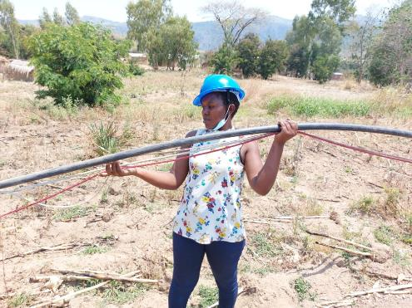
Impacts -Technical
38% increase in patient positive perception of drinking water at HCF 56% reduction in water supply disruptions
Dramatic improvement in breakdown response time (within 48 hours overall)
56% reduction in water supply disruptions
Increase in handwashing stations near toilets (i.e. where needed) (patients - 51% increased to 62.3%; Guardians 32% increased to 61.5%)
Care areas having proper waste bins, used properly increased from 39% to 66%

Slide 7
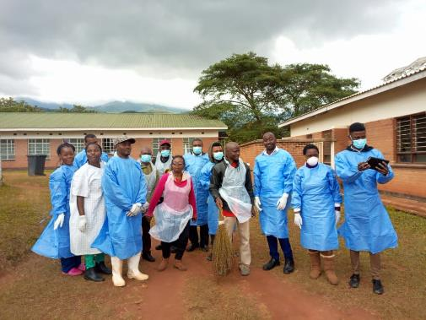
Impacts – Quality of Care
49% increase in staff ratings of waste practices
14.5% increase in patients reporting proper hand hygiene by staff
51% of staff/70% of managers reported receiving gender sensitive IPC training. (In control it was 10% of staff at baseline and only 20% at end line).
Skills training increased significantly (cleaners, waste management, incinerator operations etc.)
Decrease in seconding of cleaning staff before cleaning completed
Increase in staff reporting toilets clean: men 57% at baseline to 70% at end line; women 57% to 69%

Slide 8
Monitoring, Evaluation, Resolution, and Learning (MERL)
Monitoring
Are WASH repairs being made efficiently and effectively?
Are Circuit Riders making regular visits and providing adequate support to HCF staff?
Evaluation
Are HCF staff improving their WASH and IPC behaviors?
Is WASH infrastructure improving?
Do HCF staff have access to the resources they need to improve behavior, such as job descriptions, guidelines, and instructions?
Has gender awareness and mainstreaming improved?
Are WASH activities gender responsive?
Is our program on track?
Did our program work?

Slide 9
Monitoring, Evaluation, Resolution, and Learning (MERL)
Resolution
What problems did we run into throughout the program, and how can we address them?
Learning
Sharing what we found through monitoring, evaluation, and resolution with stakeholders and greater WASH in HCF community
How can we improve this program?

Slide 10
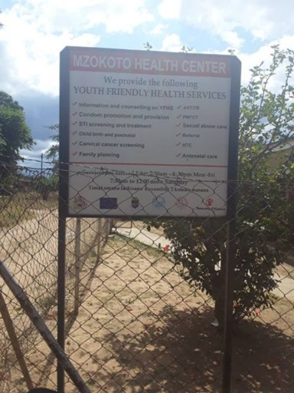
Key Findings on Sustainability Factors
Guidelines
Resources (material & financial)
Management & Supervision
Governance
Role of local government and existing infrastructure

