Slide 1
“Terre des hommes Foundation Nepal’s experience on Advocacy for Operation and Maintenance Policy for WASH in Healthcare Facilities”
Presenter/s:
Sudarshan Neupane – Head of Country Office – Nepal
Prakash Bohara – Health & WASH Programme Manager
Notes:
Tdh

Slide 2
Examples of Successful Advocacy in Nepal
O&M policy for sustainable access to WASH services in HCFs
Integration of blue school components in the municipal curriculum
Notes:
This presentation outlines the processes followed for attaining success in advocacy while making sure that local ownership through sensitization workshops/events

Slide 3
Project Information
- Swiss Development Cooperation (SDC)
District – Bardiya (Lumbini Province)
Local NGO: Geruwa
April 2020- July 2023
10 Health Care Facilities/ WASH FIT (45,000 populations)
6 Schools / Blue school approach (6,000 populations)
Behavior Change – Total Handwashing Campaign - in the communities (52,000)
Notes:
The government of Nepal has contextualized the WASHFIT tool jointly developed by WHO and UNICEF.

Slide 4
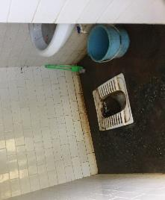
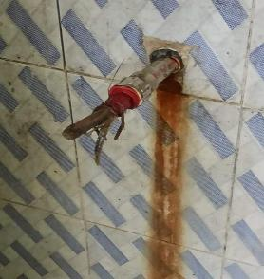
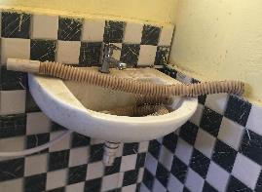
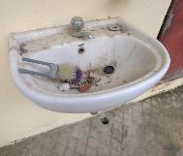
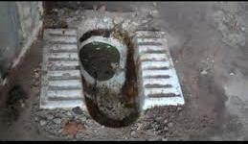
Realization for Advocacy for WASH in HCF
Poor status of WASH (infrastructures and services)
Operation & Maintenance (O&M) is not prioritized in local planning/ budgeting
Lack of evidence to inform for O&M COSTING for adequate budget allocations
LESS BUDGET ALLOCATION for WASH
Lack of O&M policy, cost information & institutional setup

Slide 5
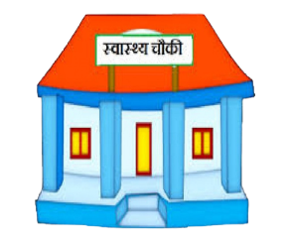
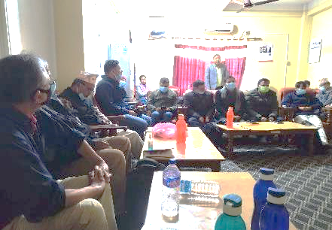
Sensitization Workshop for local decision makers
HCF
HCF
Sensitization workshop with Municipality officials/ elected representatives using data and pictorial presentations
Notes:
Pictures and data played a very significant role to gain traction from the local authorities in relation to the quality of healthcare. We must appreciate that it requires several rounds of meetings and discussions.

Slide 6
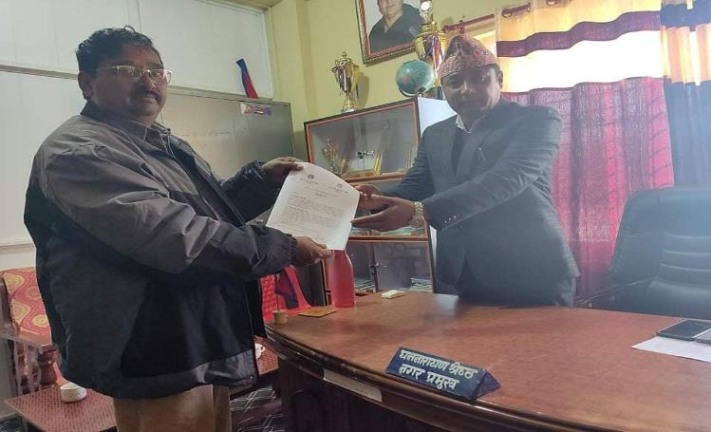
Signing of MoU
Signing an agreement with the municipality for necessary support for the development of the O&M policy

Slide 7
APPROACHES FOR ADVOCACY
Systematic approach for institutional advocacy*
In participation of right holders, duty bearers, and CSOs (Right Based)
Life Cycle/ Total Costing
*Note:
Message/product: O&M policy with implementation tools (costing, M&E, ICT).
Target: Other municipalities, provinces, and National.
Messenger: Municipality supported by the project.
Timing: When the stable government is in place.
Platforms: workshops, WASH and Health Cluster, technical working group.
Follow-up: support the municipality in implementing the policy and share the learnings.
TRUST
Notes:
Costing helped local municipalities/duty bearers to understand how much budget is required annually for operationalization of WASH infrastructure and services

Slide 8
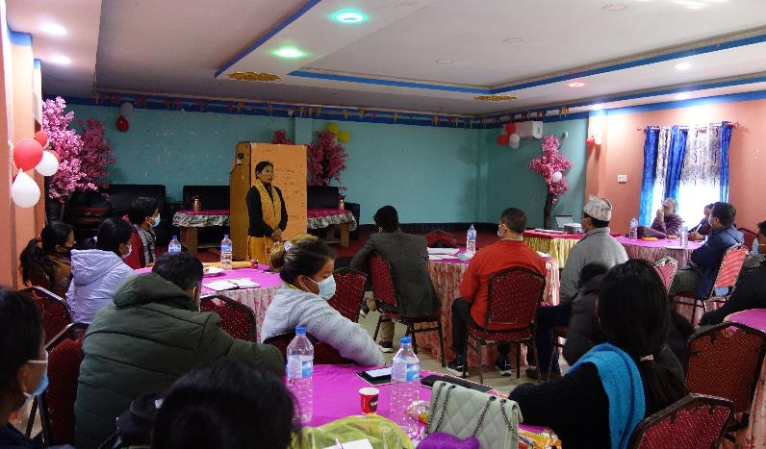
POLICY DEVELOPMENT PHASE
Policy Formulation Committee led by Deputy Mayor
Formed a technical working group for consultation & policy drafting
Notes:
This is the actual start of the policy formulation committee led by the deputy mayor.

Slide 9
Conducted Total costing data
Cost and status Category | 1 Neulapur H | 2 Neulapur | 3 Bagnaha | 4 Shivapur HP | 5 Thakurbaba HP | 6 Ranipur BHC
Capital hardware cost (NPR) | 2,046,000 | 5,742,000 | 6,880,500 | 5,720,000 | 1,762,000 | 596,000
Capital Software cost (NPR) | 260,000 | 260,000 | 260,000 | 260,000 | 260,000 | 90,000
A. Total Capital | 2,306,000 | 6,002,000 | 7,140,500 | 5,980,000 | 2,022,000 | 686,000
B1. Annual Cost (O&M) | 1,013,100 | 464,300 | 465,400 | 502,700 | 355,700 | 279,410
B2. Annual Software | 185,000 | 185,000 | 185,000 | 185,000 | 185,000 | 80,000
B3. Annual Support Cost | 40920 | 114840 | 137610 | 114400 | 35240 | 11920
C. Annual Cost of Capital (PR) | 165,900 | 491,081 | 592,022 | 583,750 | 223,771 | 53,912
Total Annual Cost (B1+B2+C) | 1,404,920 | 1,255,221 | 1,380,032 | 1,385,850 | 799,711 | 425,242
Coverage (%)/Functionality (%) | 100/88 | 100/90 | 93/96 | 100/90 | 93/96 | 100/97
Av Infrastructure Life and Age (yrs.) | 28/17 | 39/9 | 31/7 | 36/11 | 32/11 | 26/2
Annual depreciation (2022) (NPR) | 111,222 | 122,331 | 163,743 | 223,510 | 109,198 | 16,213
WASH FIT score (0-100) %
OPD per day / Delivery per week | 15/0 | 120/2 | 30/1 | 100/2 | 80/1 | 50/0
Total: NPR 16,80,656 (15,000 USD, per annum)
SN | Particulars | Neulapur* | Bagnaha | Shivapur | Thakurbaba HP | Neulapur HP | Bankati | Godana* | Ranipur | Thakurbaba | Mohanpur
1 | Capital maintenance | NA | 8977 | 8377 | 7977 | 8977 | 8977 | NA | 7977 | 7977 | 7977
2 | Recurrent training | NA | 84600 | 32950 | 35400 | 98550 | 35400 | NA | 35400 | 35,400 | 35400
3 | Consumables | NA | 41090 | 1,58,550 | 69,020 | 41090 | 58,340 | NA | 59,660 | 1,09,330 | 57560
4 | Personnel | NA | 35750 | 52,650 | 35750 | 35750 | 35,750 | NA | 35,750 | 61,750 | 35750
5 | Support | NA | 41200 | 41200 | 47400 | 41200 | 41,200 | NA | 41,200 | 21,200 | 41200
6 | Other Cost | NA | 0 | 22200 | 0 | 0 | 0 | NA | 0 | 0 | 0
 | Total | NA | 211,617 | 2,74,727 | 1,95,547 | 2,25,567 | 179,667 | NA | 1,79,987 | 2,35,657 | 1,77,887

Slide 10
Development of O&M Policy (endorsement copy)
Validation of costing data
Final consultation/validation workshop
Endorsement by Municipal Assembly
Operation & Maintenance Policy for WASH infrastructure & services - 2022
Notes:
Costing is an integral part of policy development process that supports the municipalities to determine exact amount required to maintain and improve WASH infra and services

Slide 11
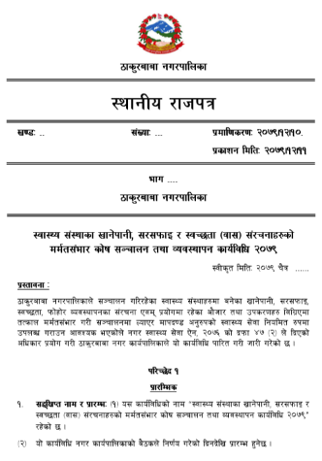
Development of Policy Implementation Procedure
Provisions made:
- Establishment of O&M Fund with $4,500 at Municipality
- Establishment of O&M Fund with $150 in each of the HCFs
- Periodic O&M training for HCF staff, particularly cleaners
?
- Provision for Private sector engagement
- Regular Preventive Maintenance of the WASH infrastructures
[Note: It will be a revolving fund and local government will ensure minimum amount of budget available in this fund every year.]
Notes:
This is a mandatory instrument that details out the key steps and processes to ensure the implementation of the O&M Policy

Slide 12
Current Status
- Established O&M Fund with $4,500 at Municipality -
- Established O&M Fund with $150 in each of the HCFs
?
- Technical support for the development of digitized monitoring tool for O&M in the health care facilities - ongoing
Note: It will be a revolving fund and local government will ensure the minimum amount of the proposed budget available in this fund every year.

Slide 13
Challenges / Mitigation measures
Need of several rounds to workshops for policy finalization: It is because of change in the leadership. Conducted sensitization meetings for new leaders
No practice of keeping records of O&M and other cost (related to life cycle costing) / Cost estimated and a system of keeping record set up.
Difficulty in ensuring the right holders' direct engagement in Policy Formulation Committee given its standard structures: We've ensured participation community consultative meetings
Sustaining the work done and Implementation of the policy

Slide 14
How other stakeholders can benefit from our experience
Availability of the policy outline
Total / Life-cycle costing tools and reports
WASH facility status and performance monitoring tools (Digital)- being piloted
Documentation of the challenges and learnings during the policy formulation process
WASH FIT experiences (technical and implementation capacity)

Slide 15
Opportunities
Advocacy for the replication of O&M policy in other municipalities under the leadership of provinces and the federal government
Scaling of the WASH FIT in other remote districts and Provinces (Key ask from the Ministry of Health and Population)

Slide 16
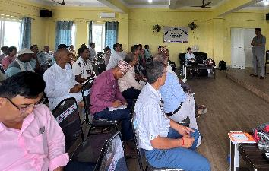
And...
"Advocacy seems easy but difficult…."
"Advocacy seems difficult but not impossible…"
"Politicians also have families, it’s not that they will not get sick. Their families and communities (voters) will also be affected if WASH in HCF is not improved”
--- shared by a participant in a community consultation meeting
Thank You!

