Slide 1


Advocacy for Water, Sanitation & Hygiene (WASH) in Health Care Facilities in Uganda
Anne Nkutu
Host Organising Committee
RI-USAID WASH Programme
Notes:
Conditions such as this are common in too many countries in the developing world—little wonder the corona virus is taking such a toll

Slide 2
WASH in HCF is the intersection of WASH and Healthcare:
Beyond medicine, water is the greatest need at a Health Centre.
Notes:
Water service is unreliable and interrupted

Slide 3
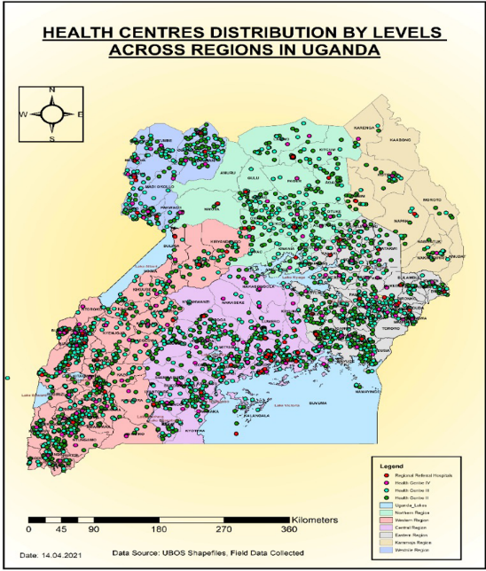
Access to safe water, sanitation and hygiene (WASH) is critical for infection prevention and control (IPC) especially in health facilities.
But many lack the basic WASH infrastructure.

Slide 4
And the need is critical in healthcare facilities in Uganda:
 | Service Levels
Indicators | Zero | Limited | Basic | Advanced
Access to safe water | 17% | 22% | 60% | 1%
Access to sanitation | 10% | 81% | 5% | 4%
Access to Hand Hygiene | 11% | 21% | 46% | 21%
Environmental cleanliness | 31% | 40% | 8% | 21%
Safe medical waste management | 3% | 18% | 56% | 23%
Notes:
Often, neonates and their mothers are particularly vulnerable to infections that are transmitted due to poor WASH conditions.

Slide 5
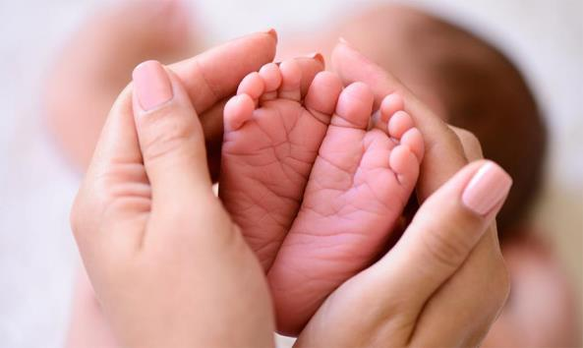
New-born mortality rate @ 27 deaths per 1,000 live births
31% of these deaths are due to neonatal sepsis.

Slide 6
RI-USAID WASH PROGRAMME IN UGANDA:
WASH in 71 Schools
Group Handwashing Stations
Separate toilets for boys and girls
WASH in 12 HCFs
Piped Water Systems
WASH in 7 Communities
Water systems
Incinerators & MHM advocacy
Hand Hygiene
Sanitation
Waste Management
Sanitation
44,171 persons reached
Notes:
Define “improved” sanitation. More on “waste” no handwashing for staff or patients. Need for segregation of waste

Slide 7
WASH in HCFs: Activities
Supporting GoU and MoH on (WHO/JMP WASH in HCFs standards 2008)
Stakeholder Engagement: Local Government & HCF
Community Engagement
Extension of piped water supply to IPC points & maternity wing.
Installation of hand basins in labour suites, OPD, consultation areas and laboratories.
Capacity Building for HCF Staff on IPC guidelines
O & M training
Awareness raising for HCF users

Slide 8
Outcomes
Written cleaning protocols
Handwashing stations at all critical points of HCF
MoU with Local Governments on O & M
Increment of WASH Budget for HCF
Ministry of Health directive

Slide 9


Join the WASH Rotary Action Group and MAKE A DIFFERENCE
WASH-RAG.org

