Slide 1


Tools and Resources for WASH in HCF
Waleska Crowe
Notes:
Conditions such as this are common in too many countries in the developing world—little wonder the corona virus is taking such a toll

Slide 2

Water and Sanitation for Health Facility Improvement Tool
Notes:
Water service is unreliable and interrupted

Slide 3
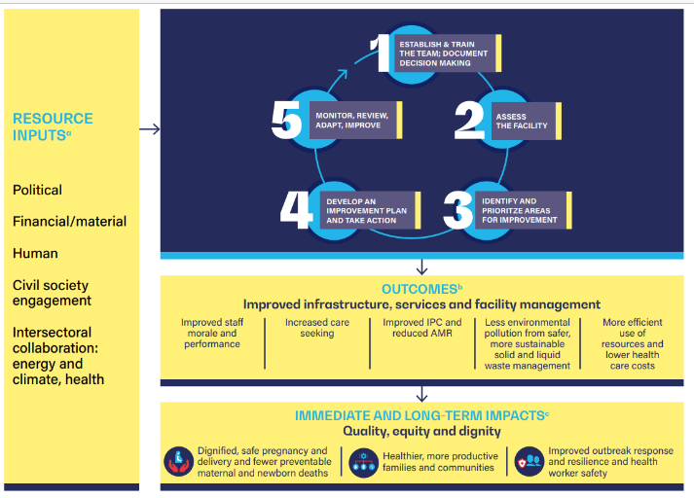
WASH FIT
Notes:
Water service is unreliable and interrupted

Slide 4
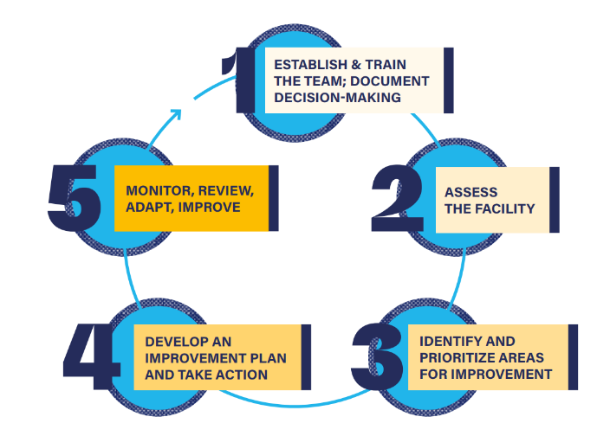
WASH FIT
Notes:
Water service is unreliable and interrupted

Slide 5
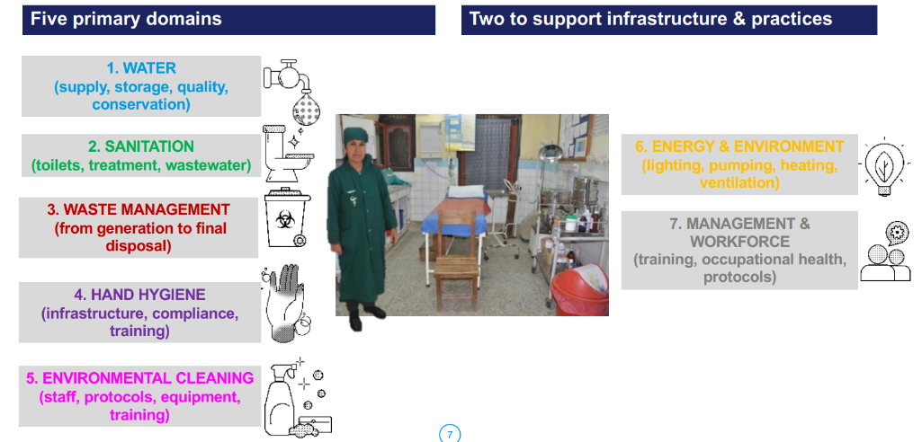
WASH FIT
Notes:
Water service is unreliable and interrupted

Slide 6
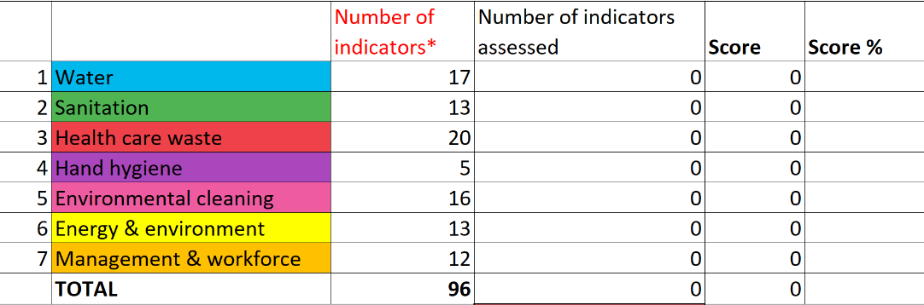
WASH FIT
Notes:
Water service is unreliable and interrupted

Slide 7
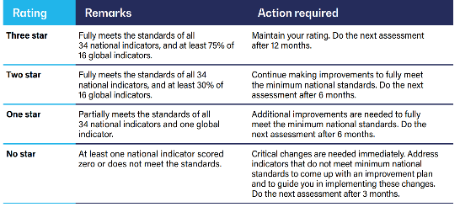
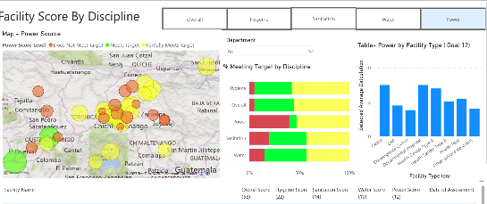
WASH FIT
Philippines WASH FIT scoring system for action planning
Scoring system by code color used in Guatemala
Notes:
Water service is unreliable and interrupted

Slide 8
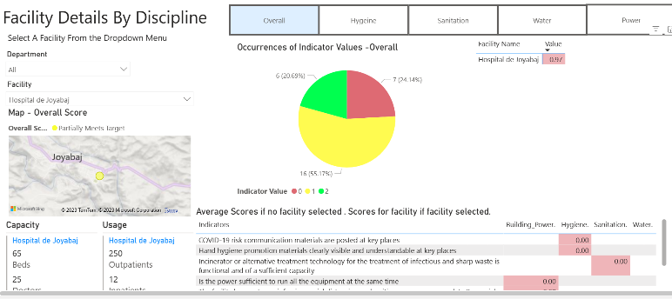
WASH FIT
Complimentary Software tools
KOBO Toolbox
Excel
mWater
Power BI
Notes:
Water service is unreliable and interrupted

Slide 9
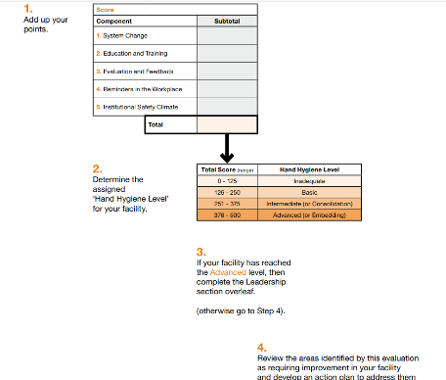
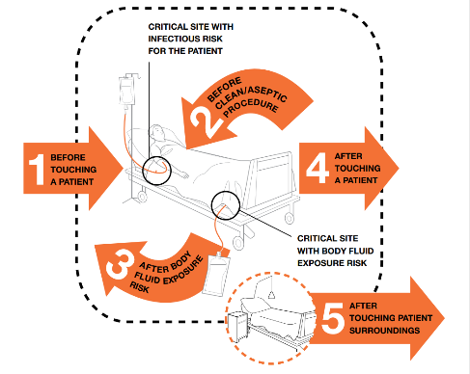
Hand Hygiene
Hand Hygiene Self-Assessment Framework
The WHO 5 moments of Hand Hygiene for Health Care Workers
Notes:
Water service is unreliable and interrupted

Slide 10
Other Resources
Websites:
WHO
USAID (Maternal and Child Survival Program)
CDC
UNICEF
https://www.washinhcf.org/
Download WASH FIT Excel form here:
WASH FIT assessment form (updated February 2022) | WASH in Health Care Facilities (washinhcf.org)
Subscribe WASH in HCF Community of Practice
Notes:
Water service is unreliable and interrupted

Slide 11

Let’s use the tools!
Waleska Crowe
waleskacrowe@gmail.com

Slide 12


Join the WASH Rotary Action Group and
MAKE A DIFFERENCE
WASH-RAG.org

