Slide 1
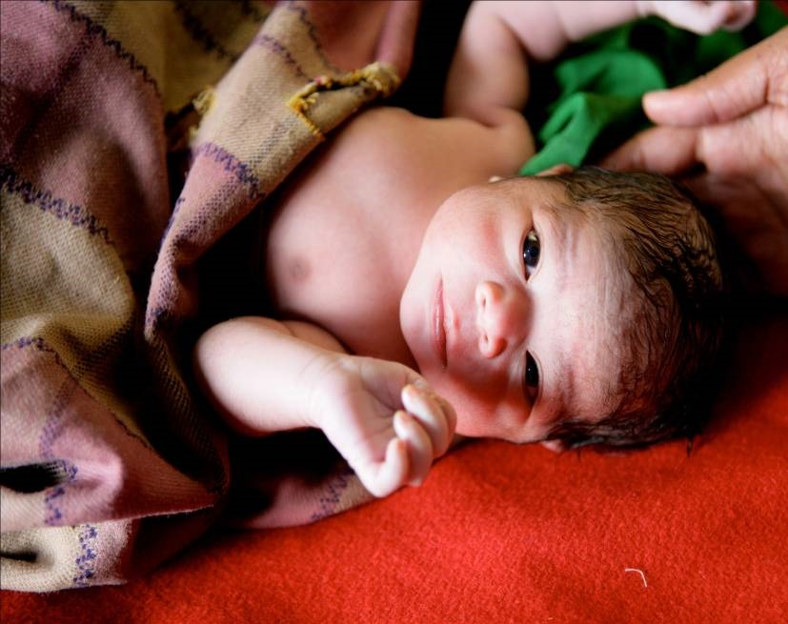
Every Mother & Newborn deserves quality health care
WASH In Health Care: A Case for sustained investment to save mothers and newborns
A medical & Public Health perspective ;
Dr Vandana Bhatia, Health Specialist West Bengal
Pankaj Mathur, WASH Specialist Madhya Pradesh
Dr.Vivek Singh, Health Specialist ICO

Slide 2
Why WASH in Health Care ?
*More than one million deaths each year are associated with unclean births, while infections account for 26% of neonatal deaths and 11% of maternal mortality (7, 2)
**Estimated 8 Million People die annually in 137 low and middle income countries with US$6trillion losses.
*Most of these deaths are concentrated in low- and middle-income countries where the rates of health care-associated infections (HCAI) are twice that of high-income countries (HCAI)
Poor Quality of Care is bigger contributor than access to care. WASH is important component
*An estimated 15% of patients in low- and middle-income countries develop one or more infections during a hospital stay (8). Estimated 896 million people use health facilities with no water service, 1.5 billion use a facility with no sanitation service
Many of these patients are women who come to health facilities to deliver. If a woman lives in a country with a high rate of neonatal mortality, her infant faces a risk of sepsis related neonatal mortality 34 times greater than in countries with a low rate of neonatal mortality (9).
India is one of the major contributors to Maternal and Newborn mortality in several states like Madhya Pradesh, Uttar Pradesh, Bihar, Assam, West Bengal
20-30% of the Maternal Newborn Deaths in India are due to Sepsis
Those who do not die are exposed to high Antibiotic usage- causing Antimicrobial Resistance (AMR) due to irrational use of Antibiotics
High cost of Antibiotics
2019-estimates report 5 million deaths attributed to AMR
*WASH in Health Care –Practical steps to achieve Universal Access to Quality Care (WHO & UNICEF)*
2023 Global Report on WASH, Waste & Electricity services in Health Care facilities

Slide 3
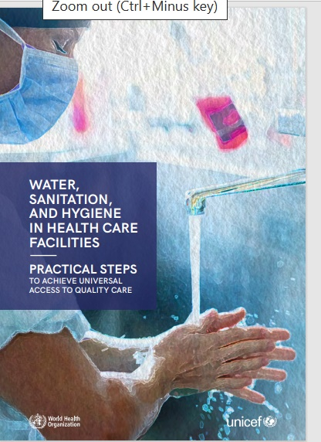

Slide 4
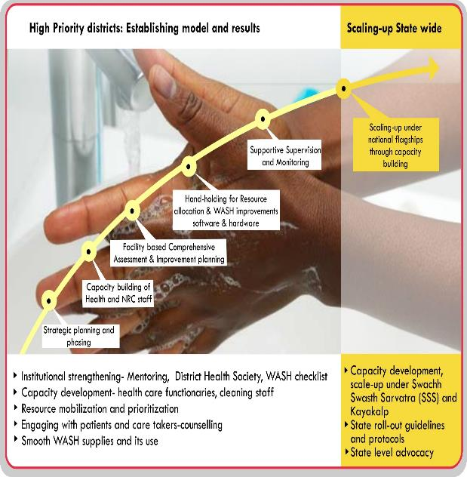
Strategic approach: UNICEF support to WASH in Health and NRC in MP
WASH assessment and improvement planning
Phase 2
Handholding for improvements
Phase 3 COVID Pandemic
.
Phase 4
COVID Infection Prevention and Control
Phase 1
.
Scale-up under National Flagship programmes
i
TA to QA unit in periodic state review, CB and support internal/ Peer/State/National assessment & improvement planning under Kayakalp, SSS, MusQan & NQAS through WASH-CCES, BMWM & IPC
2017 2023

Slide 5
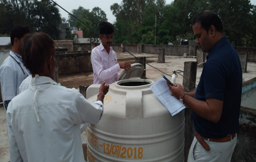
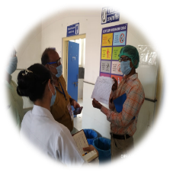
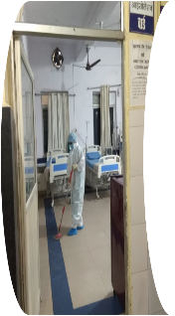
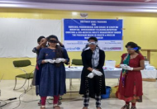
176 health facilities Monitored for WASH
COVID-19 pandemic WASH supplies – 90,000 PPE, 500,000 sanitisers ,soaps, 12,000 liquid soaps, 150+ COVID-19 vaccination & COVID care facilities assessed for Infection prevention control(IPC) and WASH
TA to QA unit of NHM in state review, planning and conducting Internal, Peer, State and National assessments for Kayakalp, LaQshya, MusQan and NQAS
2023
2020
7000 Health Care providers trained , 8 districts monitored WASH , tools. District Health review meetings,
3042 Water crisis survey report completed
299 Hand washing stations retrofitted
Road map for ppt
198 facilities
2019
2017
81 Health facilities
2022
2018
Health facilities applied for Kayakalp, MusQan,
NQAS certification 4 districts
Madhya Pradesh UNICEF NHM Collaboration- Health Systems strengthening (HSS) for
WASH in Health, Infection Prevention Control (IPC)& Biowaste Management (BMW)
148 facilities
2016
2015
Kayakalp launched by Govt of India
Madhya Pradesh 7 High Priority Districts (HPDS) WASH in Health care support initiated

Slide 6
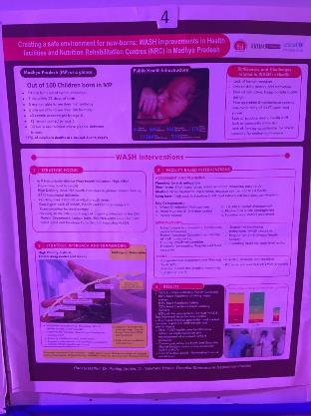
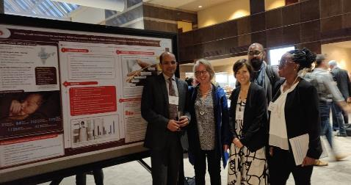
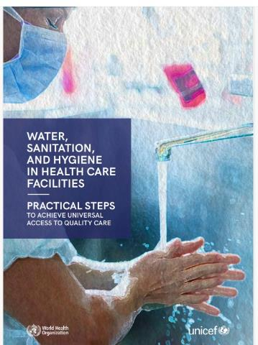
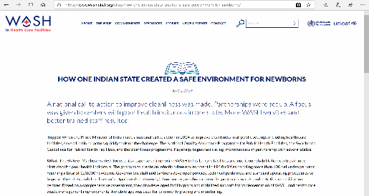
WIHNRCS MP in presented Nationally and Internationally as a practice
University of North Carolina, Chapel hills, Oct.18
“National Summit on Good & Replicable Practices & Innovations in Public Health Care System” Assam, Oct. 2018

Slide 7
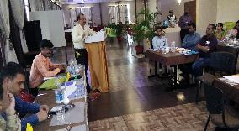
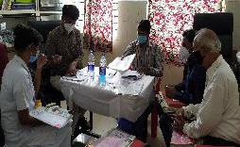
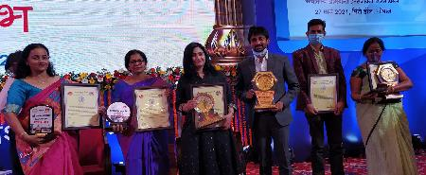
Technical support to achieve Kayakalp Awards in 8 HPDs:
Kayakalp Awarded HCFs from WiH intervention districts: -
Year 2017-18 - 6
Year 2018-19 – 18
Year 2019-20 – 28
Year 2020-21 - 49
Year 2021-22 - 71
Year 2022-23 – Result awaited
District / Facility level trainings and handholding support – 8 Districts (Guna, Shivpuri, Sheopur, Alirajpur, Jhabua, Barwari, Indore and Vidisha)
Year 2022-23 : Internal Assessment completed– 170 HCFs ;
scored more than 70% – 164 HCFs
Peer Assessment completed – 164 HCFs ;
scored more than 70% - 95 HCFs
District level training
Final Kayakalp Assessment
Final Assessment completed - 95 HCFs ;
scored more than 70% - Result awaited
Kayakalp Winners
State level review – Every month by QA team
Fire Audit status: Order released to all 51 districts to complete fire audit. Till 15 May 23, total 287 HCFs completed fire audit who have less then 50 beds

Slide 8
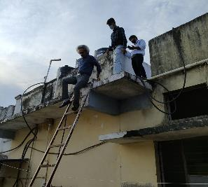
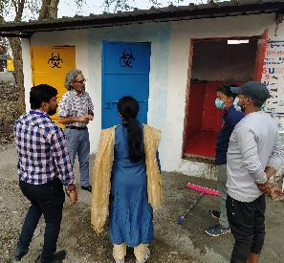
Technical &Handholding support for NQAS certification:
Input : Capacity Building of MOICs, Nursing Officers, Lab Technicians, Supervisors and Cleaning staff of selected potential HCFs & newly recruited DQMs/ Quality nodal during State/ District & Facility level trainings on:
NQAS guidelines
AOCs (19 departments- DH, 12 departments – CH/CHCs and 6 departments - PHCs)
Standards, Measurable Elements and Check points
Assessment methods, Gap analysis and develop CAPA
Use of Quality Tools & Process mapping for improvement
Record keeping process including SOPs, Policies and other relevant records
National NQAS Assessment
Key Results :
PHC Kshipra of Indore district declared as First NQAS certified HCF of M.P.
DH Vidisha achieved NQAS certification with more than 90% score
PHC Bori of tribal district Alirajpur achieved NQAS with 92% score
Civil Hospital Sanawad of Khargone achieved 88% score in NQAS
National Assessment completed for PHC Pitol and CHC Rama of Jhabua district
State level NQAS assessment completed with more than 70% score in 3 more HCFs
Since last 3 years, 35 HCFs have received NQAS certification across the state
National NQAS Assessment

Slide 9
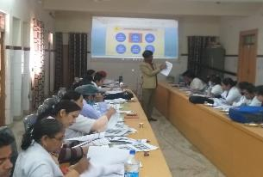
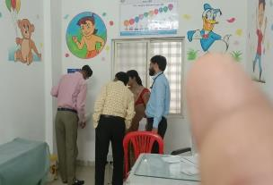
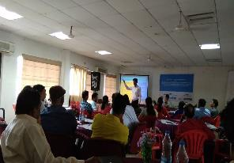
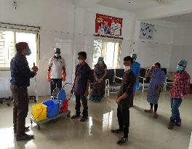
Technical support under MusQan program:
Resource support during State & Divisional level trainings on role of WASH, BMWM and IPC under MusQan programme
Two days District level trainings of more than 100 health care providers including Paediatricians, SNCU & NRC in charge, NBSU in charge and MOiCs of District Hospital Alirajpur, Jhabua, Barwani and Sheopur on MusQan guidelines , assessment and improvement planning
One day Orientation of SNCU nodal, MO-Paed.- OPD, NO-Paed. Ward and FD- NRC on MusQan guidelines, also practiced the MusQan assessment tool (DH Alirajpur, Jhabua, Barwari & Sheopur)
Baseline MusQan assessment completed : Alirajpur, Jhabua and Barwani
State level MusQan assessment completed : DH Alirajpur, Barwani and Jhabua
MusQan District Training
MusQan work monitoring
MusQan District Training
Handholding support

Slide 10
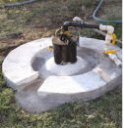
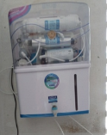
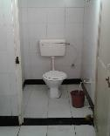
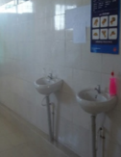

Slide 11
Cost of WASH in Health Care Interventions

Slide 12
Investment case for WASH in Health Care per facility/ district – India
INR 2,600,000 per district USD 31,707 per district
For 10 districts per state
*USD 317,073
X 10 states USD 3,170,731
Average mother baby cohorts- 40,000 per district (USD 80 per mother baby cohort) Quality of care(QoC), reduced stay, bed occupancy, cost of antibiotics, prevent Antibiotic resistance, provided , lives saved due to sepsis related complications (20%)- 8000 (USD 400)
Capacity & needs Assessments, workshops & Technical support , facility wise action planning, per district – INR 600,000
Supportive Supervision & Real Time monitoring Analysis - TA, Supervision travel cost, RTM monitoring apps, analysis feedback, INR 12,500 per facility per week per district x 10 facilities per month per district x 12 months =INR 15,00,000
Operations Maintenance -10 to 30 bedded facility – INR 300,000 to 500,000 annual (leverage donations/ state/district facility maintenance grants)

Slide 13
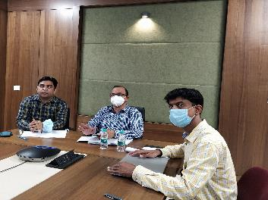
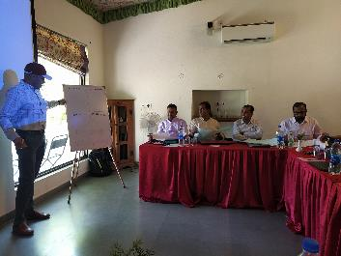
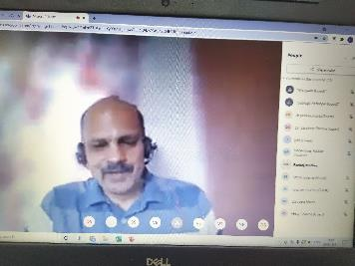
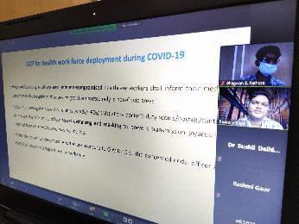
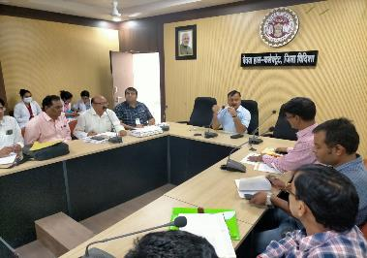
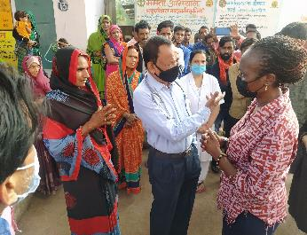
State, District and Field level Review of the programme

Slide 14
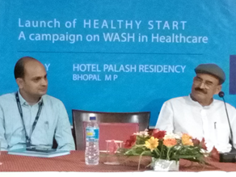
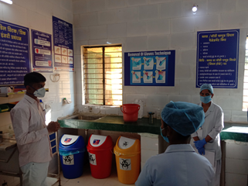
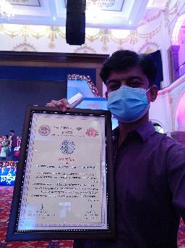
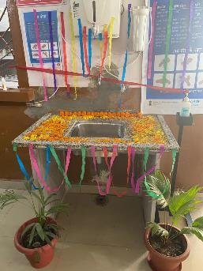
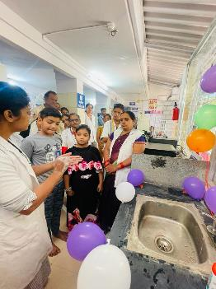

Slide 15
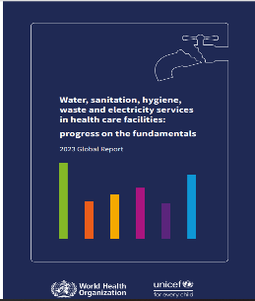
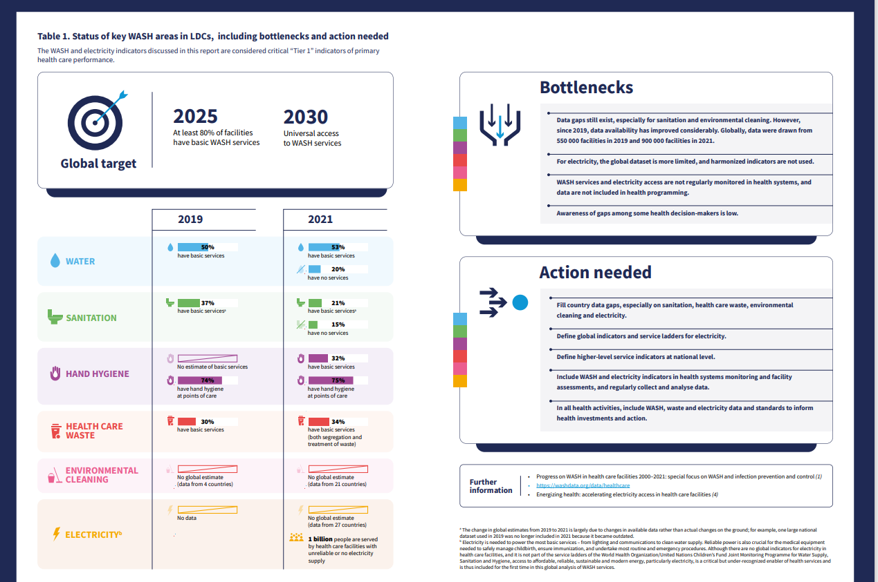
WASH -critical lever of Primary Health Care delivery
Supports gender equity & Human rights
WASH electricity services- are patient safety issues
A cornerstone for Public health emergency preparedness response
At CoP27 2022- 50 countries committed to climate resilient, low carbon facilities

Slide 16
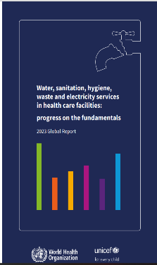
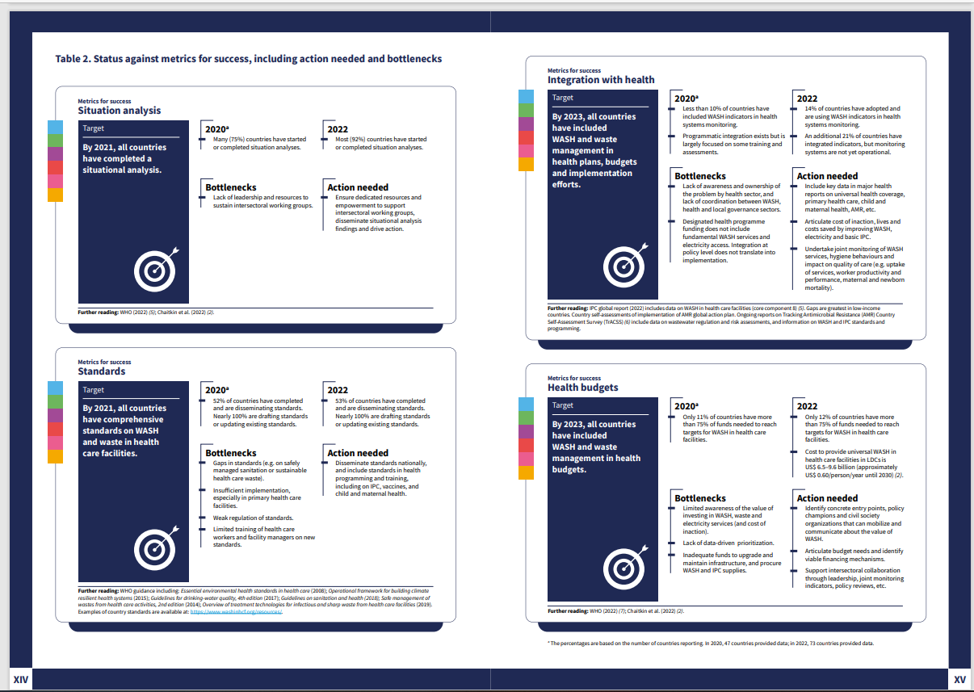
“Costs for Provision of WASH services is modest- Average US$0.60 per person per year per LDC/ 6% of current annual capita income government spending for Universal access to WASH in Health Care. There is a lack of regular , dedicated budget, critical for maintenance of services, in millions of facilities”.

Slide 17
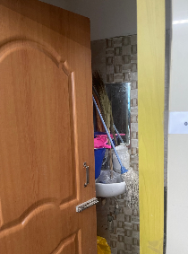
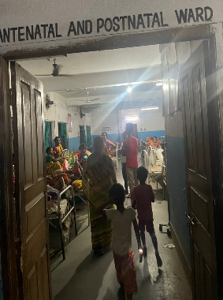
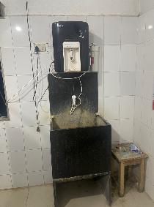
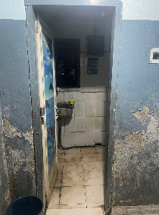
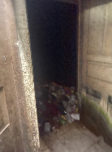
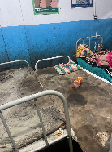
Lets sustain our gains, to save mothers & newborns by investing in Climate resilient WASH in Health care facilities…
Miles to Go before we sleep!......
Thank you
UNICEF India, Madhya Pradesh, West Bengal
Pankaj Mathur, Deepika Mehrish Sharma, Vandana Bhatia, Nageshwar Patidar, Vivek Singh

