Slide 1
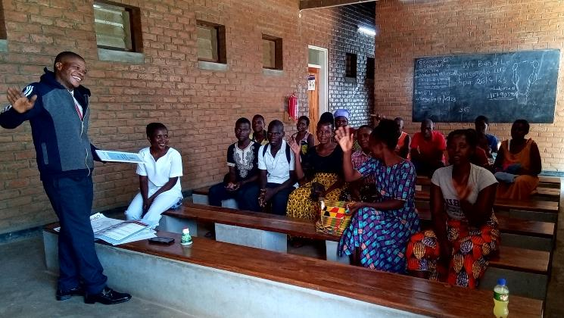
WASH in HCFs Barriers to Sustainability Lessons Learned
PDG Nancy Gilbert
Notes:
Ask participants to write in the chat their ideas about what sustainability means in WASH in HCFs

Slide 2
Sustainability means meeting our own needs without compromising the ability of future generations to meet their own needs Sustainability is ability to maintain or support a process over time. Sustainability consists of fulfilling the needs of current generations without compromising the needs of future generations, while ensuring a balance between economic growth, environmental care and social well-being..

Slide 3
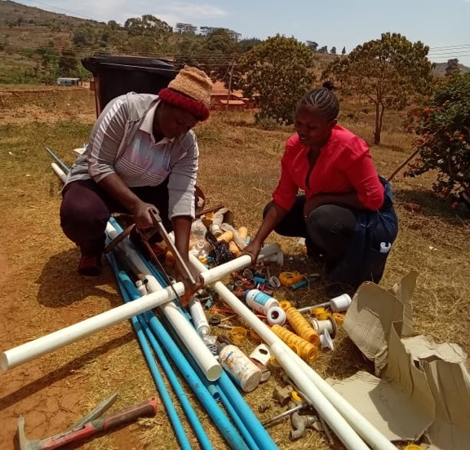
Literature Review
Literature Review – factors association with sustainability in WASH
Lots of tools for improving (assessing) WASH in HCF
WASH Fit
WASH Con tool
Limited tools focusing on sustainability

Slide 4
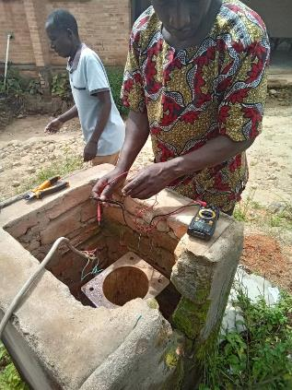
Literature Review
Literature Review – factors association with sustainability in WASH
Hardware and infrastructure that are appropriate for the context, considering their design, construction, operation, and maintenance, against the level of skills and resources available.
Adequate on-site capacity of staff to properly use, operate, and maintain services, supported by ongoing training and supervision
Leadership and proper management of staff and services in guiding WASH service delivery, staff behavior, and resource allocation
Ownership, demand, and behavior of users, which leads to the proper use and maintenance of WASH services
Adequate support from technicians or experts who may be needed to help solve problems that on-site staff cannot solve on their own, and to supervise the implementation of proper practices
Finances to support recurrent costs of operating and maintaining hardware, and training staff.

Slide 5
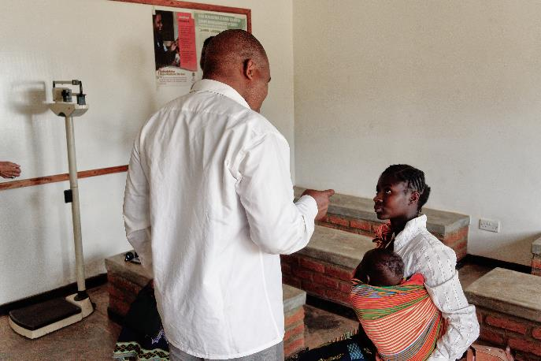
Research in Rumphi District
Research in Rumphi District (November 2019)
18 govt and faith-based facilities
Baseline assessment
Opportunities and barriers to sustainability
Notes:
Workers in health care facilities need sufficient
quantities of safe water to provide health care services.
Drinking and cooking, hand hygiene, showering and
bathing, and a variety of general and specialized medical
uses all require reliable supplies of safe water. Water is
also essential for cleaning rooms, beds, floors, toilets,
sheets and laundry. It is central to patient experiences
of health care, as it enables them to remain hydrated, to
clean themselves, and to reduce the risk of infections.
Families and care-givers also need water to tend to
patients and their own needs. Without water, a health
care facility isn’t a health care facility.
Different health care facilities have different water
requirements depending on the type of health
services offered and the scale of the facility. The
quantity and quality of water available, the location
and accessibility of water points within the health
JMP report 2019 p. 14

Slide 6
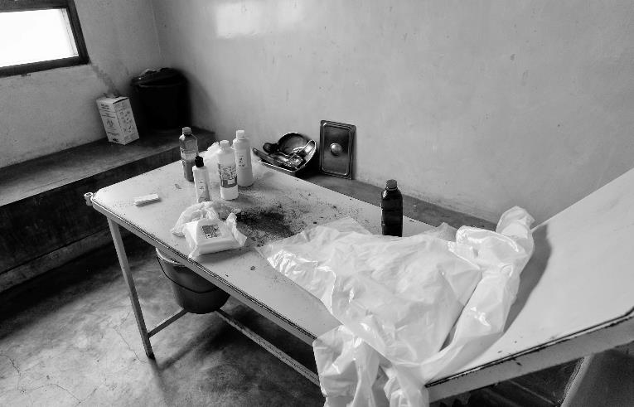
Research Question
Research Question:
“What mechanisms are currently in place that can help, and what barriers prevent, the continued functionality of WASH services?”

Slide 7
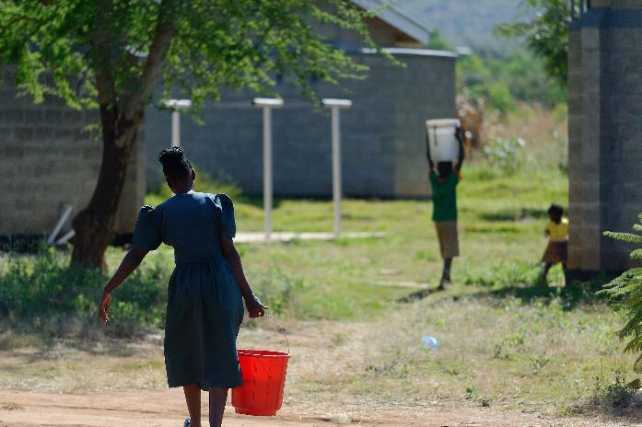
Research
Results grouped as:
local capacity,
training,
guidelines, instructions and cues,
staff attitudes and motivation,
leadership, management, and supervision,
resources, and,
governance.

Slide 8
Local Capacity
Local Capacity:
Ability to maintain WASH infrastructure
25% said they could fix most WASH problems
Balance said could fix some or very few problems (such unresolved problems had a wide range, from missing or improperly functioning toilet doors, to dysfunctional incinerators)
Facility level – had no one to turn to for assistance other than district maintenance staff
District level – limited ability, resources, time

Slide 9
Training
Training:
Majority of HCFs reported no orientation for new staff on IPC or WASH
District staff reported lack of training was a funding issue primarily (so when training had been offered it was often through an NGO)
When new facilities were constructed rarely training provided to HCF staff so gap in knowledge on O&M
All levels of staff felt training was important: 100% of in-charge officers agreed WASH and IPC training should be mandatory for all staff including cleaners; 30% of staff mentioned training as a factor that would help to overcome challenges in delivering WASH service
Lack of knowledge was cited as a reason for poor adherence to existing WASH guidelines, suggesting that training would improve adherence.
Notes:
cleaning and handwashing are so important in MCH and deliveries and in reducing antimicrobial resistance. Bonet et al: Routine antibiotic prophylaxis after normal vaginal birth for reducing maternal infectious morbidity (Cochrane Database System Revision 2017 November) states that in some countries 90% of women receive prophylactic use of antibiotics during childbirth. This is in part due to the inability to ensure a hygienic and clean delivery room and staff hand hygiene. There are also linkages with this to more than 50% of surgical site infections being antibiotic resistant, and effective IPC can reduce health care associated infections by 30% or more.

Slide 10
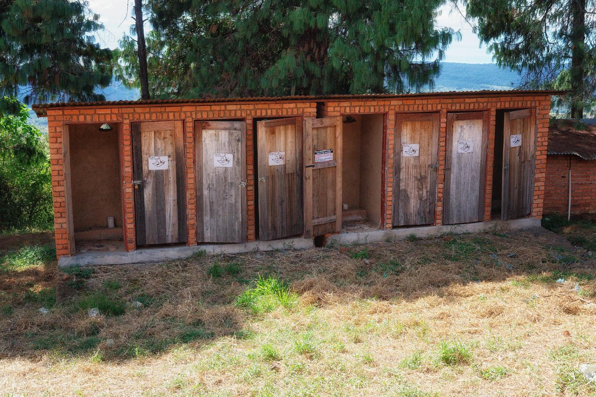
\
Notes:
Similarly in even resource rich countries hand hygiene compliance in health facilities can be as low as 0%, with levels most frequently below 40% (WHO: Health care without avoidable infections https://www.youtube.com/watch?v=K-2XWtEjfl8

Slide 11
Guidelines, instructional aids, cues
Guidelines, Instructional Aids, Cues
Standards of practice (SOPs) provide staff with guidance on requirements
Instructions and cues are necessary to encourage proper behavior of all users, including patients and visitors and to help reinforce what staff have learned through their training
“guidelines are shared with management staff, but not with frontline workers such as himself”
Location and quality of instructions and cues is important – i.e. not so useful in an office if it is intended for patients
“Staff mentioned that visual reminders and prompts would help them improve WASH service delivery” e.g. schedules for cleaning; how-to for handwashing
Patient/Guardian instructions – literacy an issue so pictograms helpful
Notes:
Similarly in even resource rich countries hand hygiene compliance in health facilities can be as low as 0%, with levels most frequently below 40% (WHO: Health care without avoidable infections https://www.youtube.com/watch?v=K-2XWtEjfl8

Slide 12
Staff Attitudes and Motivation
Staff Attitudes and Motivation
Found motivation high and work attitudes positive
Collaboration high
District-level staff also mentioned that past competitions between health care facilities have incentivized staff to improve cleanliness, citing the importance of staff motivation and collaboration in achieving better provision of service.

Slide 13
Leadership, Management, and Supervision
Leadership, Management, and Supervision
70% of facilities do not conduct staff appraisals or performance reviews on a regular basis
nor do they address high performing staff by recognizing them or low performing staff by taking corrective actions
no formal feedback processes nor follow-up processes re issues at a facility; need to improve the frequency and depth of supervision visits by district staff; District govt generally not aware of WASH maintenance challenges
Record keeping is poor - no records are kept on routine activities such as water treatment, cleaning, or waste management.

Slide 14
Resources
Resources
Insufficient resources, particularly materials and supplies, pose a major challenge for all facilities, who have little control over the quantity they receive; long wait times for maintenance support from the district due to lack of funds;
Among staff, 40% agreed that their work routine frequently gets disrupted because of lack of WASH services, and 76% mentioned insufficient materials as a challenge they personally face in their jobs.
“…in the past, lack of water due to lack of funds has caused the facility to temporarily close their maternity ward and refer maternity patients to the district hospital”
Table 8. WASH domains in which health care facilities have experienced insufficiencies in the past year:
Maintaining a steady supply of water for the facility | 67%
Water treatment | 60%
Spare parts for the water supply | 38%
Hygiene supplies such as soap and toilet paper | 53%
Cleaning equipment | 47%

Slide 15
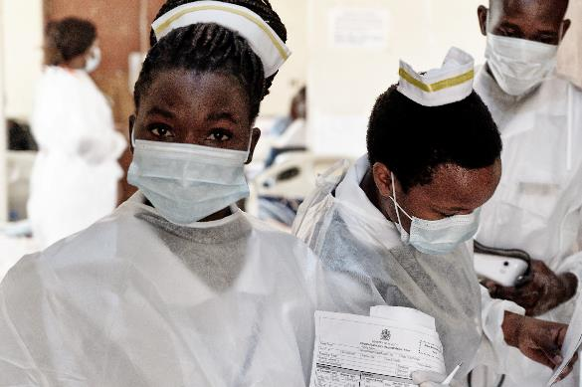
Governance
Governance
WASH – a preventive health measure and a cross-sector area, fails to be prioritized highly as a health intervention;
There are no life-cycle costing or long-term plans for WASH services in place.
Budgets for environmental health departments frequently are re-allocated to the curative branch to meet urgent medical needs in spite of the knowledge that WASH has longer term benefits
Curative branch is the priority

Slide 16
Barriers to Sustainability – Summary
Local capacity at both the facility and district level
Training - multiple times - when starting a job, regular refresher training, mentorship
Provision of guidelines, instructional aids, posters, cues
Rewarding and recognizing good work and addressing shortcomings in staff work
Processes to ensure proper monitoring, record keeping, reporting, accountability
Adequate funding and resources - recognizing the important in investing in preventative medicine

Slide 17
Thank You
Contact
Dr. Nancy Gilbert
nancy.gilbert@transforminternational.org

