Slide 1
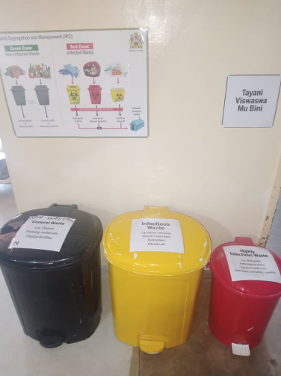
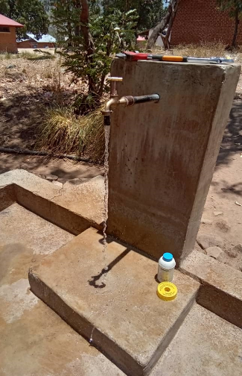
WASH in HCFs Notes from the field
Daniel Nyirenda

Slide 2
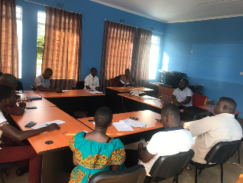
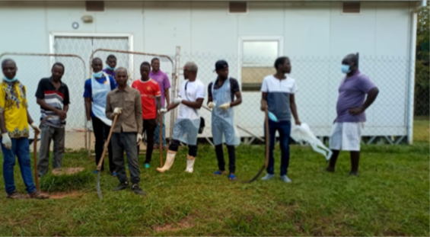
Presentation Outline
In this presentation….
Program location
How the project was designed
Gaps vs Suggested actions
Ensuring Local Government ownership
Partners and approach
What is working?
Technical Circuit Riders
Quality of Care Circuit Riders
Bottlenecks
Call for continued support

Slide 3
Program Location
Program Location
The project is being implemented in all the 18 Health Care Facilities in Rumphi District
Rumphi is one of 6 Districts in Northern Malawi
The population of Rumphi is approximately 230,000
The District cover close to 5,000 sqkm in area

Slide 4
How the program was designed – Gaps vs Suggest actions
2019 Assessment Recap
DCT’s Suggested Actions
Gaps in all WASH services (water, sanitation, hand hygiene, waste management, and cleaning), with much infrastructure in disrepair
Insufficient training on IPC and WASH for staff
Lack of clear guidelines and job descriptions for staff
Insufficient resources/lack of prioritization for WASH
Capacity building
Identifying and training community members on O&M of WASH infrastructure
Making guidelines available to all members of staff
Enhancing sectoral collaboration
Putting maintenance department of the hospital under Directorate of Public Works
Utilizing Public-Private Partnerships
Revisiting reward system introduced by DHO
Notes:
Workers in health care facilities need sufficient
quantities of safe water to provide health care services.
Drinking and cooking, hand hygiene, showering and
bathing, and a variety of general and specialized medical
uses all require reliable supplies of safe water. Water is
also essential for cleaning rooms, beds, floors, toilets,
sheets and laundry. It is central to patient experiences
of health care, as it enables them to remain hydrated, to
clean themselves, and to reduce the risk of infections.
Families and care-givers also need water to tend to
patients and their own needs. Without water, a health
care facility isn’t a health care facility.
Different health care facilities have different water
requirements depending on the type of health
services offered and the scale of the facility. The
quantity and quality of water available, the location
and accessibility of water points within the health
JMP report 2019 p. 14

Slide 5
How the program was designed – Ensuring local government ownership
Ownership - Sustainability
Several meetings were held with the District Coordinating Team (DCT) after research into barriers to sustainability of WASH Systems
The DCT suggested possible action to address the gaps that were identified
The local implementing partner was identified by the DCT
Circuit riders were proposed by the DCT
CRs already in system with some knowledge or skills

Slide 6
Partners and Approach
The Approach
An adapted version of the Circuit Rider Approach blended with the WASH FIT Methodology
Qualified traveling technicians (Circuit Riders) visit a number of water systems/communities, providing support and assistance
The District is divided in 4 zones with each zone having 2 CRs – Technical (T) and Quality of Care (QoC)
The Partners

Slide 7
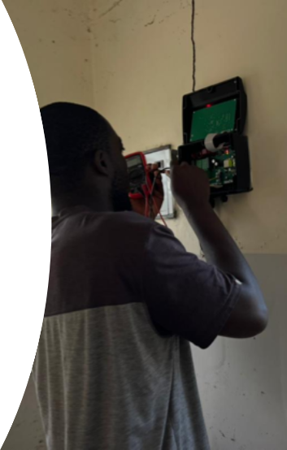
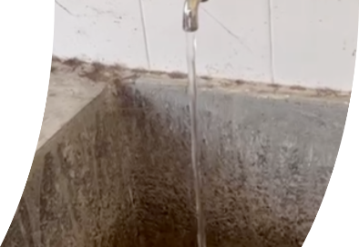
What is working? – Technical Circuit Riders
Technical Circuit Riders
Preventive maintenance (56% reduction in water disruptions)
Proactive approach
Easy mobility to facilities, availability of some spare parts and availability of tools (Dramatic improvement in breakdown response time – 48hrs)
Continued knowledge sharing and support via whatsapp

Slide 8
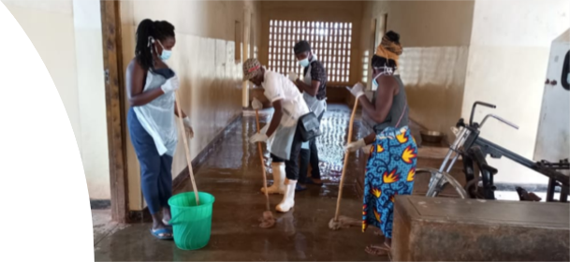
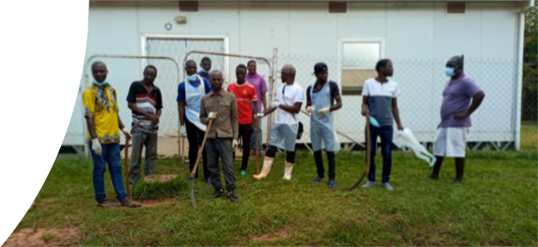
What is working? – Quality of Circuit Riders
Quality of Care Circuit Riders
Establishment and operationalization of WASH FIT Teams (incremental improvements being observed – HW and WM)
Engagement of communities through Health Centre/Hospital Management Committees
Routine data collection and backstopping WASH FIT Teams
Continued knowledge sharing and support via whatsapp

Slide 9
Bottlenecks
Bottlenecks
Lack of community support as evidenced by failure of some HCMC members to attend meetings at HCF
Transfer of trained HCF staff leading to capacity gaps
Failure to get samples to the lab on time due to distances and road conditions
Lack of budget allocation and clear process for obtaining needed parts to do repairs
Technological challenges by some CRs

Slide 10
Bottlenecks
Opportunities
Strong leadership in some facilities
Continued support from government workers notably from the District Gender Office, Rumphi District Hospital and Water Development Department
Coming in of Red Cross with similar interventions
Availability of reliable boats for HCFs on the lake
Participation in QoC Meetings and Task Forces at National level

Slide 11
Call for continued support
Continued support required…..
Most of the HCF need either improved or increased infrastructure to reach basic status which can be sustained by the CRs.
Notes:
cleaning and handwashing are so important in MCH and deliveries and in reducing antimicrobial resistance. Bonet et al: Routine antibiotic prophylaxis after normal vaginal birth for reducing maternal infectious morbidity (Cochrane Database System Revision 2017 November) states that in some countries 90% of women receive prophylactic use of antibiotics during childbirth. This is in part due to the inability to ensure a hygienic and clean delivery room and staff hand hygiene. There are also linkages with this to more than 50% of surgical site infections being antibiotic resistant, and effective IPC can reduce health care associated infections by 30% or more.

Slide 12
Thank You
Contact
Daniel Nyirenda
daniel.nyirenda@ruraldp.org

