Slide 1
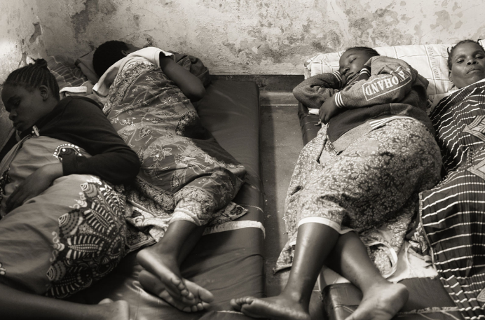

WASH in HCFs
What does it include? What are we aiming for?
PDG Nancy Gilbert

Slide 2

Basic Definition:
Sustainable water, sanitation and hygiene infrastructure, resources, services, and practices in a healthcare setting.

Slide 3
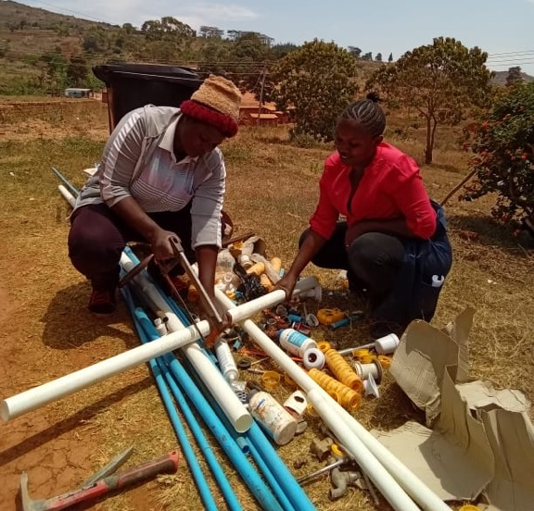
Water supply – quantity and quality
Water is needed:
Handwashing
Medical procedures (e.g., cleaning wounds, irrigating tissue)
Patient hygiene & bathing (newborns, mothers, other inpatients)
Drinking water (including oral medications)
Disinfecting and sterilizing medical equipment
Use of certain medical devices (e.g. CPAP machine, nebulizer)
Sanitation (including latrines, fecal waste management)
Environmental hygiene (cleaning floors and surfaces)
Disposal of hazardous waste
Laboratory activities

Slide 4
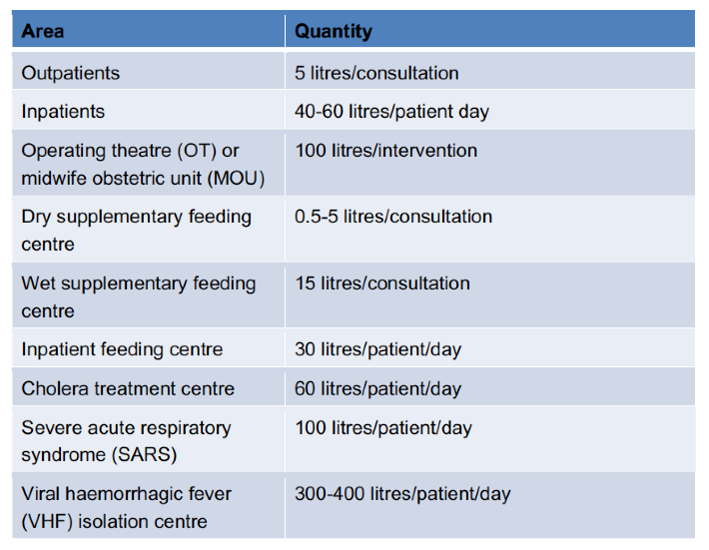
Water supply – quantity and quality
Water quantity:
Will vary depending on situation
*International Society for Infectious Diseases, Guide to Infection Control, ch. 19
Notes:
Workers in health care facilities need sufficient
quantities of safe water to provide health care services.
Drinking and cooking, hand hygiene, showering and
bathing, and a variety of general and specialized medical
uses all require reliable supplies of safe water. Water is
also essential for cleaning rooms, beds, floors, toilets,
sheets and laundry. It is central to patient experiences
of health care, as it enables them to remain hydrated, to
clean themselves, and to reduce the risk of infections.
Families and care-givers also need water to tend to
patients and their own needs. Without water, a health
care facility isn’t a health care facility.
Different health care facilities have different water
requirements depending on the type of health
services offered and the scale of the facility. The
quantity and quality of water available, the location
and accessibility of water points within the health
JMP report 2019 p. 14

Slide 5
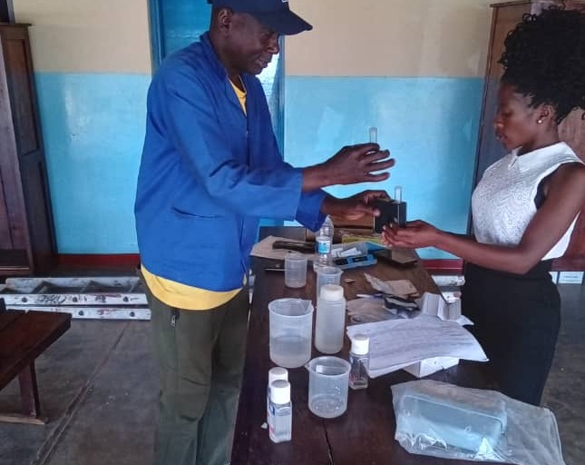
Water supply – quantity and quality
Water quality:
Testing
Filters and/or chlorination
National water quality guidelines
Notes:
Workers in health care facilities need sufficient
quantities of safe water to provide health care services.
Drinking and cooking, hand hygiene, showering and
bathing, and a variety of general and specialized medical
uses all require reliable supplies of safe water. Water is
also essential for cleaning rooms, beds, floors, toilets,
sheets and laundry. It is central to patient experiences
of health care, as it enables them to remain hydrated, to
clean themselves, and to reduce the risk of infections.
Families and care-givers also need water to tend to
patients and their own needs. Without water, a health
care facility isn’t a health care facility.
Different health care facilities have different water
requirements depending on the type of health
services offered and the scale of the facility. The
quantity and quality of water available, the location
and accessibility of water points within the health
JMP report 2019 p. 14

Slide 6
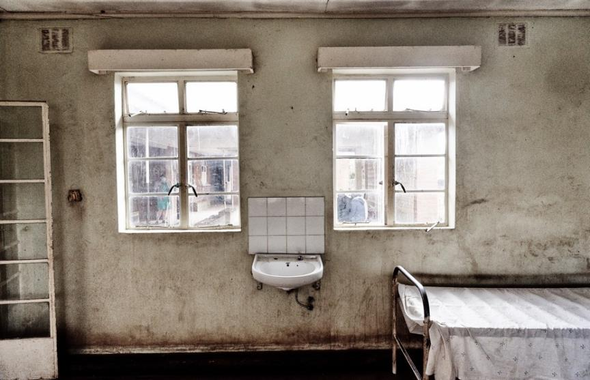
Water supply – quantity and quality
Capacity Building:
Ongoing maintenance of WASH Systems
System for addressing more complex repairs and maintenance issues
Budget for and access to parts
Water quality testing regime (district-wide?)
Ability to review and understand test results
Ability to address water quality issues

Slide 7
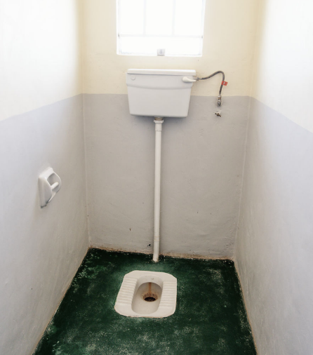
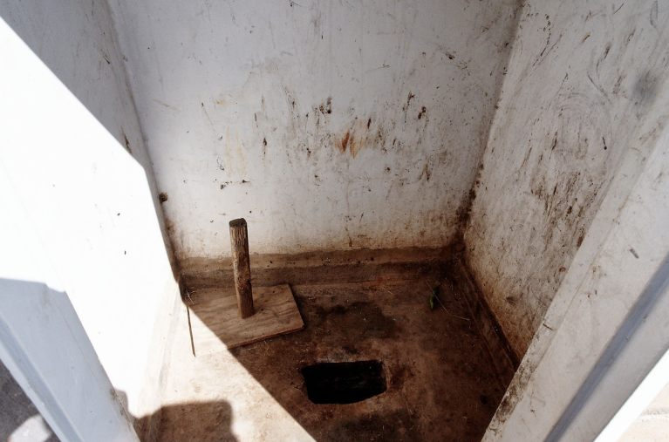
Sanitation

Slide 8
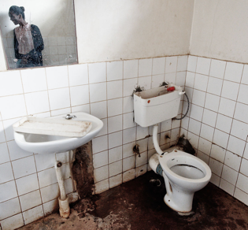
Sanitation
Toilets:
Many types are possible:
Pit latrines
Flush or pour flush
Composting
But they should be:
Gender segregated and labelled
Separate facilities for patients, and staff
Facilities for Guardians
Clean, no smell, no flies
Lighting
MHH facilities for women and girls

Slide 9
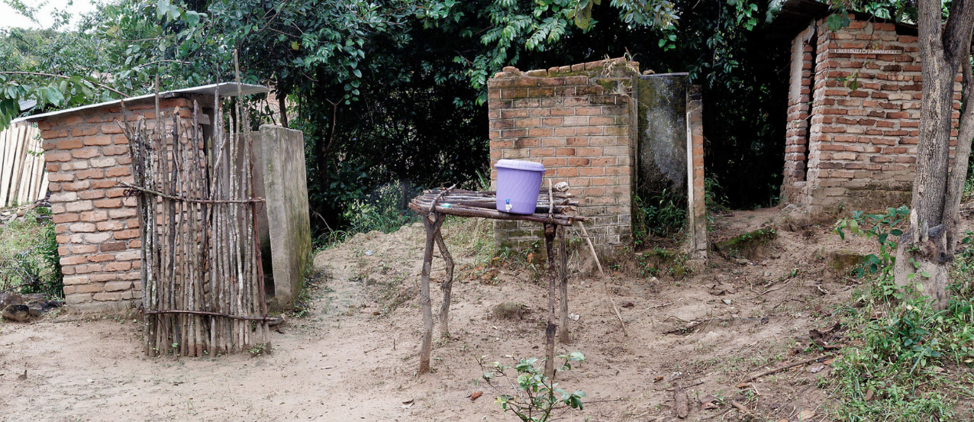
Hygiene

Slide 10
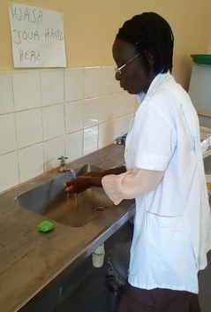
Hygiene
Handwashing with Soap / Alcohol rub
Important considerations:
Location
  Enough handwashing stations
  Ensuring handwashing stations are near points of care
  Near toilets and food prep areas
Adequate Supplies i.e. soap, hand rub
Signage (posters)

Slide 11
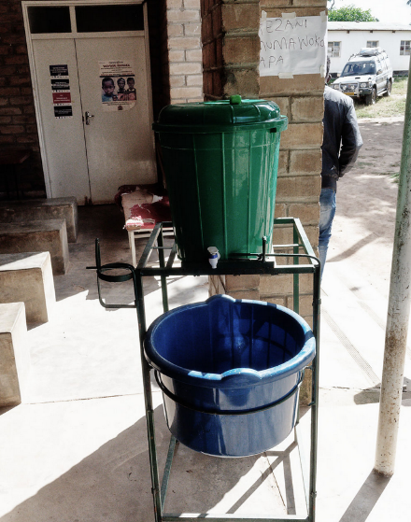
Hygiene
Capacity Building:
How, when, where of hand washing
  WHO 5 moments (staff)
  Guidance posters (patients, guardians)
  When to wash hands with soap, and when to use alcohol rub
Hand washing observation and feedback (WHO)
Facility Assessment
Ensuring adequate supplies

Slide 12
Hygiene

Slide 13
Environmental Cleaning

Slide 14
Environmental Cleaning
Inside Facility:
Cleaning done regularly
Properly:
  cleaning top to bottom,
  Correct proportion of chlorine etc.
  Adequate mops and buckets
  PPE
Outside Facility:
Grounds kept tidy

Slide 15
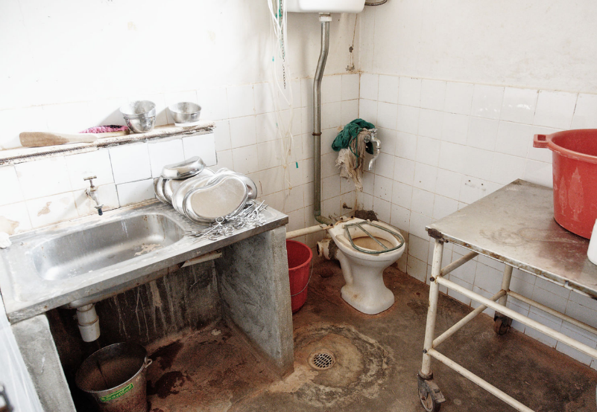
Environmental Cleaning
Capacity Building:
Teaching correct cleaning methods e.g. Soapbox Collaborative materials
Importance of adequate supplies
Tracking supply usage and stocking

Slide 16
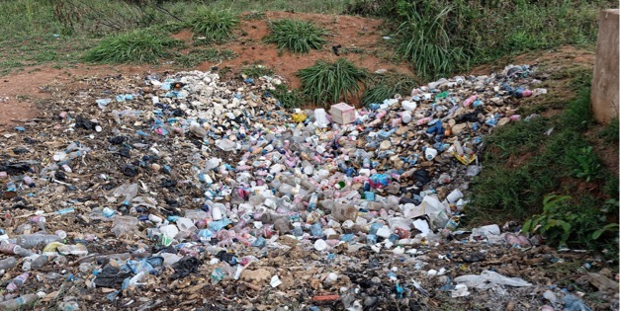
Waste Management

Slide 17
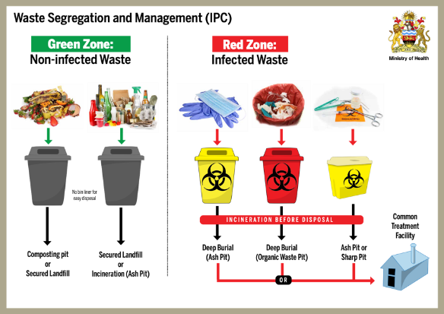
Waste Management
Inside Facility:
Proper separation of waste into 3 bins
  Contaminated waste
  Recycling
  Other waste
Proper collection and storage
  Tracking
  Storing securely
  Storage times monitored (depends on weather)
Outside Facility:
Proper collection or incineration/disposal
  Incinerator
  Placenta pit
  Ash pit
Protected from dogs / children

Slide 18
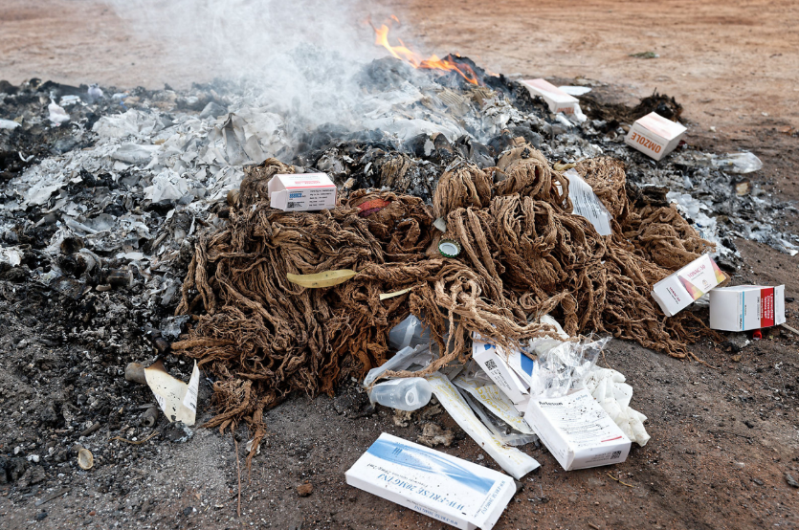
Waste Management
Capacity Building:
Waste segregation
Waste handling (collection & storage)
Incinerator use
  Understanding air quality issues
  Correct use (burn temps, time etc.)
  PPE

Slide 19
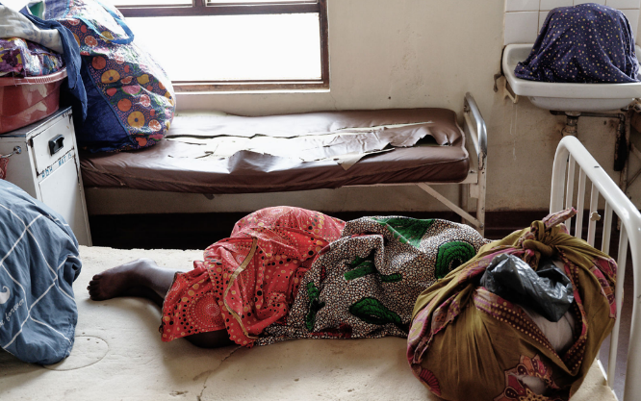
Cross-cutting issues:

Slide 20
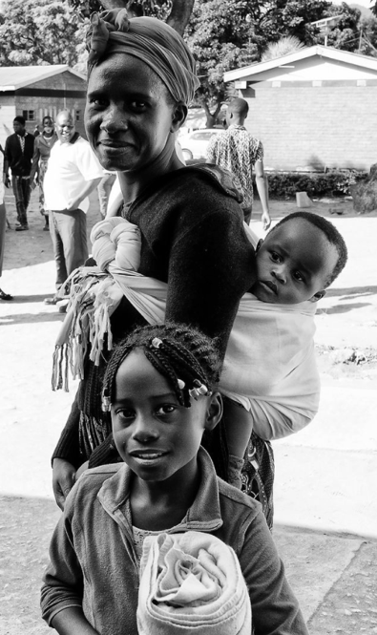
Embedding Gender Dimensions and Women’s Empowerment
Explicit training for staff on gender issues, GBV, women’s roles, how staff are valued, and making work more equitable.
All WASH training and activities are embedded with gender equity building. All HCFs develop workplace GBV policy.
Understanding of women’s infrastructure needs, e.g. menstrual hygiene, access to toilets by pregnant women.
Incorporation of community gender network or other existing resources in WASH Fit (WHO WASH Facility Improvement Tool) activities.

Slide 21
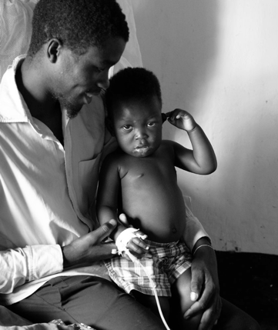
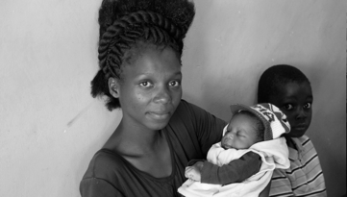
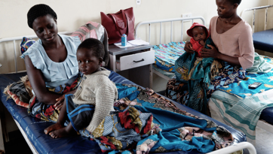
Equity – ensuring access
Climate Change
Mitigating the impacts of climate change and building resilience into the WASH system
Preparing for droughts and/or floods
Extreme temperatures

Slide 22
Thank You
Contact
Dr. Nancy Gilbert
nancy.gilbert@transforminternational.org

