Slide 1
WASH in Healthcare Facilities
An Introduction
Lindsay Denny, MPH

Slide 2
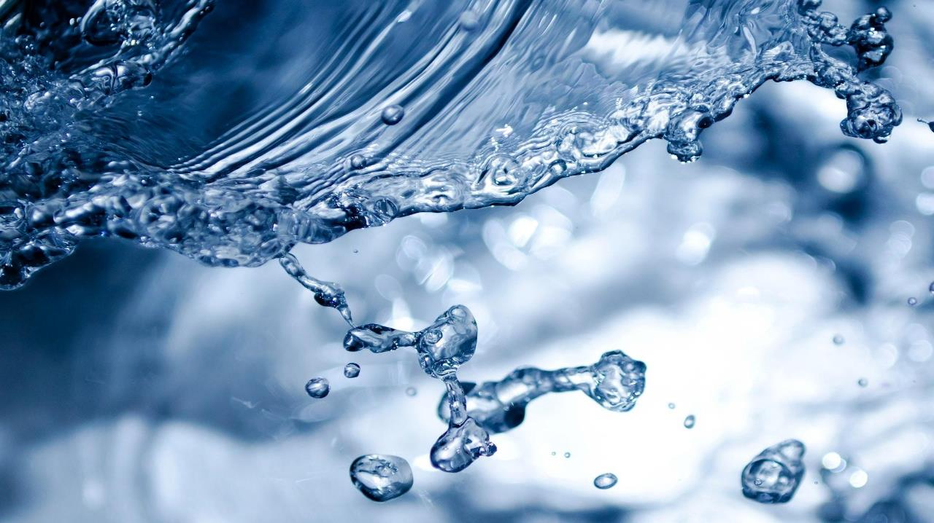
“A healthcare facility without WASH is not a healthcare facility.”
Dr. Maria Neira
World Health Organization

Slide 3
What is WASH in Healthcare Facilities?
The provision of WASH infrastructure, resources, services, and practices in a healthcare setting:
Water
Sanitation
Hand Hygiene
Healthcare Waste Management
Environmental Cleaning
Notes:
Supported by enabling environment** (monitoring, management, leadership, etc.).
Hygiene and sanitation have broader definitions than in community WASH - sanitation including healthcare waste management and
highlighting the need to aim at "Climate Resilience" of WASH infrastructure, resources, services, etc…
Three of these components are also part of the IPC Standard Precautions -- overlap with other sectors/programs

Slide 4
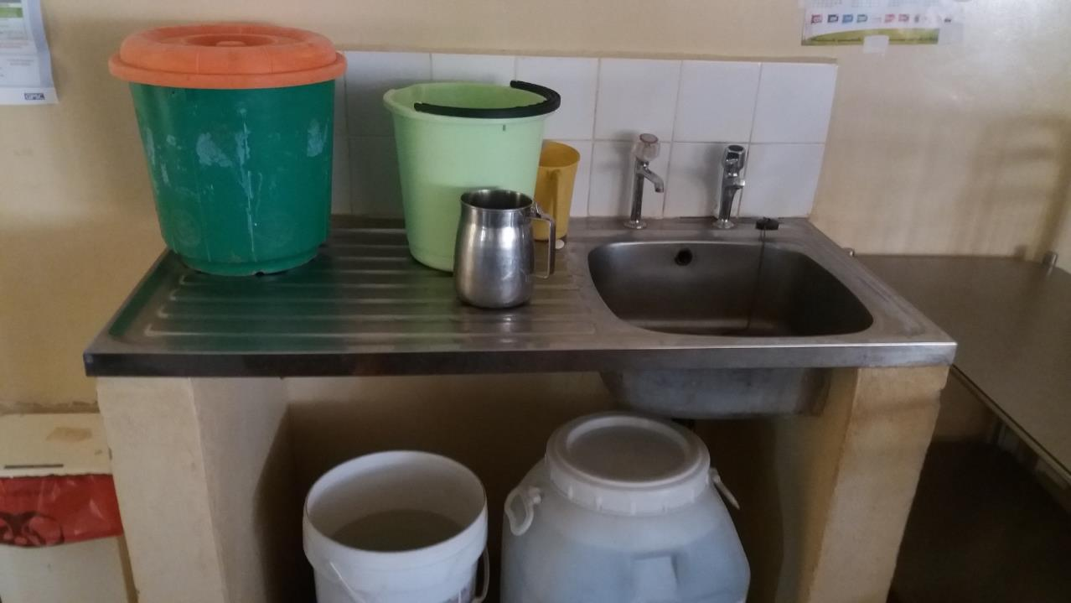
WATER
WATER

Slide 5
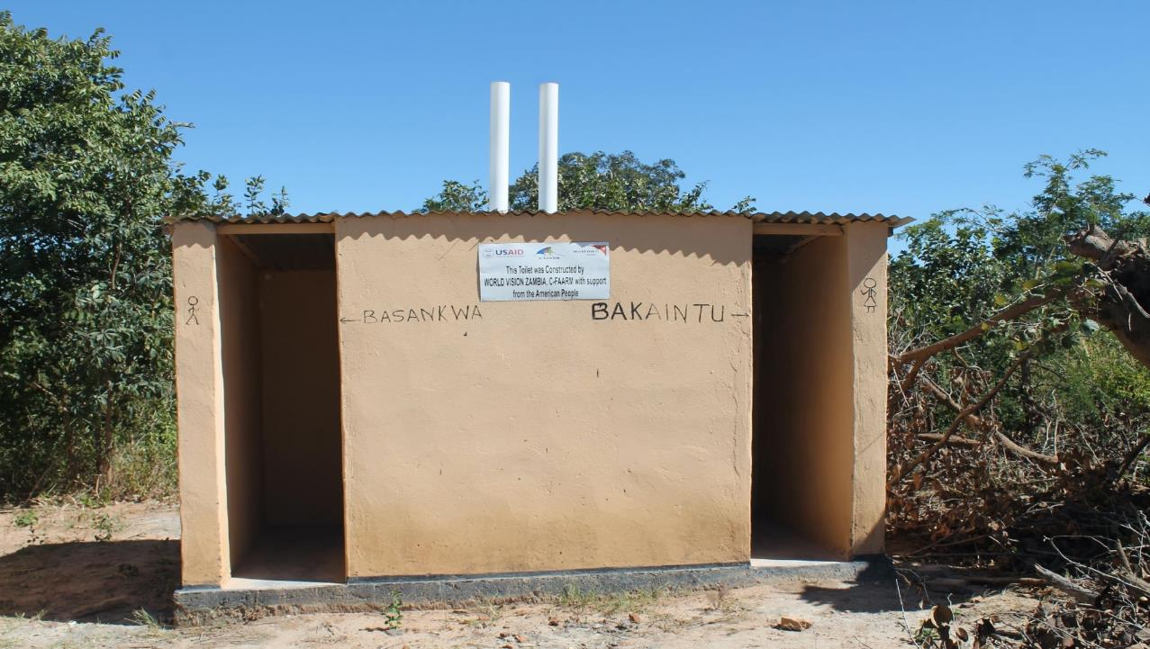
SANITATION

Slide 6
HYGIENE

Slide 7
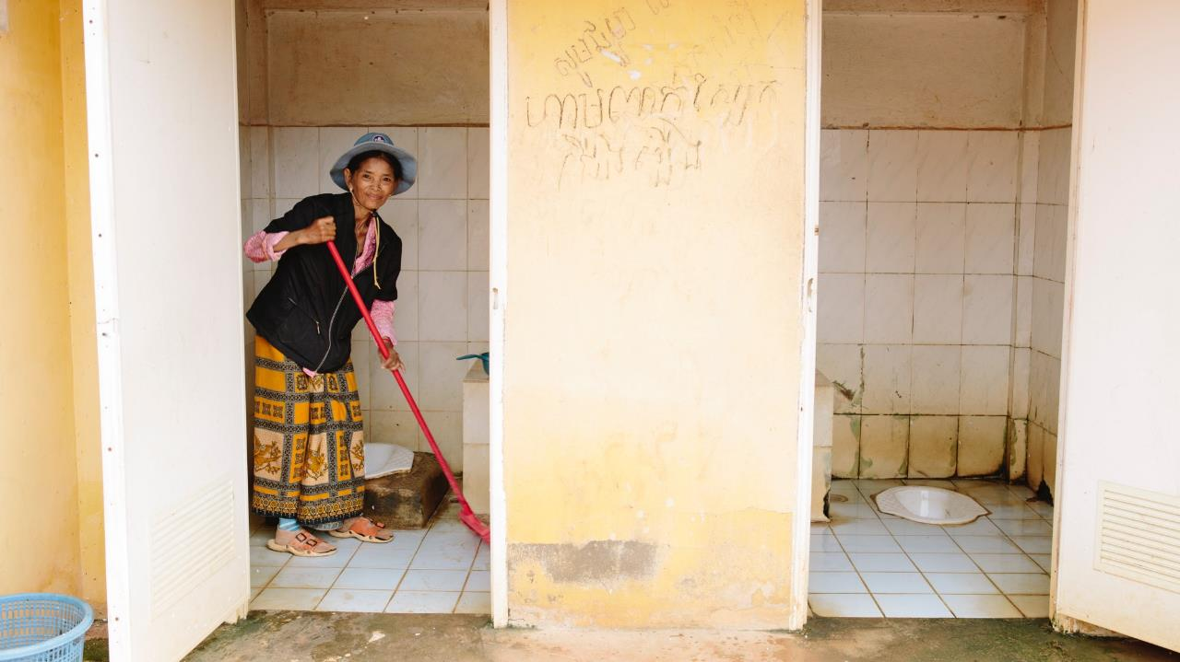
ENVIRONMENTAL CLEANING

Slide 8
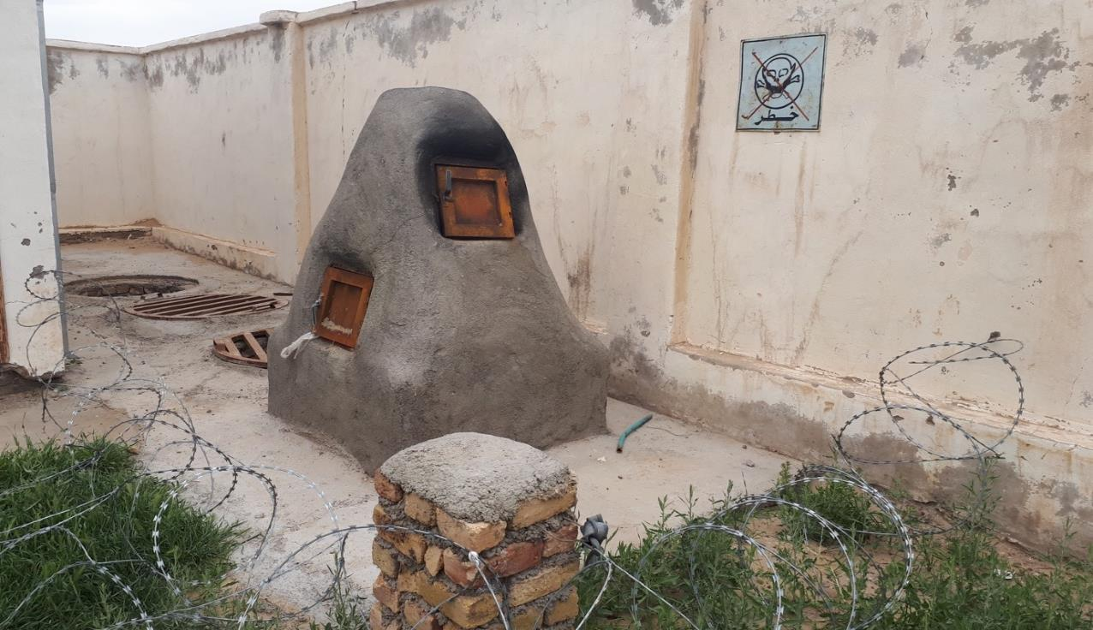
WASTE MANAGEMENT

Slide 9
Which HCF Activities Require Basic WASH?
Hand hygiene
Medical & surgical procedures (e.g., cleaning wounds, irrigating tissue)
Patient hygiene & bathing (newborns, mothers, other inpatients)
Drinking water (including oral medications)
Cleaning, disinfecting and sterilizing medical equipment
Use of certain medical devices (CPAP machine, nebulizer)
Sanitation (including latrines, fecal waste management)
Environmental hygiene (cleaning floors and surfaces, laundry)
Healthcare waste disposal
Laboratory activities
Production of hygiene materials (hand sanitizer, chlorine)
Notes:
Gagan: Better to remove newborns from Bathing.
Add Skilled birth attendance and essential newborn care and care for small and sick babies.
Ask the participants to include their ideas in the chatbox

Slide 10
The Principles of WASH & Health Are NOT New
PRINCIPLES OF WASH and HEALTH ARE NOT NEW
Physicians have been calling for improved hygiene as part of the strategy to reduce morbidity and mortality among patients for several centuries:
1795 - Alexander Gordon asserted that deaths from puerperal fever could be prevented with greater cleanliness and that ‘‘nurses and physicians ought carefully to wash themselves’’ after contact with an infected patient (Velleman, 2014).
1800’s - Ignaz Semmelweis reduced maternal deaths in HCF by requiring doctors to wash their hands in chlorine solution before examining women in labor (Velleman, 2014).

Slide 11
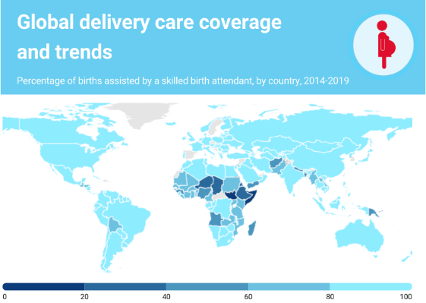
Push for Healthcare Facility Births
The push for women to give birth in HCF has been essential to international strategies to improve the health of mothers and babies in the developing world.
Ensuring all births are assisted by a skilled birth attendant is a critical strategy for reducing maternal and newborn morbidity and mortality.
Inadequate or non-existent care during pregnancy and delivery was responsible for the death of 295,000 mothers in 2017 and 2.5 million newborns in the first month of life in 2018.
Source: UNICEF/WHO, 2019 and WHO (2019)
Notes:
if numbers of women delivering in HCF is increasing why is maternal mortality not going down? what could this be attributable to?

Slide 12
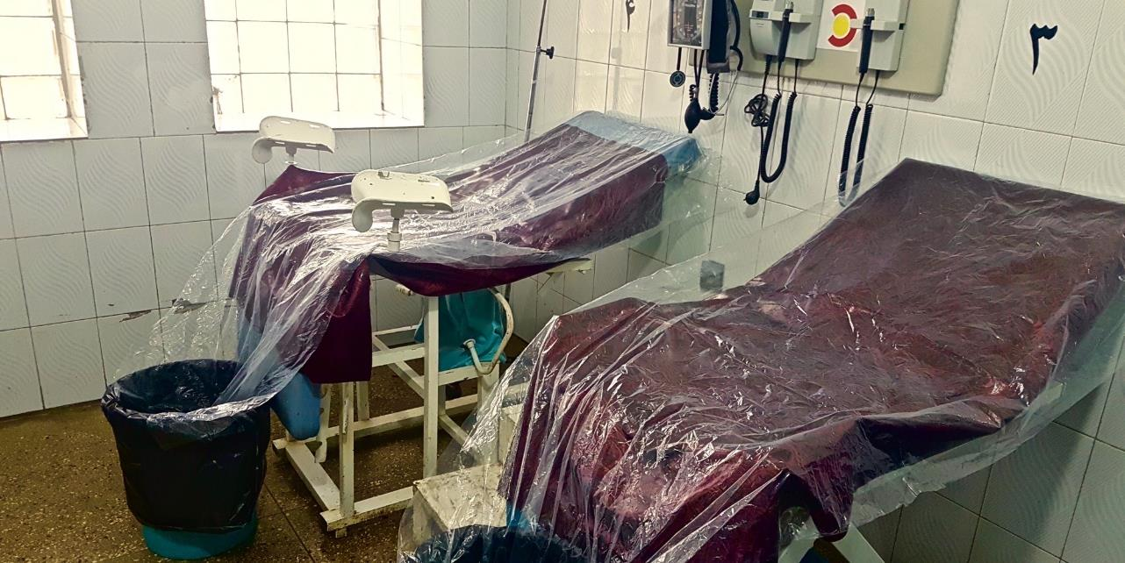
WASH provision is inadequate in many healthcare facilities in LMICs, including labor wards.
Notes:
DELIVERY ROOM PHOTO – Wendy Graham.

Slide 13
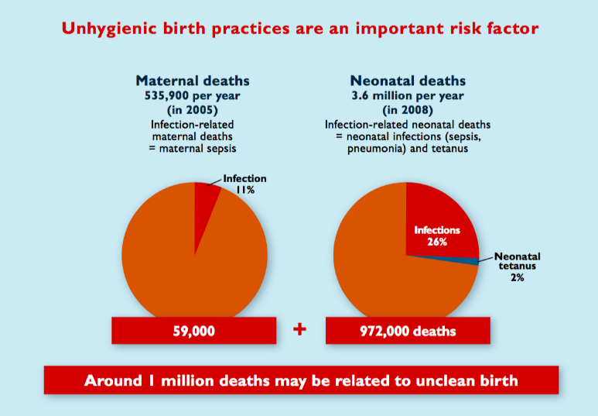
Maternal and Neonatal Mortality
Globally, around 1 million of the 4.1 million maternal and neonatal deaths per year may be related to unhygienic birthing practices (Blencowe, 2010).
Notes:
In 2013, 22.8% of the deaths were caused by infection (sepsis, pneumonia, tetanus, diarrhea). Of the 2.8 million babies who died, this would account for 638,400 deaths
consider the following references:
Fleischmann-Struzek C, Goldfarb DM, Schlattmann P, Schlapbach LJ, Reinhart K, Kissoon N. The global burden of paediatric and neonatal sepsis: a systematic review. Lancet Respir Med. 2018;6(3):223-230. doi:10.1016/S2213-2600(18)30063-8
Say L, Chou D, Gemmill A, et al. Global causes of maternal death: a WHO systematic analysis. Lancet Glob Health. 2014;2(6):e323-e333. doi:10.1016/S2214-109X(14)70227-X
-Molly Patrick

Slide 14
Global Status on WASH in HCF
1 in 5 healthcare facilities lacks basic water services.
In Least Developed Countries, 1 in 2 lack basic water services.
1 in 10 healthcare facilities lacks ANY sanitation services. In Least Developed Countries, 4 in 5 lack basic sanitation services.
1 in 2 healthcare facilities lack basic hygiene services. In Least Developed Countries, 2 in 3 lack basic hygiene services.

Slide 15
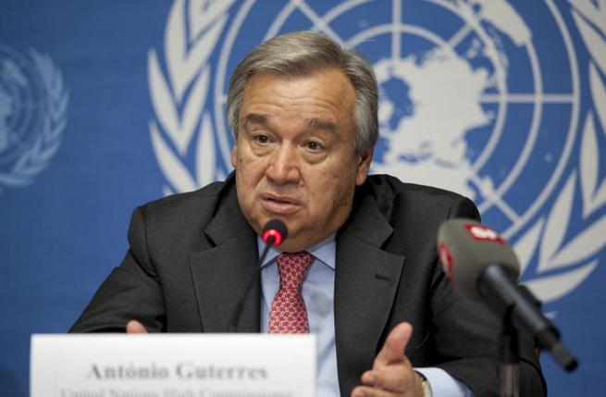
UN Secretary-General’s Call to Action
“Today, I am using the launch of the Water Action Decade to make a global call to action for water, sanitation and hygiene — or WASH — in all healthcare facilities…We must work to prevent the spread of disease. Improved water, sanitation and hygiene in health facilities is critical to this effort.”
United Nations Secretary-General António Guterres March 22, 2018
Notes:
This together with the subsequent slides could be pushed up linked with the SDGs...resolution. Human right to WASH

Slide 16
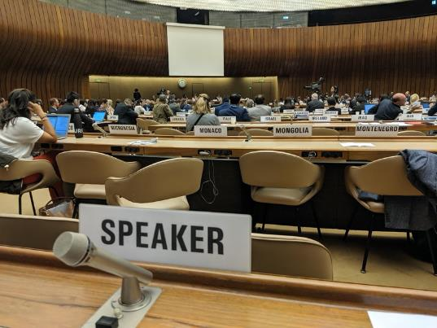
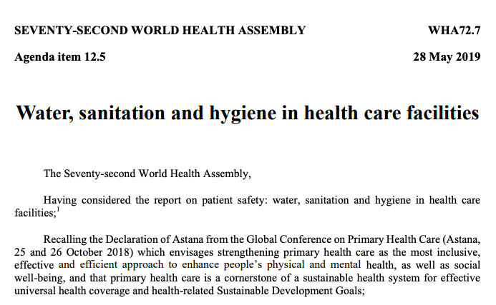
World Health Assembly Resolution
In May 2019, WHO Member States passed a Resolution on WASH in Healthcare Facilities, urging governments to take action in line with the 8 Practical Steps (WHA 72.7)

Slide 17
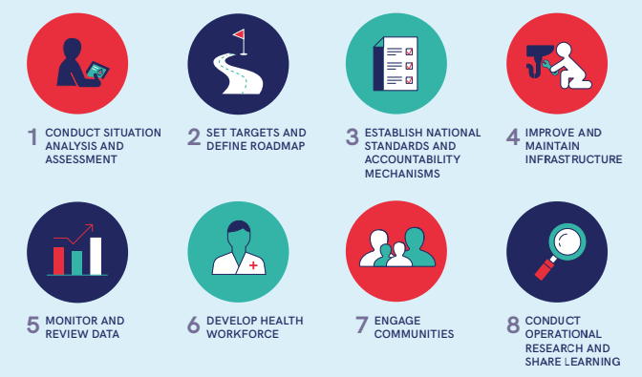
Practical Steps for Action on WASH in HCF

Slide 18
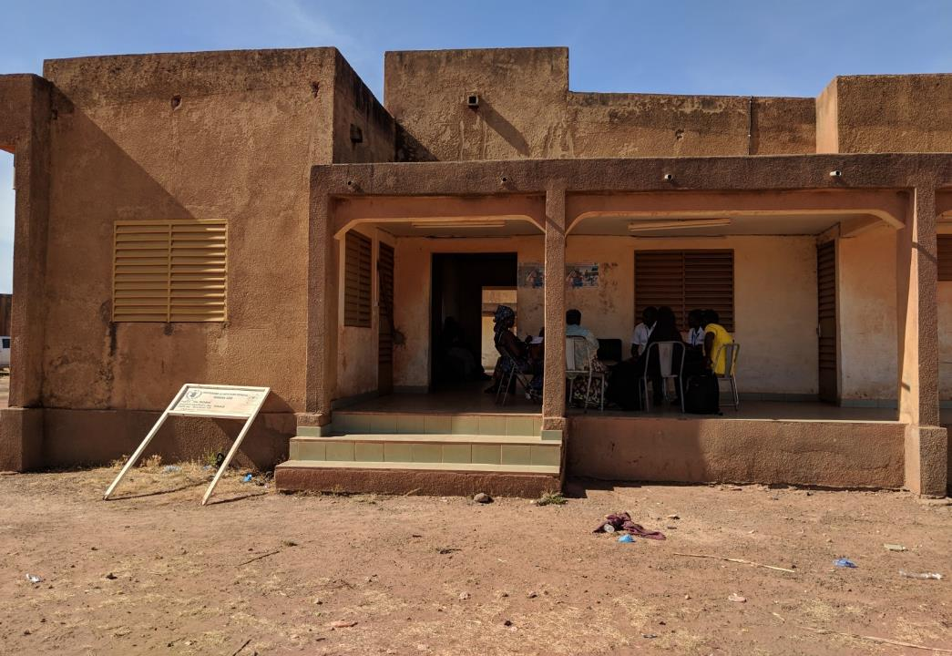
Global Vision
Every healthcare facility has the necessary, functional, and climate resilient WASH services and practices in order to provide essential, quality health services for everyone, everywhere.
(WHO & UNICEF, 2019)

Slide 19
Thank you!

