Slide 1
424 Aviation Road NE
Calgary, Alberta, T2E 8H6, Canada
Phone: + 1 (403) 243-3285, Fax: + 1 (403) 243-6199
E-mail: resources@cawst.org, Website: www.cawst.org
CAWST, the Centre for Affordable Water and Sanitation Technology, is a nonprofit organization that provides training and consulting to organizations working directly with populations in developing countries who lack access to clean water and basic sanitation.
One of CAWST’s core strategies is to make knowledge about water common knowledge. This is achieved, in part, by developing and freely distributing education materials with the intent of increasing the availability of information to those who need it most.
This document is open content and licensed under the Creative Commons Attribution Works 3.0 Unported License. To view a copy of this license, visit http://creativecommons.org/licenses/by/3.0 or send a letter to Creative Commons, 171 Second Street, Suite 300, San Francisco, California 94105, USA.
You are free to:
Share – to copy, distribute and transmit this document
Remix – to adapt this document
Under the following conditions:
Attribution. You must give credit to CAWST as the original source of the document. Please include our website: www.cawst.org
CAWST will produce updated versions of this document periodically. For this reason, we do not recommend hosting this document to download from your website.
CAWST and its directors, employees, contractors, and volunteers do not assume any responsibility for and make no warranty with respect to the results that may be obtained from the use of the information provided.
Stay up-to-date and get support:
Latest updates to this document
Other workshop & training related resources
Support on using this document in your work
CAWST provides mentorship and
coaching on the use of its education
and training resources.

Slide 2
This presentation is used with Lesson Plan 21: Handwashing in the Latrine Design and Construction Trainer Manual.
Available at www.cawst.org/resources

Slide 3
Handwashing

Slide 4
Learning Outcomes
Demonstrate proper handwashing technique.
List the critical times for handwashing.
Identify key features of a handwashing station.

Slide 5
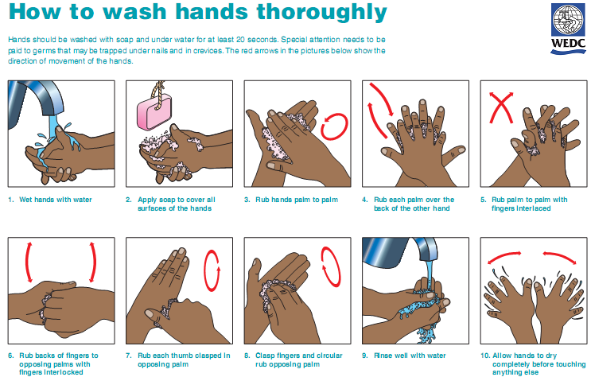
Notes:
Get participants to practice all the steps.

Slide 6
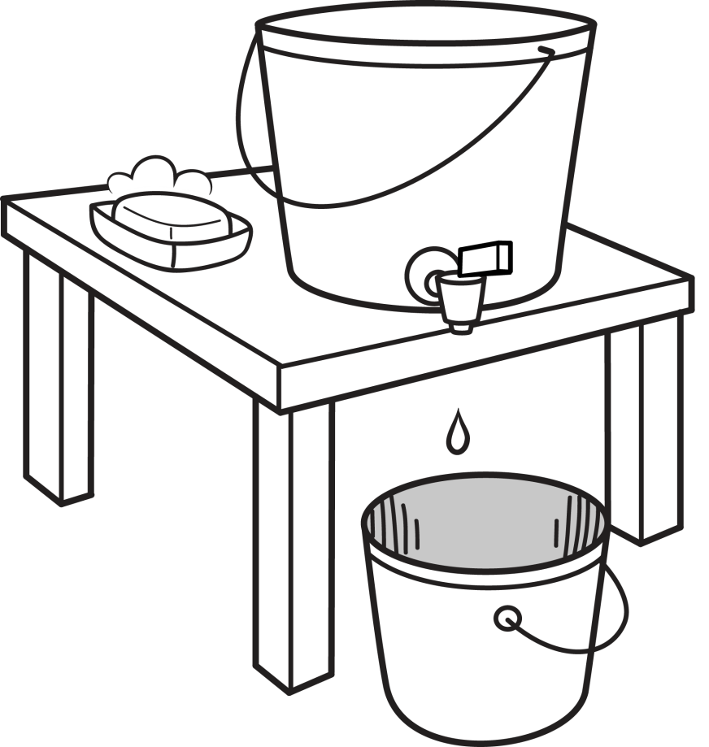
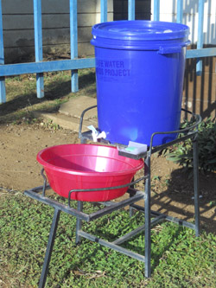
Handwashing Bucket
(CDC, 2013)

Slide 7
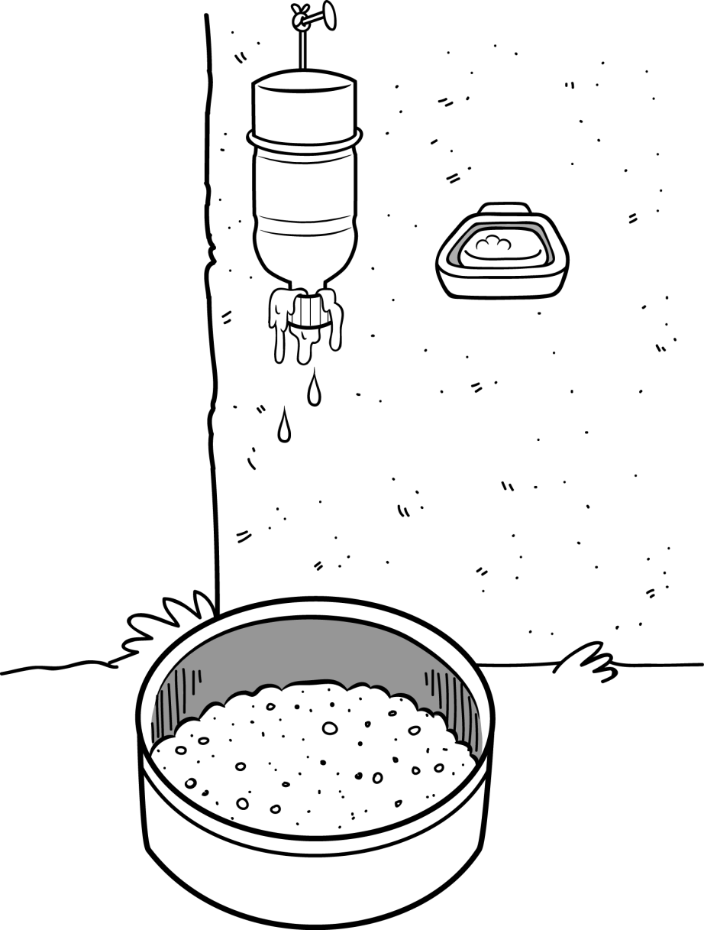
Hanging Bottle
(Susana, 2006)

Slide 8
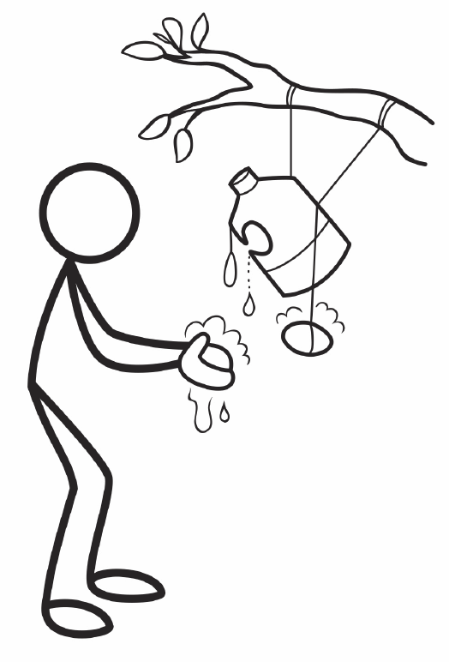
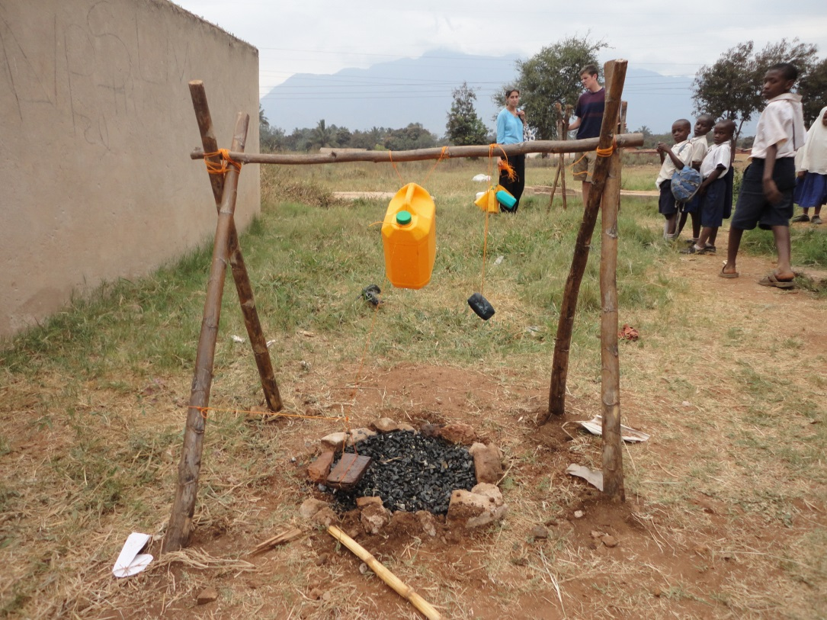
Tippy Tap

Slide 9
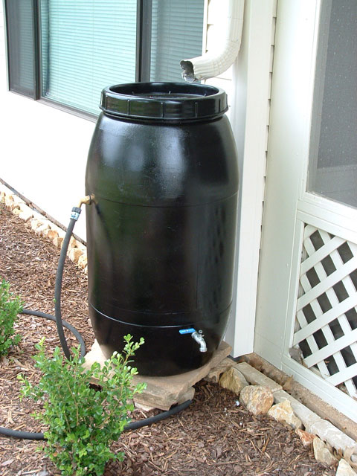
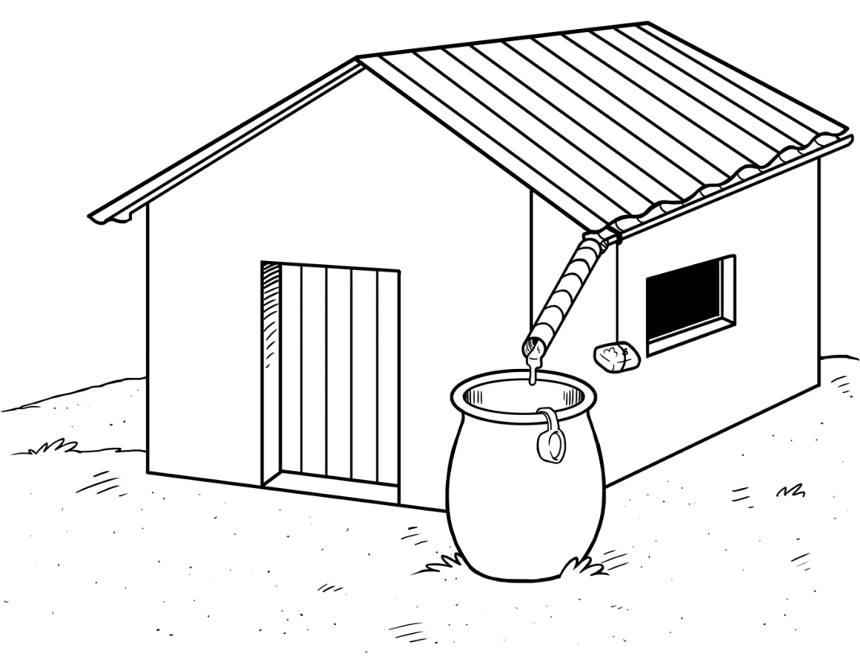
Rain Barrel
(IWS, 2004)

Slide 10
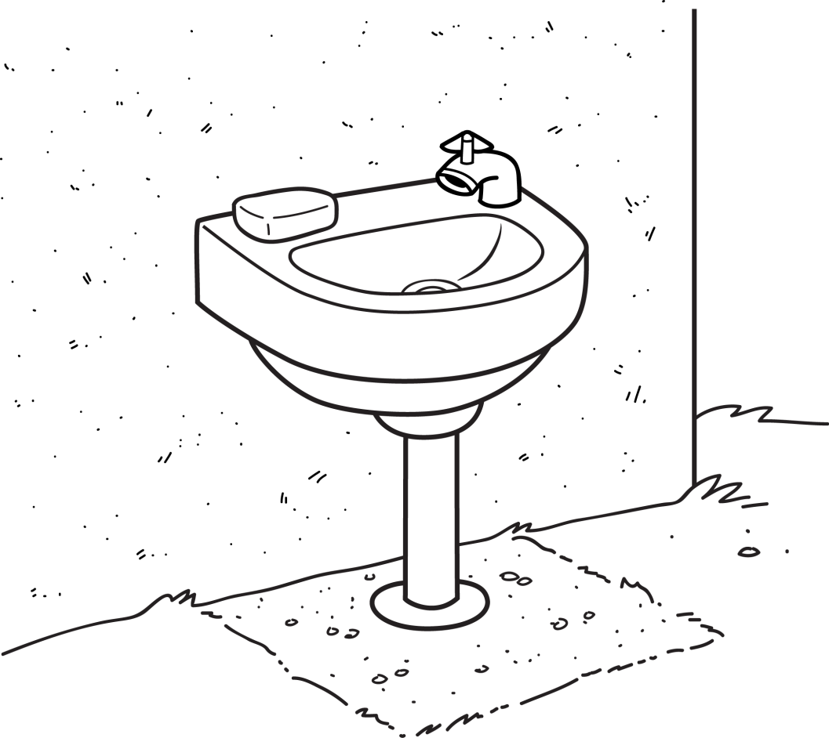
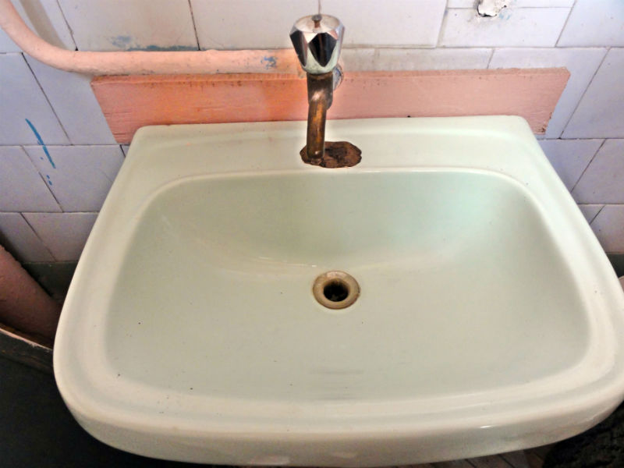
Sink on Wall

Slide 11
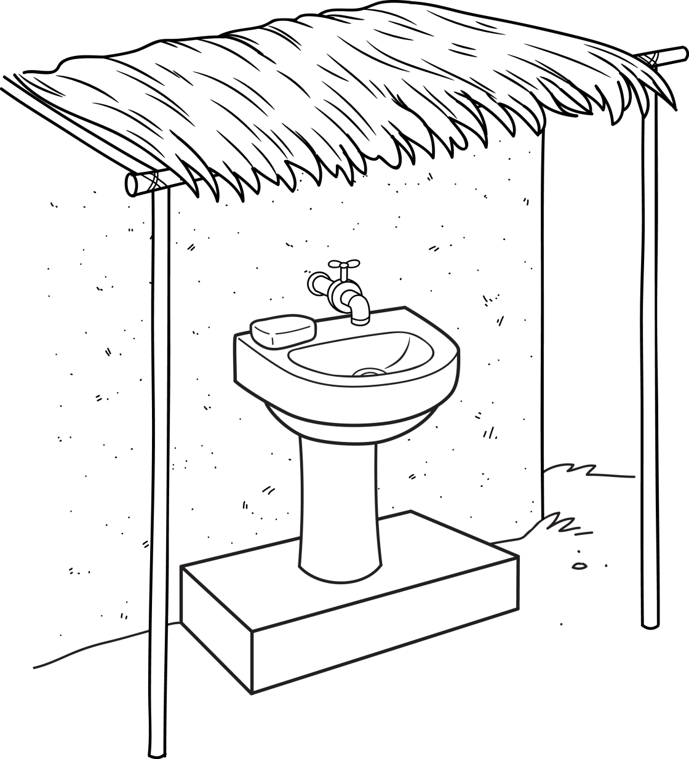
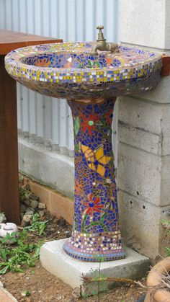
Pedestal Sink

