Slide 1
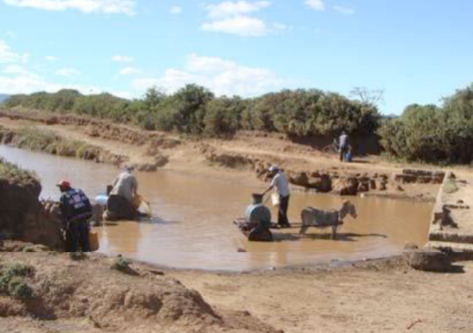
WASH and Health…..
Go Hand in Hand
How WASH Contributes to
Improved Health:
An In-Depth Look
March 5, 2024
Notes:
Conditions such as this are common in too many countries in the developing world—little wonder the corona virus is taking such a toll

Slide 2
WASH and Health Issues
Drinking unsafe water
Cleaning foods with unsafe water
Washing hands with unsafe water
Cleaning pans, bowls, utensils with unsafe water
Intestinal infections spread to others
Bacteria in hospitals, nursing/care homes, Clinics –
spreads easily and fast
Imperfect hand hygiene
Sterilization of medical equipment
Waste water
Waste management

Slide 3
Effects of Unsafe Water and Poor Sanitation Systems
Each year, an estimated 1.7 to 2.2 million persons die from waterborne diseases - most of these deaths are due to diarrheal diseases
Approximately 5,000 children die every day from diarrhea acquired from unsafe drinking water
Total burden of morbidity due to unsafe drinking water is estimated to be 1 billion episodes of gastroenteritis and other infections annually

Slide 7
Successful WASH in HCF Requirements
Planning
Buy-In from all sectors within a HCF
Training
Monitoring
Measurement of Hand Hygiene Interventions and Health Outcomes

Slide 8
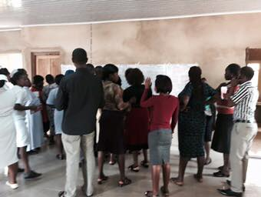
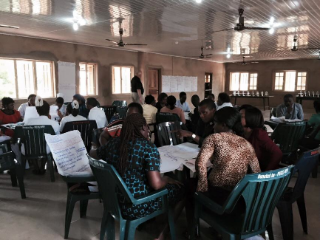
Three-Day Strategic Planning Session
Strategic Planning with administrators,
physicians, nurses, laboratory technicians,
nursing and lab students, finance,
environmental services, social work
Participants from Bishop Shanahan, Adani,
Enugu Ezike, Nursing and Midwifery
Programs, Laboratory, Finance, and
Environmental Services

Slide 9
Prioritizing Using Dot Approach

Slide 10
Follow Up and Implementation Priorities
Discussions with each hospital and community residents
Prioritizing of strategic issues
Next Steps
Finalization of Strategic Plan
Final report
Implementation of Priorities with Leaders and Health Boards
Ongoing communication of developments with hospital boards, staff, and community and village leaders

Slide 11
NSUKKA DIOCESAN HEALTH SERVICES STRATEGIC PLAN:
JULY 2015 – JUNE 2020
Mission
Goals
Strategic Initiatives & Outcomes
Provide the highest quality health services and healthy living information to increase the health and well-being of the people of Nsukka
Community Health Education and Outreach
Increase voice and effectiveness on healthy living through outreach and education in church, community settings, hospitals, clinics, and schools
Partner with other providers and public and private organizations to develop and support medical education programs and coordinate public health and disease prevention messages
Go To Resource for Healthcare Services
Develop and support services to meet the needs of the community
Implement performance based programs to provide highest quality healthcare services
Organizational Infrastructure Support
Prioritize staff needs and develop plan to secure necessary equipment and supplies to effectively and efficiently serve patients
Develop a building design plan to address patient and staff needs in the hospital with short-term priority given to maternal care
Develop and implement plan for clean water, water distribution, and contaminated waste water disposal for hospitals
Vision
Create and sustain the highest quality physical, mental, spiritual, and social well-being services and support for all residents served by the Nsukka Diocesan Health Services
Staffing Support
Develop a comprehensive plan to achieve a supportive wage and salary plan for clinical and non-clinical staff
Provide staff with on-line and local educational programming resources to increase and maintain professional clinical knowledge
Engage and support staff in ongoing multi-hospital discussions within clinical service areas on a monthly or quarterly basis
Governance and Financial Resources
Recruit local and national health experts to serve on the Nsukka Diocese Healthcare Commission
Provide board members with performance expectations and orientation
Develop and Implement a plan to ensure proper payment for services delivered to patients, including public and private support
Develop a collaborative organizational approach with other religious-based health providers for government support and payment for patients and communities serving poverty and extreme poverty communities
Develop an approach for qualified insurers to provide health insurance plans to Nsukka Diocesan residents for usage within the Diocesan Health System

Slide 12
Strategic Plan Report – 20 plus pages

Slide 13
Sanitation, Hygiene and Sanitary Protocols
Not Natural if you don’t have WASH at home or school
Notes:
Dirty, unclean surfaces and conditions give rise to widespread infection. Spread of pandemics and disease, maternal and child mortality

Slide 14
The COVID-19 Action Plan
In May 2020, the World Health Assembly called for:
“All member states to support access to safe water, sanitation and hygiene, giving attention to the promotion of personal hygienic measures in all settings particularly in health facilities.”

Slide 15
And by 2030, every HCF to:
Have safe drinking water for staff, caregivers, patients
Provide safe sanitation for all
Encourage and facilitate frequent hand hygiene
Implement regular cleaning and disinfecting
Manage excreta, feces and urine safely
Safely manage health care waste
This is an opportunity for Rotarians everywhere
Notes:
Sufficient drinking water

Slide 16
“Wisdom is knowing the right thing to do.
Integrity is doing it.”

