Slide 1
Ensuring WASH in Health Care Facilities
Lindsay Denny, Programme Specialist (UNICEF)

Slide 2
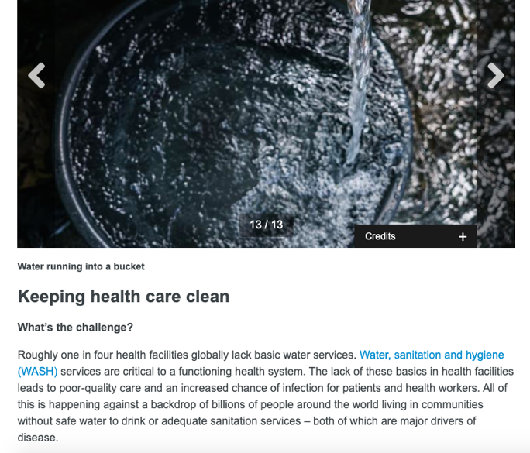
WHO: Urgent Health Challenges for the Next Decade
In January 2020, WHO announced a list of the priority urgent health challenges for the coming decade, including: “Keeping health care clean.”

Slide 3
Water
Sanitation
Hygiene
Health Care Waste Management
Environmental Cleaning
WASH in HCF consists of all WASH infrastructure, resources, services, and practices in a healthcare setting.
Notes:
A healthcare setting is anywhere where a patient can receive care – from a health post or a dispensary to a tertiary hospital

Slide 4
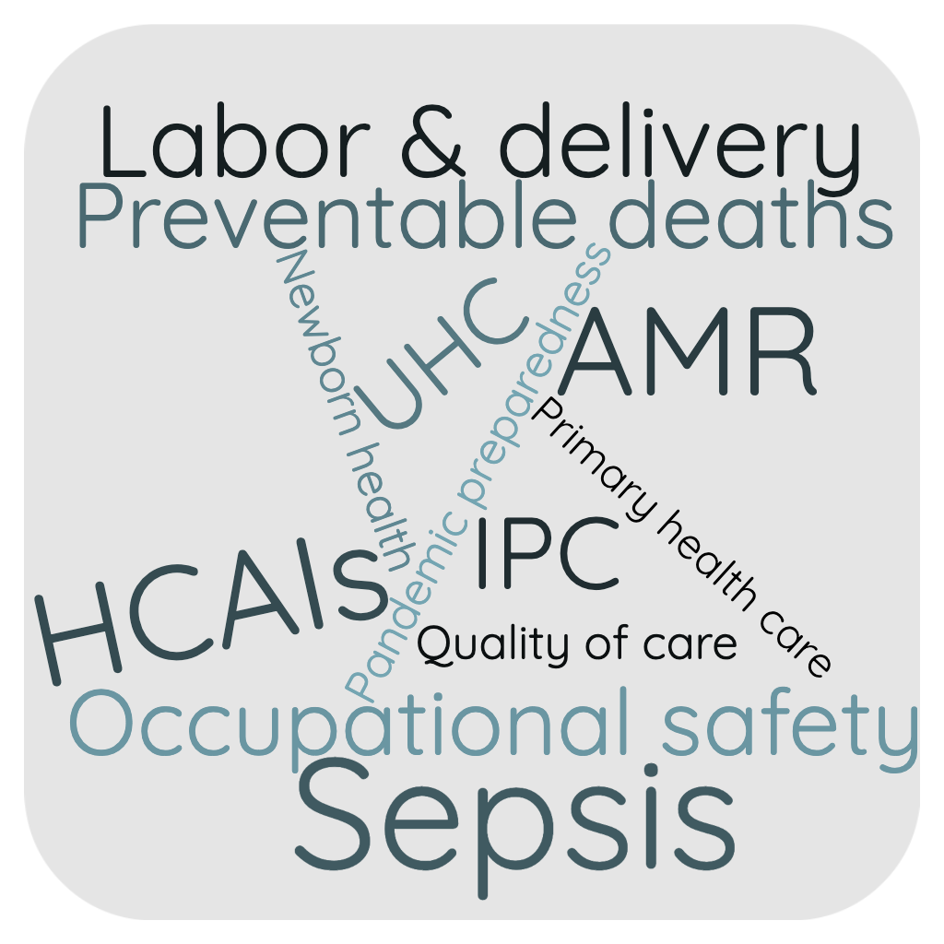
What activities do you need WASH for in a health care facility?
Hand Hygiene
Medical & surgical procedures
Patient hygiene & bathing
Drinking water, including for oral medications
Use of certain medical devices
Sanitation
Environmental hygiene
Sterilizing medical equipment
Laundry
Healthcare waste management
Laboratory activities

Slide 5
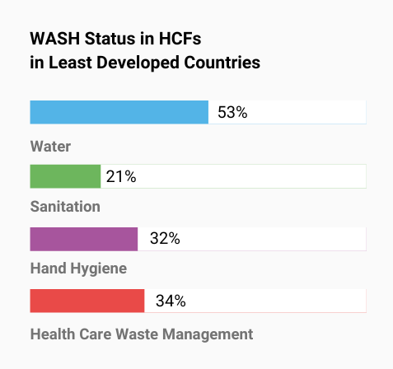
Global Status of WASH in HCFs
22% of healthcare facilities lack basic water services, impacting the care provided to more than 1.7 billion people.
10% of facilities lack toilets. The estimation for basic sanitation services is not available, but presumably much worse.
49% of facilities lack basic hygiene services – access to soap and water/ABHR at points of care and toilets.
The situation in the Least Developed Countries is significantly worse (i.e., 1 in 2 lack basic water)
Source: WHO/UNICEF Joint Monitoring Programme (2022)

Slide 6
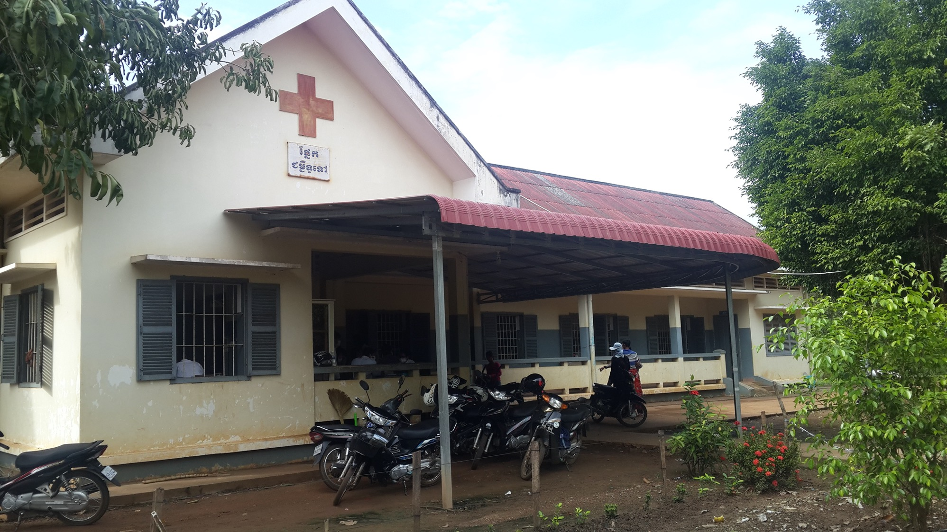
Notes:
Give more instruction on the facility that they are picturing. What risks are they facing? What kind of impacts? “Imagine …”

Slide 7
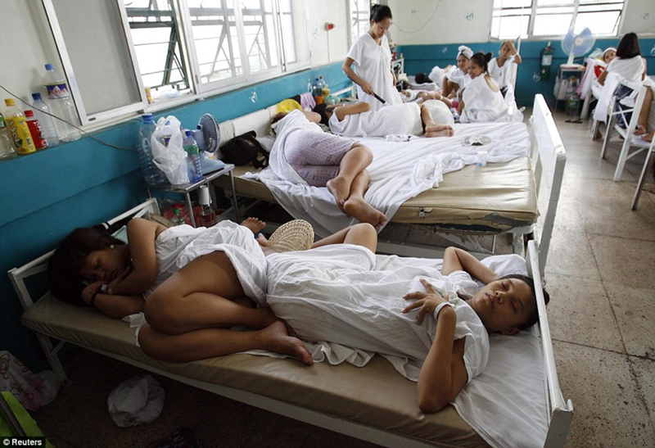

Slide 9
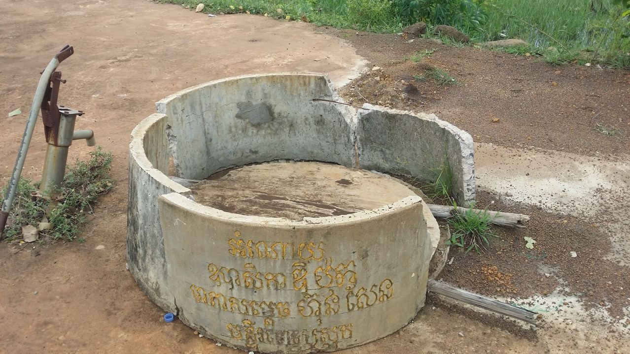

Slide 11
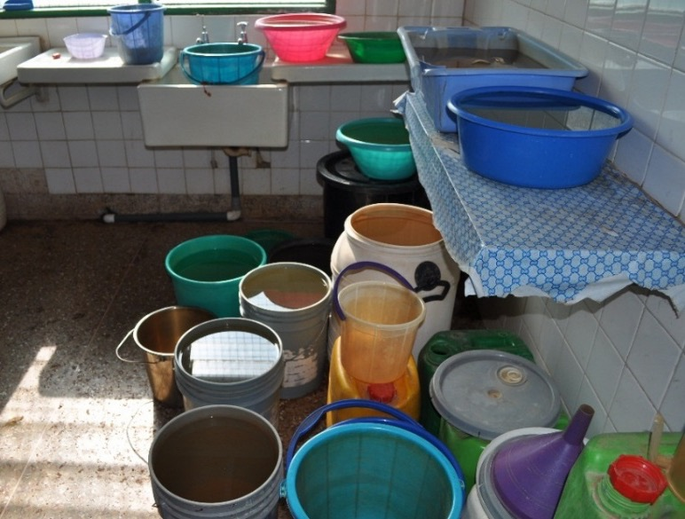

Slide 13
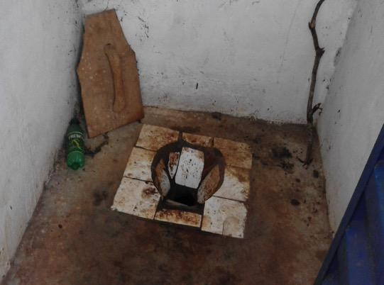

Slide 15
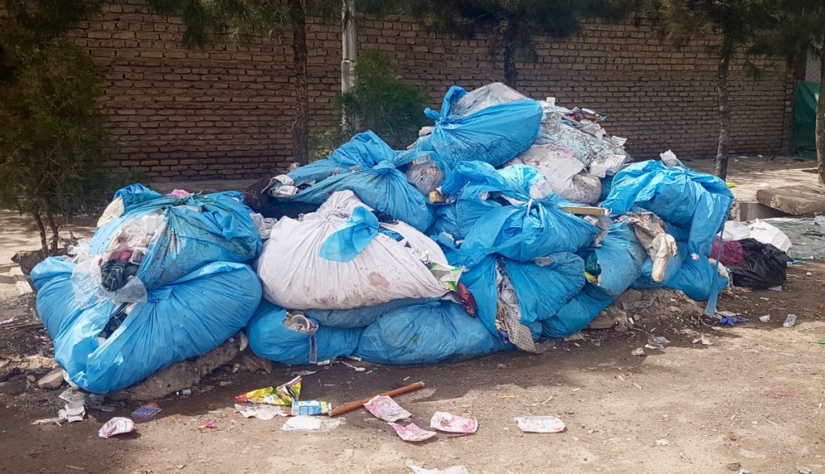

Slide 19
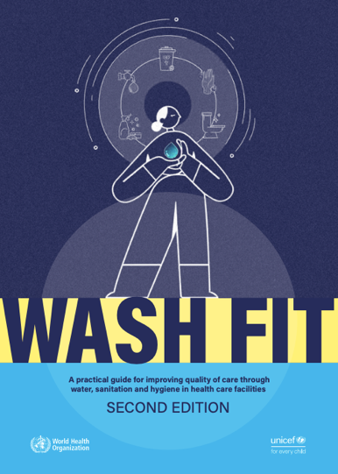
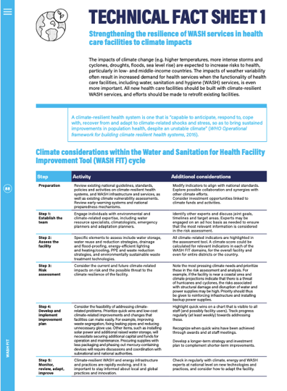
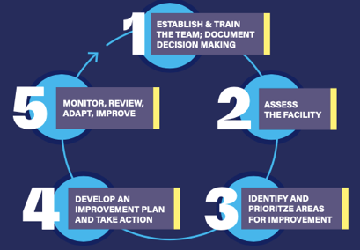
WASH Facility Improvement Tool
Source: WHO/UNICEF WASH FIT 2.0

Slide 20
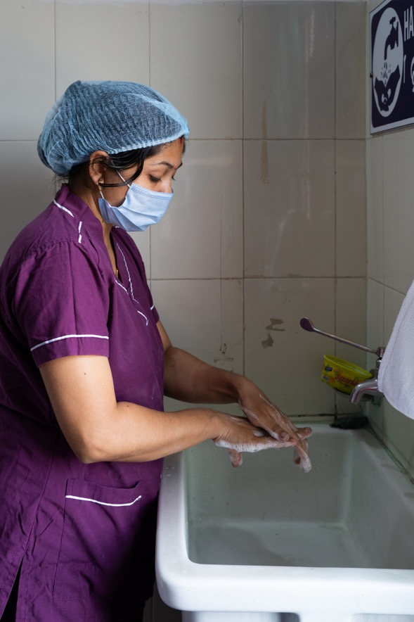
Best Practices
Engage the health care facility leadership and identify their key needs (through assessment + interviews).
When considering solutions, conduct stakeholder consultation, including health facility workers, cleaners and patients
Try to build WASH into existing health facility efforts (quality improvement and infection prevention and control/hand hygiene).
Any infrastructure improvement should be complemented by training as well as sustainability pillars: organizational, technical & financial.
Prioritize operations and maintenance (including budget for these activities).

Slide 21
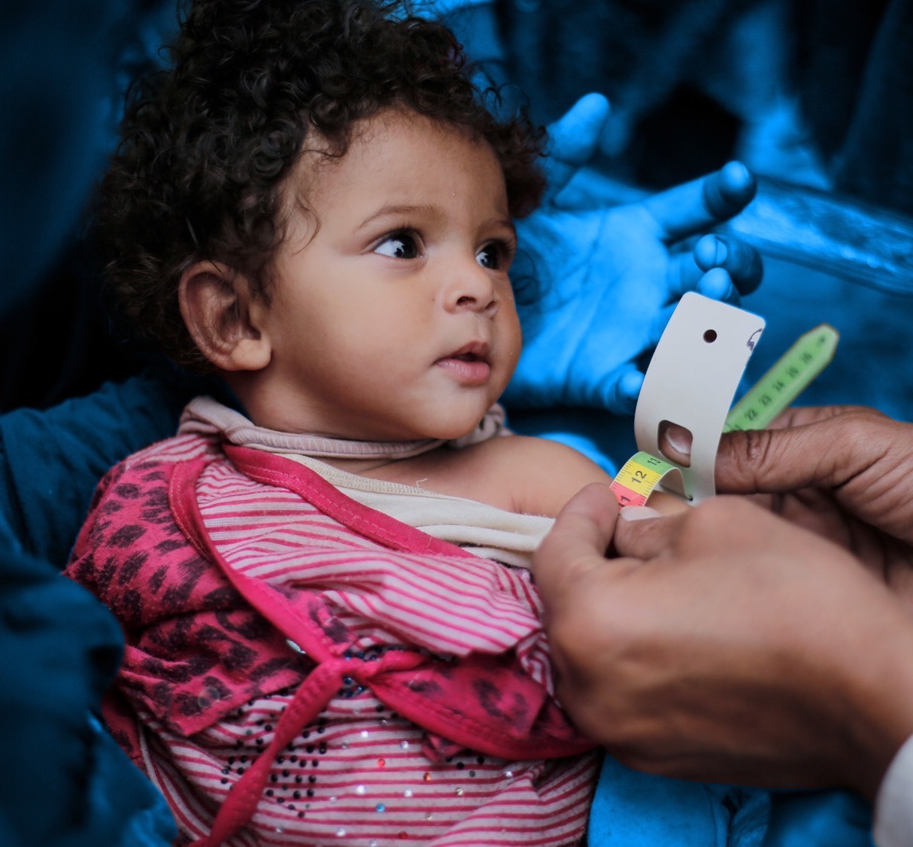
What can you do?
When you visit a community, check out the WASH conditions in the HCF, including via assessment.
Discuss with local leaders, District Health Officers, and HCF staff/administrators how to improve poor WASH conditions, what support they will need, and how they might access resources.
Inquire about current training of HCF staff regarding WASH/infection control issues.
Be vocal! Become a WASH in HCFs champion, raising awareness of the issue and encouraging local government, partners, and decision makers to prioritize the issue

Slide 22
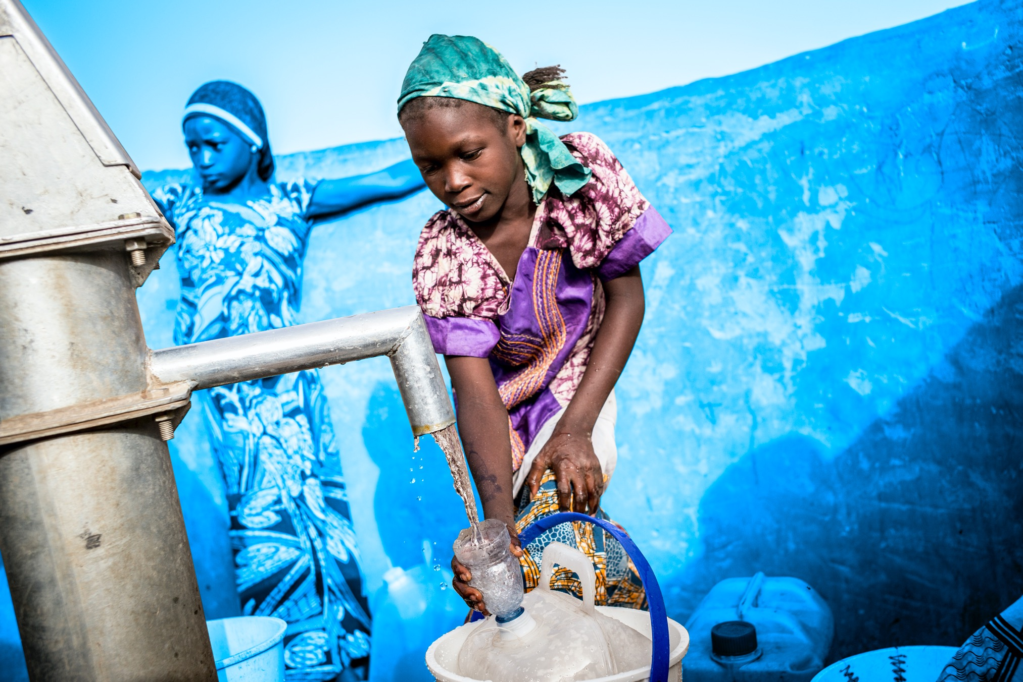
Thank you!
For questions: Lindsay Denny ldenny@unicef.org

