Slide 1
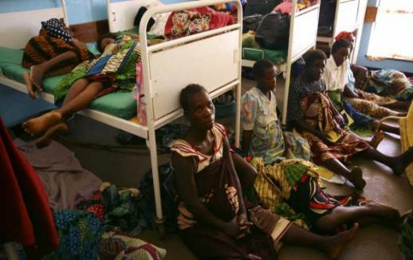


WASH in Health Care Facilities
and COVID-19
F. Ronald (Ron) Denham
Chair Emeritus
WASH Rotary Action Group
Notes:
Conditions such as this are common in too many countries in the developing world—little wonder the corona virus is taking such a toll

Slide 2
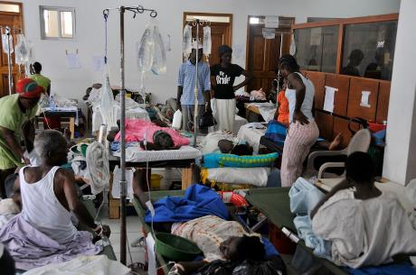
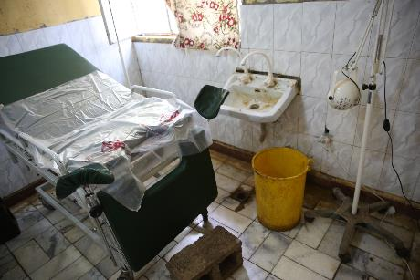
The Reality
Notes:
Congestion is bad but so also is Lack of access to handwashing, with soap and water. Both have huge impact on health around the world

Slide 3
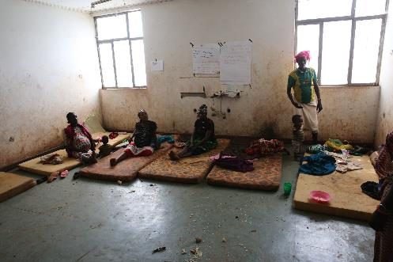
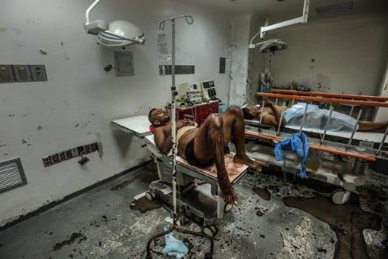
The Reality
Notes:
Dirty, unclean surfaces and conditions give rise to widespread infection. Spread of pandemics and disease, maternal and child mortality

Slide 4
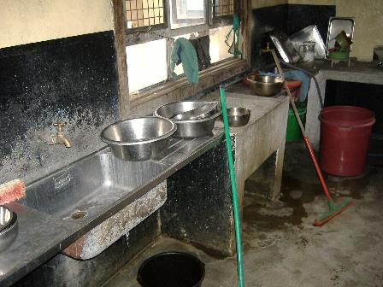
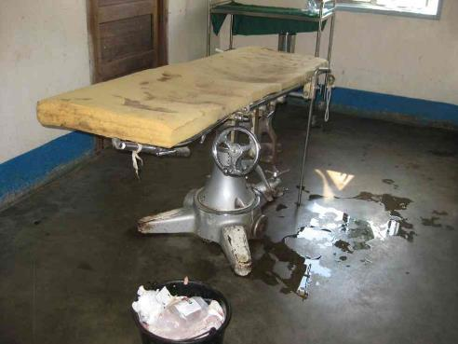
The Reality
Notes:
Aggravated by poor sanitation and no hygiene

Slide 5
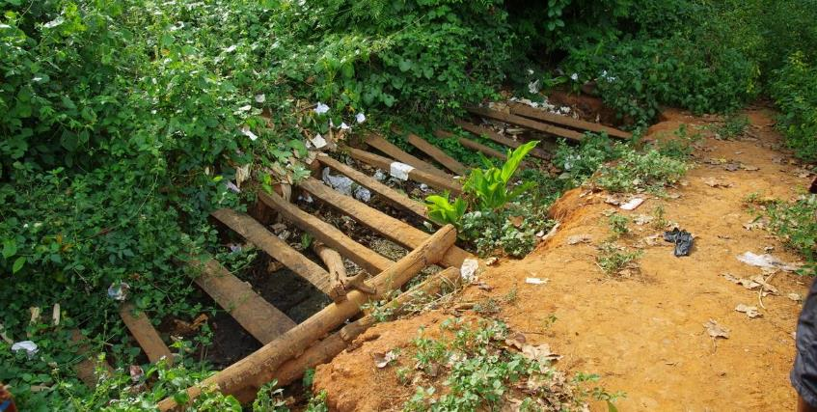
The Reality

Slide 6
The Current Situation is Critical
In many lower- and middle-income countries:
45% of health care facilities (HCFs) lack basic water service
60% lack basic sanitation service
43% have no handwashing facilities with soap
39% lack adequate infectious waste disposal facilities
Only 2% of facilities provide all these services!!!
Source: WHO, UNICEF, Global Baseline Report 2019
Notes:
Define “improved” sanitation. More on “waste” no handwashing for staff or patients. Need for segregation of waste

Slide 7
Billions of People are Affected
900 million people have NO water service at HCFs
1.5 billion people have no sanitation at their HCFs
Fewer than 25% of HCFs have WASH in delivery room
No dedicated toilets for women, no space for MHM
Toilets are filthy, with foul smell, virtually unusable
40% of HCFs have no hand hygiene at points of care
Notes:
Water service is unreliable and interrupted

Slide 8
With Disastrous Consequences
for the Community
Patients and staff at risk for infections
Poor hygiene causing water- and hand-borne infections
20% infant mortality due to unclean water
1,200 children under age 5 die each day
from poor sanitation
300,000 maternal deaths per year, due
to unclean facilities
Notes:
11% maternal deaths (1 million/yr), infections from unclean facilities. 20% of neo-natal deaths, 11% maternal deaths from infections

Slide 9
The COVID-19 Action Plan
In May 2020, the World Health Assembly
called for:
“All member states to support access to safe water, sanitation and hygiene, giving attention to the promotion of personal hygienic measures in all settings particularly in health facilities.”

Slide 10
And by 2030, every HCF to:
Have safe drinking water for staff, caregivers, patients
Provide safe sanitation for all
Encourage and facilitate frequent hand hygiene
Implement regular cleaning and disinfecting
Manage excreta, feces and urine safely
Safely manage health care waste
This is an opportunity for Rotarians everywhere
Notes:
Sufficient drinking water

Slide 11
Plus, better management and organization:
Adequate funding for operation and maintenance
Effective cost-recovery system
Trained leadership and management at all levels
Better technical and administrative support
Educate and motivate towards WASH goals
Effective monitoring and feedback
Notes:
Implying advocacy for improvement, and funding

Slide 12
Rotarians are helping
communities achieve results:
Building easy-to-maintain toilets and latrines
Installing handwashing stands
Funding water systems, filtration,
storage tanks, cisterns etc.
Installing additional water storage tanks
Developing cleaning protocols
Funding MHM programs and materials
Restoring water services to clinics
Notes:
Here quote specifics of projects—e.g.micro-flush toilets in northern Ghana, training community in managing WASH systems in Uganda-Bugiri

Slide 13
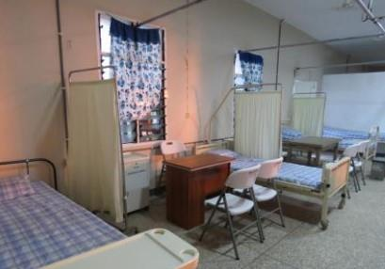
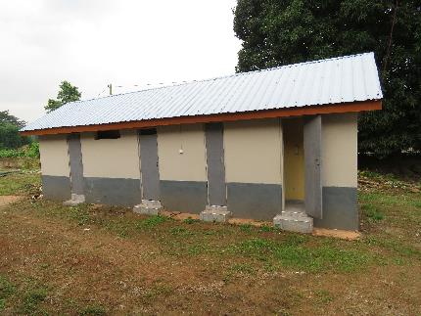
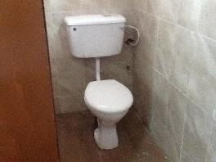
Many clubs are
already achieving results:
Notes:
New toilets in ???, or equipping a ward in ….

Slide 14
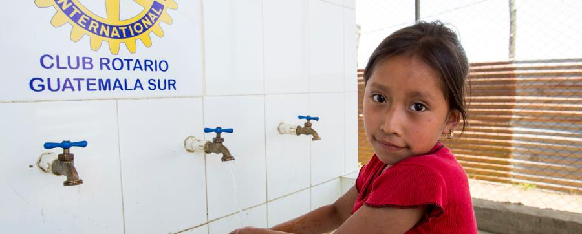
Many clubs are
already achieving results:
Notes:
A handwashing station in Central America

Slide 15
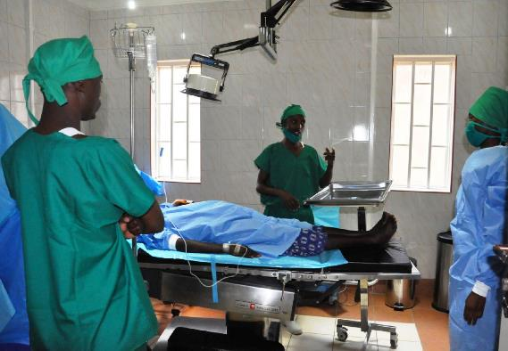
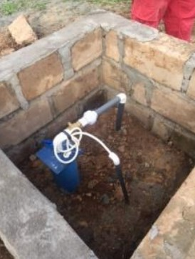
Many clubs are
already achieving results:
  u

Slide 16
What we can do about it – a program for
Rotary clubs in the time of COVID-19:we can do about it - a program for Rotary cl
Engage the local health care community
Assess the situation, analyze results, identify gaps
Understand potential solutions/programs
Agree on priorities, set targets, prepare a plan and budget
Seek partners: Rotary clubs, donors, foundations, corporations, WASH Rotary Action Group
Motivate the HCF community to change

Slide 17
Rotarians, Rotaractors and Rotary Community Corps are qualified to take the lead: we can do about it - a program for Rotary cl
We have credibility because of Polio eradication
Rotarians are the community – they have a vested interest
They understand local values and culture
They have contacts, relationships in the community
They can organize and have the skills to lead change
They have the global reach; get support from anywhere
They collaborate with others, form effective teams

Slide 18
WASH Rotary Action Group can help you:
Mentor and train Rotarians to use assessment tools
Provide expertise and resources to plan the project/program
Identify international partner clubs and sources of funding
Prepare applications for global grants
Assist in designing the monitoring and evaluation systems
Advocate for change at all political levels
Provide protocols for cleaning, operating facilities

Slide 19


“Wisdom is knowing
the right thing to do.
Integrity is doing it.”
JOIN the WASH Rotary Action Group
and MAKE A DIFFERENCE

