Slide 1


Achieving Lasting Impact in WASH:
Rotary’s Greatest Challenge
Ron Denham, Chair Emeritus
WASH Rotary Action Group
District 7070
Oshawa - May 2020

Slide 2

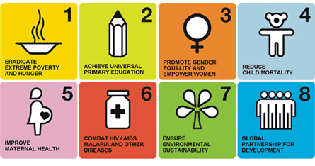

Millennium Development Goals (MDGs): to build a safer, more prosperous and equitable world by 2015
2000
2015
GOAL 7:
Reduce by 50% the proportion without access to:
Safe drinking water
Safe sanitation

Slide 3
200
0
s
3
In 2000:
1.2 billion people lacked access to safe water
2.4 billion to sanitation
s
e
2.
5
c
c
A
2
t
u
n
o
o
h
1.
5
i
t
t
i
a
W
r
t
e
1
e
i
l
t
n
p
a
a
o
0.
5
W
S
e
P
0
1.
2
2.
4
B
illio
n

Slide 4
Much has been done by Rotarians & hundreds of other organizations
to achieve the MDGs:
Implementation initiatives
Drill boreholes
Build pipelines
Dig wells
Rainwater Harvesting
Latrines, toilets
Solar disinfection
Dams, ponds
Provide filters

Slide 5
Much has been achieved in getting access to safe water. But much more is needed to increase access to sanitation
Implementation initiatives
20
20
s
3
Drill boreholes
Build pipelines
Dig wells
Rainwater Harvesting
Latrines, toilets
Solar disinfection
Dams, ponds
Provide filters
s
e
2.
5
c
c
A
2
t
u
n
o
o
h
1.
5
i
t
t
i
a
W
t
e
1
i
l
n
p
a
o
0.
5
r
S
e
e
P
t
a
0
W
0.67
.
2.
4
B
illio
n

Slide 6
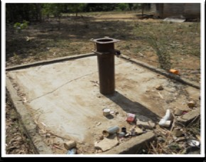
But access does not mean sustainable access. Despite an investment of billions of dollars and millions of hours, few projects have achieved lasting impact.

Slide 7
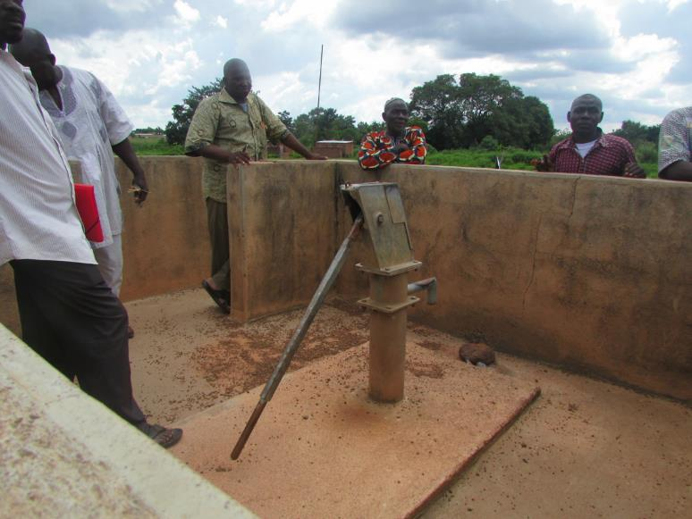
And another …

Slide 8
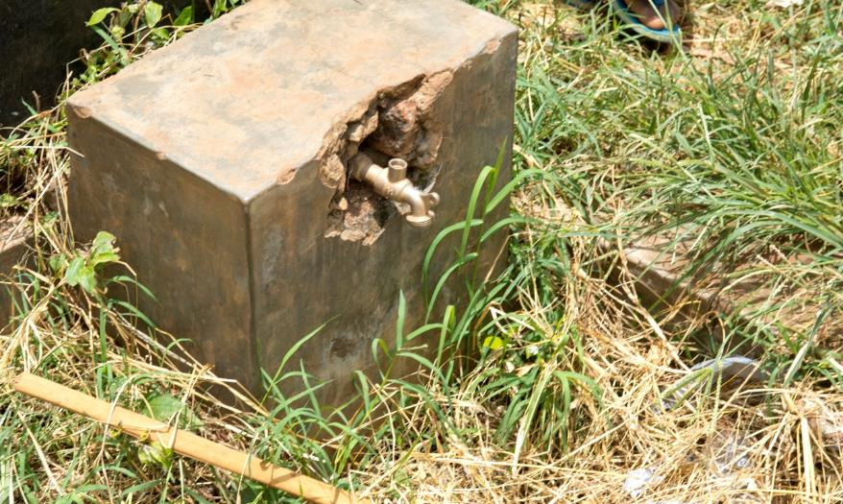
And another …

Slide 9
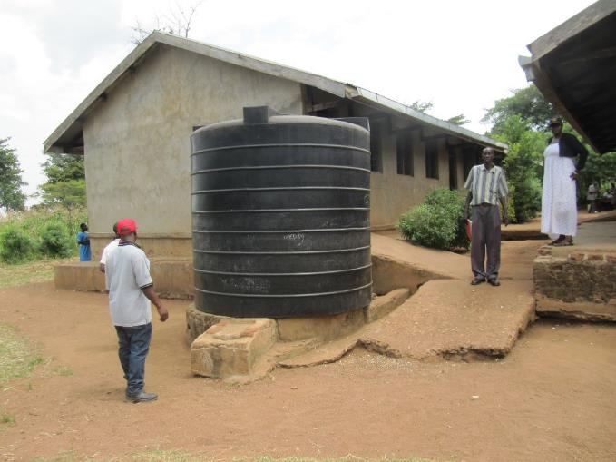
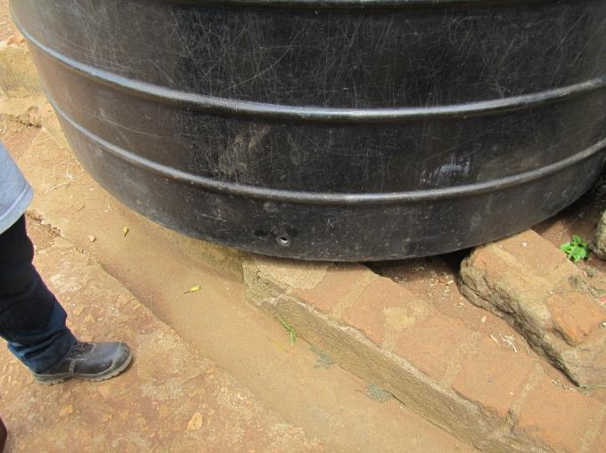
Vandalism is another concern…

Slide 10
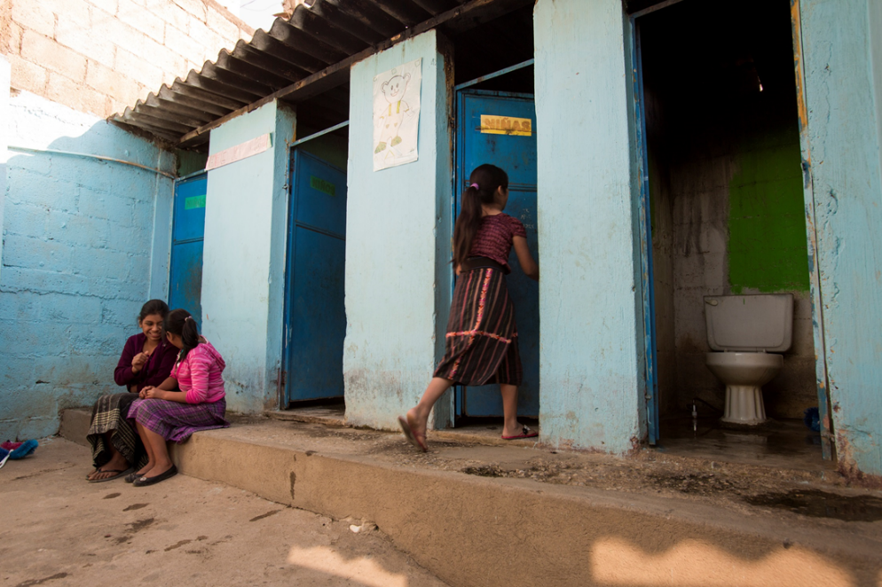
And theft …

Slide 11
In Sub-Saharan Africa alone $1.4 billion spent on failed systems…..
  50% inoperable after 5 years
  75% water points non-functional
  Millions of Rotary $$$ on “rehabilitation”

Slide 12
Kenya | $2 million investment in water schemes: 35% non-functional 50% rural water sources functional
Liberia | 40% of 10,000 water points failed 57% of water points contaminated with E. coli
Madagascar | 80% of boreholes not functioning
South Africa | 50% of hand pumps not working
India | 25% of infrastructure in need of repair
Nepal | 82% of 40,000 water systems not fully functional
Pakistan | 39% of water systems in schools need replacement
Central America, Haiti | 60% water kiosks out of service

Slide 13

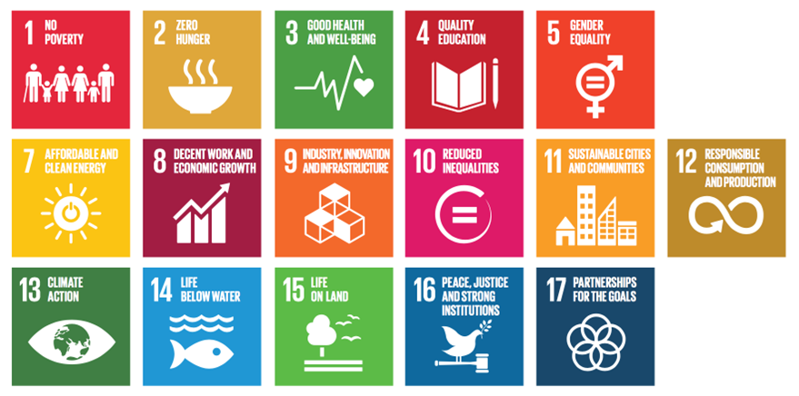
The international community is now focusing on the Sustainable Development Goals (SDGs) to achieve lasting impact:
SDG#6 – Availability and sustainable management of water and
sanitation for ALL

Slide 14
It implies designing & managing projects around four building blocks:
Capacity Building
Monitor Evaluate Report
Sustainability
Technology
Funding

Slide 15
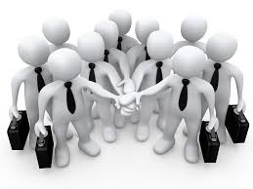
Capacity building: community to own and manage the service forever:
Engage all stakeholders, especially women
Empower community & water users committee
Engage local authority.
Change behaviour.
Train operators and technicians
Develop advocacy capability

Slide 16

Choose appropriate technology & supporting systems:
Operated, maintained by local people
Local supply chain
Life cycle analysis: trade-off capital outlay vs. ongoing expense
Smart technology

Slide 17

Funding: think business, not charity:
How to fund ongoing O&M
Understand local financial capacity
Establish pricing and payment mechanisms
Public-Private Partnerships
Global Grants, focus on value, not cost
Social entrepreneurship, generate economic value

Slide 18

Monitoring & Evaluation: achieving the objectives
Professional management
Clear organization structure, roles and responsibilities
Sound financial and administrative practices
Agreeing on metrics—outputs and outcomes/impacts
Systematic data collection
Regular reporting and feedback

Slide 19
WASH-RAG can help you!
Find a project and get started
Provide a compendium of best practices
Identify potential matching clubs and private sector partners
Facilitate partnerships, attract donors
Provide expertise in designing sustainable processes
Facilitate workshops to get commitment from stakeholders
Design Monitoring and Evaluation processes

Slide 20

Rotary is leading the eradication of Polio:
Created a global image of Rotary as a humanitarian organization
Co-opted other organizations: CDC, WHO, UNICEF
SDGs are an opportunity to maintain that leadership
Are we ready
for this Challenge?

Slide 21
